Slide 1




Mission Assignment: Learn about your body parts: the ears, mouth and hair
EYFS-08-04
Complete the sentences.
My e _ _ _ are used to help me hear.
I use my m _ _ _ _ to talk and to e _ _.
My h_ _ _ grows on my body and h _ _ _.
Draw the ears, mouth and hair.
2
Developing Experts Copyright 2024 All Rights Reserved

Slide 2
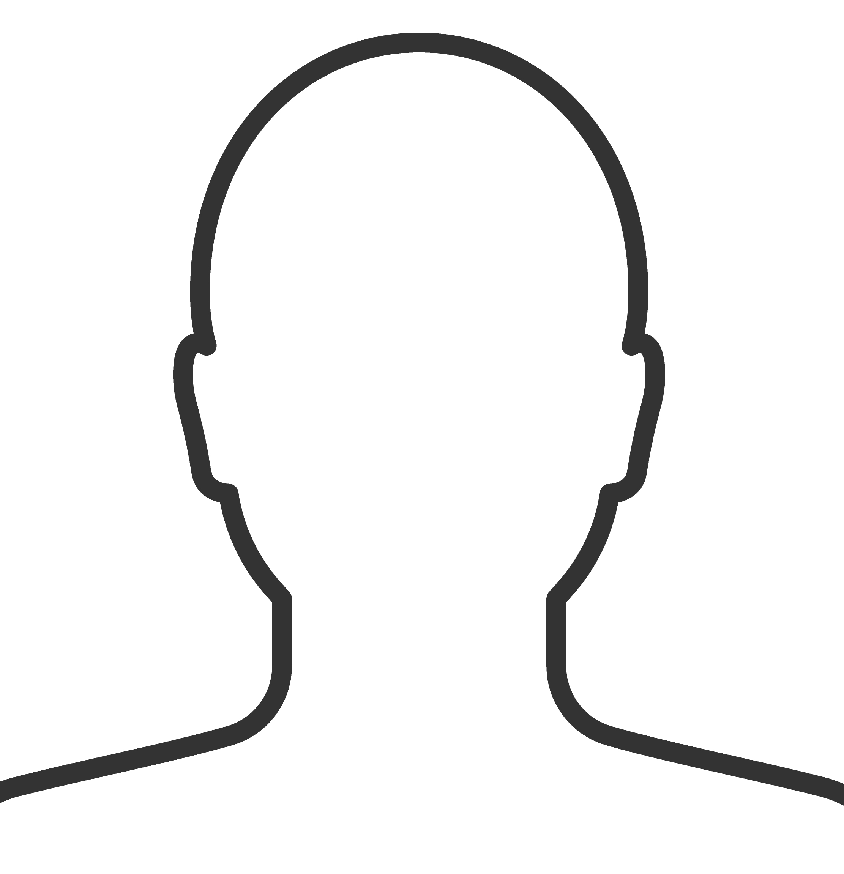
Mission Assignment: Learn about your body parts: the ears, mouth and hair
EYFS-08-04
Use the head outline to create your collage.
2
Developing Experts Copyright 2024 All Rights Reserved

