Slide 1
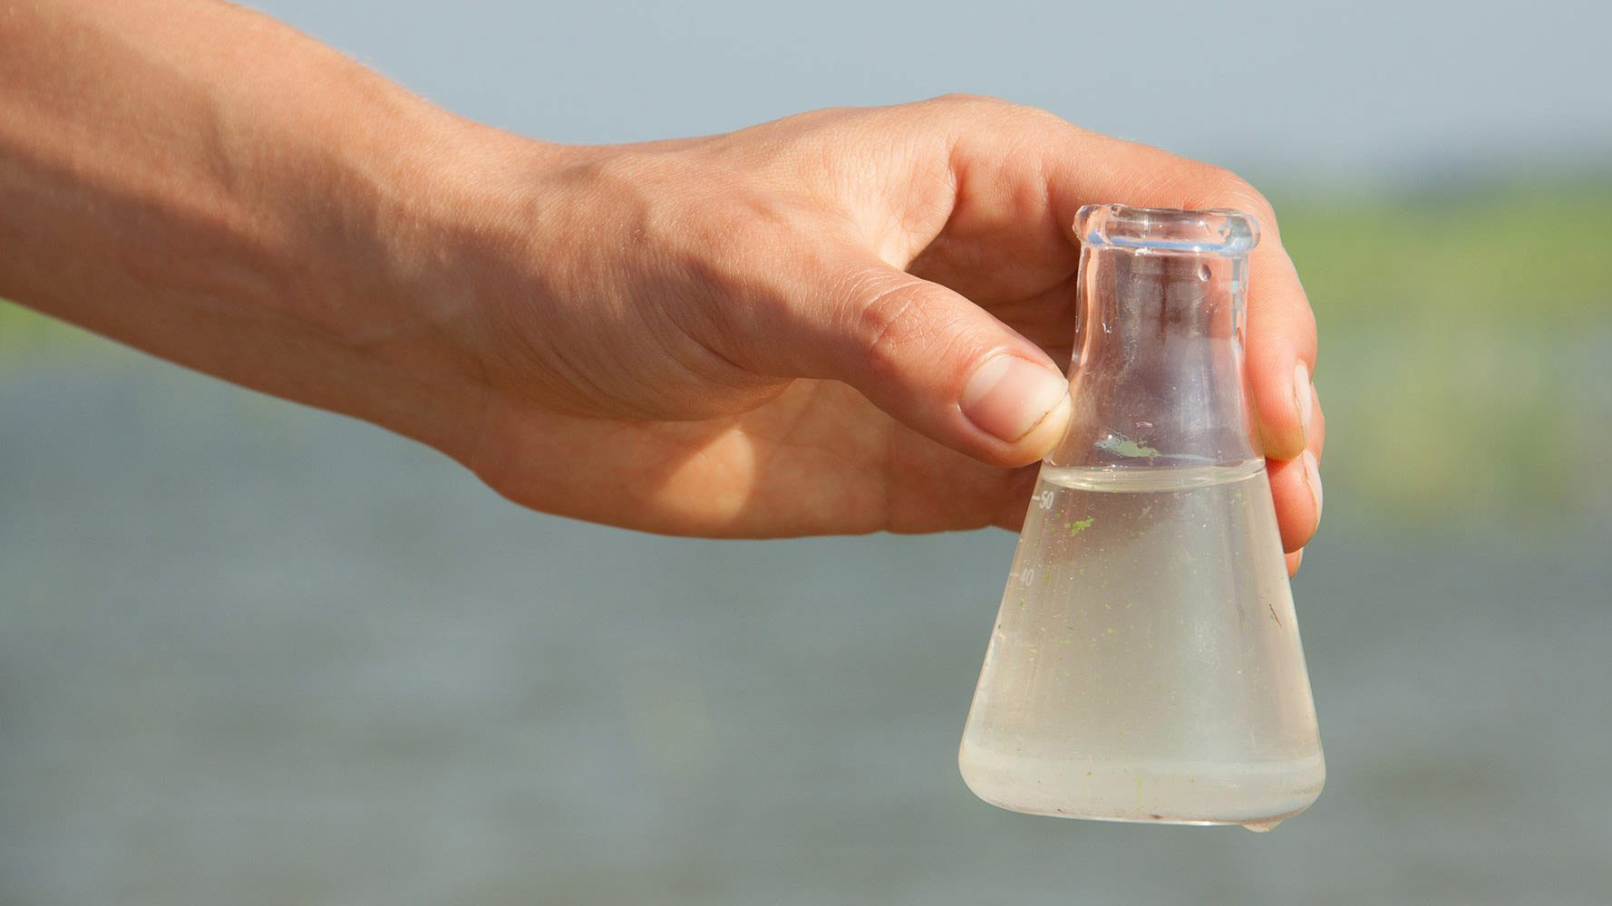
Developing Experts All rights reserved © 2021

Slide 2
Thermal distillation involves heat: Boiling water turns it into vapour—leaving the salt behind — that is collected and condensed back into water by cooling it down.
Developing Experts All rights reserved © 2021

Slide 3
Explore potable water - practical
Describe how to analyse a sample of water for purity.
Describe how to purify a sample of water by distillation.
Developing Experts All rights reserved © 2021

Slide 4
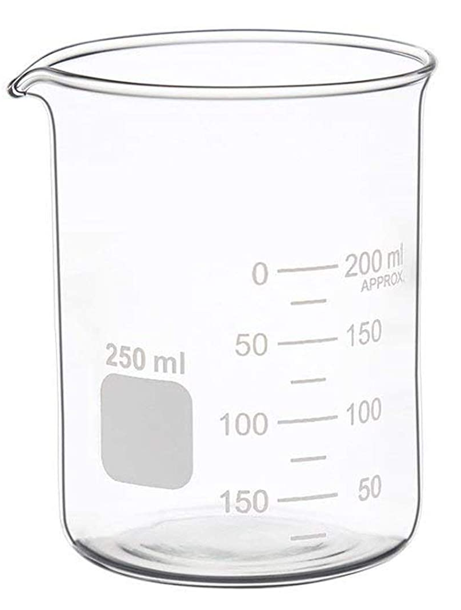
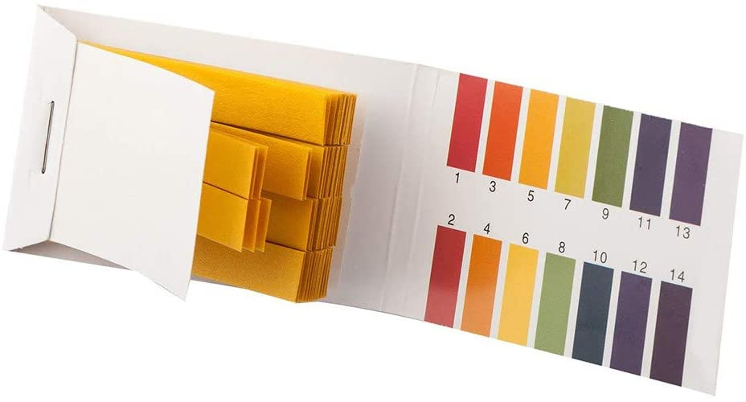
Developing Experts All rights reserved © 2021

Slide 5
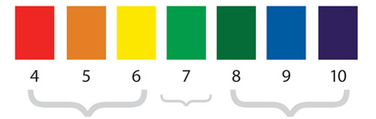
Universal Indicator pH Colour Chart
4
5
6
7
8
9
10
Acid
Neutral
Base
Developing Experts All rights reserved © 2021

Slide 6
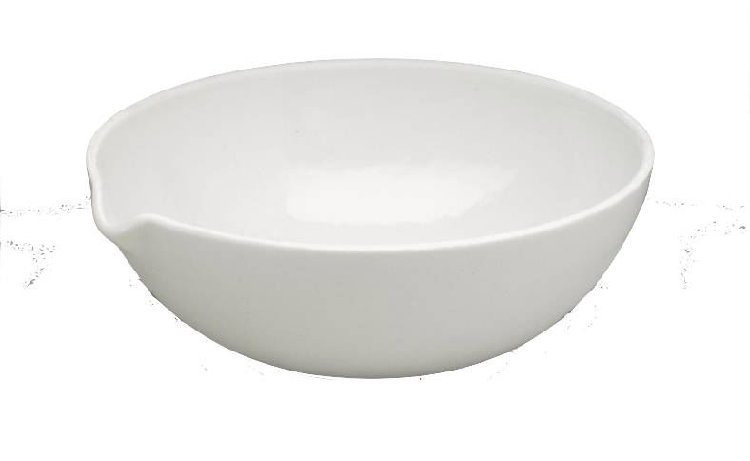
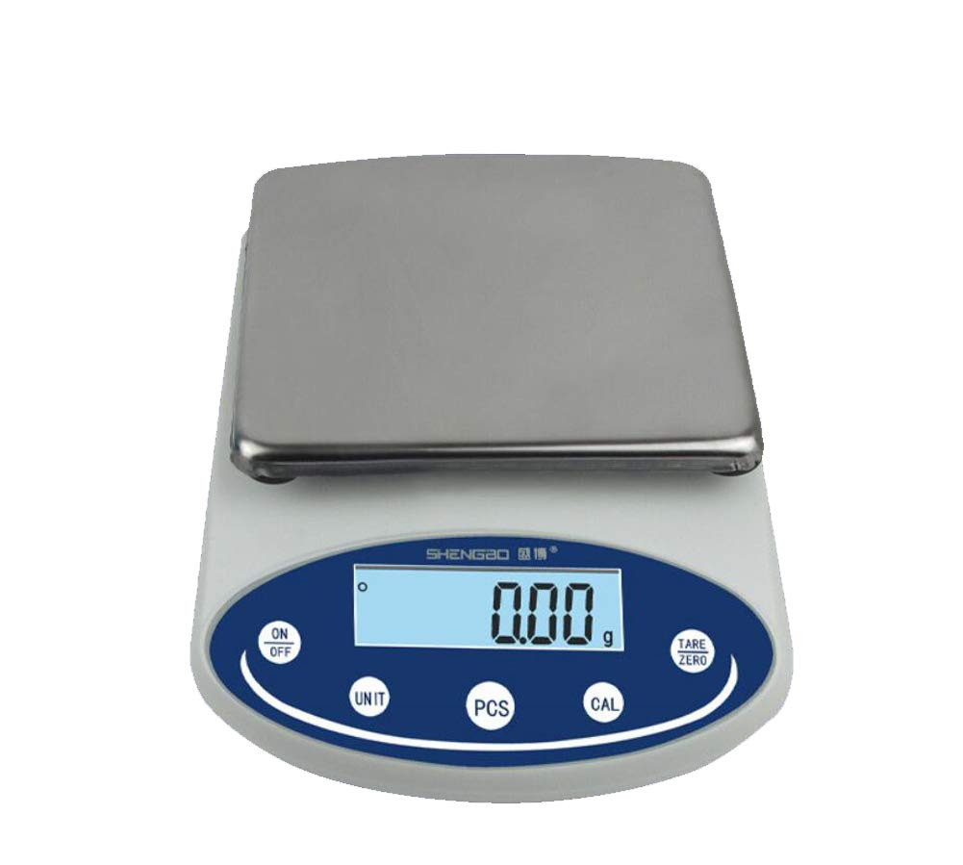
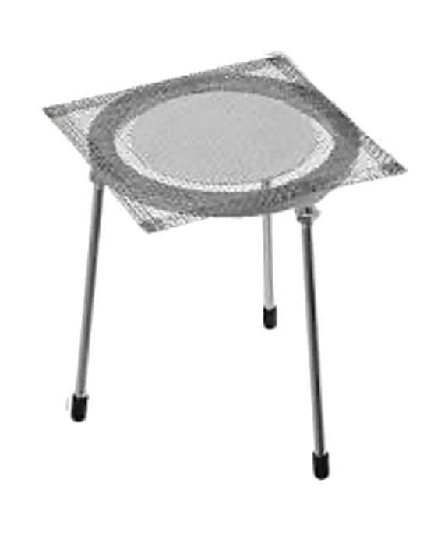
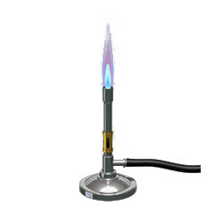
Developing Experts All rights reserved © 2021

Slide 7
Developing Experts All rights reserved © 2021

Slide 8
Developing Experts All rights reserved © 2021

Slide 9
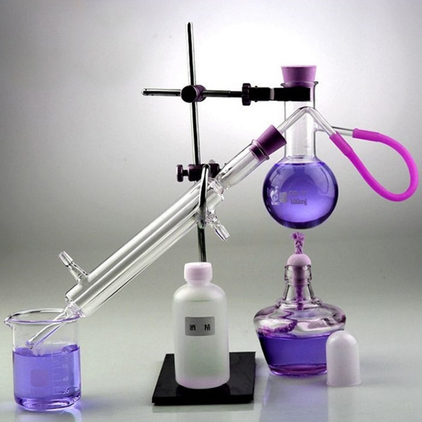
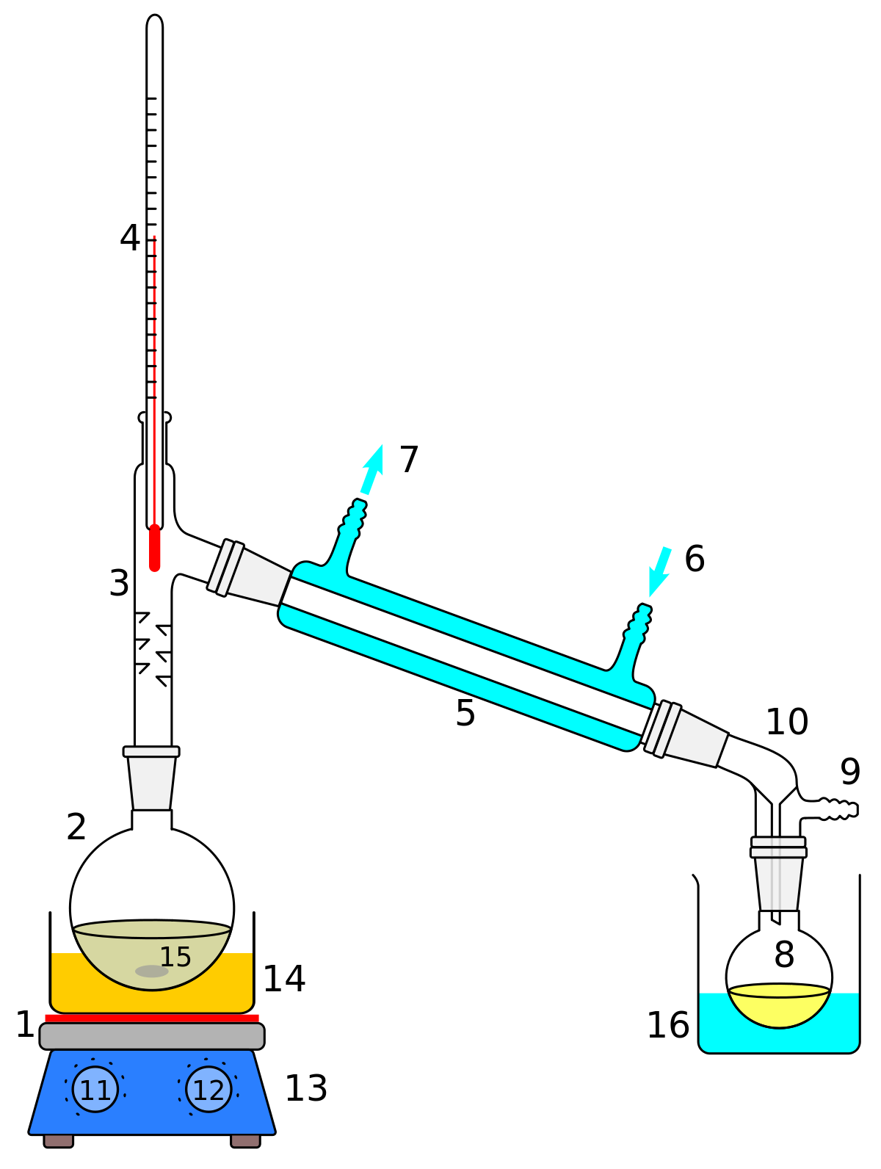
Developing Experts All rights reserved © 2021

