Slide 1

Resource Handout: S04.03.06 Handout
Understand salivary glands and taste buds
In this exercise, see what you can recall about salivary glands and taste buds. Use the lesson presentation and key points to help.
When you digest food, it means you are ______________ it down inside your body. There are many parts of the digestive system, but the first part is your _____________. Inside your mouth is ________________ which comes from the salivary glands and helps to break down our food so we can _______________ it.
Inside our mouths, on the tips of our tongues are tiny ___________ _________. We have around _________ of these, and they are replaced about every _________ weeks. These can sense the kind of taste of the food you are eating and send _______________ to your brain to say whether the food is sweet, sour or _____________, for example. These taste buds are important in deciding nice and nasty tastes, and also to ensure we can decide what kind of food is _____________ to eat!
WORD BANK
mouth taste buds safe two
Breaking swallow 10,000
Saliva messages salty
Developing Experts Ltd. © 2022
.

Slide 2
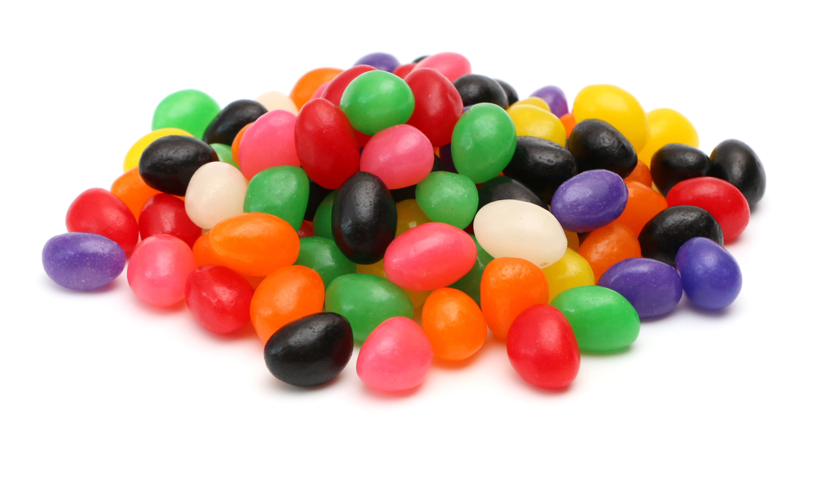
Resource Handout: S04.03.06 Handout
Understand salivary glands and taste buds.
You’re going to blindfold your talk partner. They are going to chew and eat the same flavour sweet three times.
Blindfolded and nose pinched
Blindfolded only
Neither blindfolded or nose pinched.
Predictions:
When eating the sweet, how well will your talk partner identify the flavour?
Blindfolded and nose pinched ……………………………………………………
………………………………………………………………………………………....
Blindfolded only …………………………………………………………………….
………………………………………………………………………………………....
3. Neither blindfolded or nose pinched ………………………………………….
………………………………………………………………………………………....
Take the Test!
Flavour | Blindfolded and nose-pinched | Blindfolded only | Neither blindfolded or nose pinched
Developing Experts Ltd. © 2022

