Slide 1
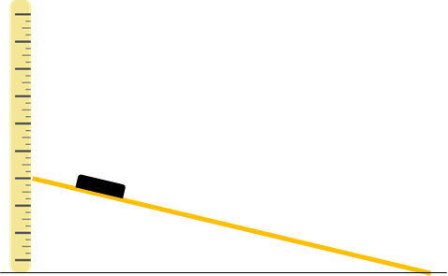
You are going to investigate which surface provide the best grip.
Method
Cover a ramp in a material and place
a weight at the top of the ramp.
Raise the top of the ramp gently while
watching the weight .
As soon as the weight begins to slip,
stop raising the ramp and record the
height of the ramp.
Repeat this process changing the
material on the ramp.
Equipment
Metre stick
A short ramp
Different materials; foil, felt, film, sandpaper, bubble wrap.
Weight
Material | Height or ramp
Stretch
Give an example of where friction is useful and an issue.
Which material provided the largest
frictional force? Suggest why this
material has the largest frictional force.
______________________________
______________________________
______________________________
______________________________________________________________________________________________________________
Which material provided the largest frictional force? Suggest why this material has the largest frictional force.
_____________________________________________________________________________________________________________________________________________________________________
Challenge
Why do driver change their driving behaviour during different weathers.

