Slide 1
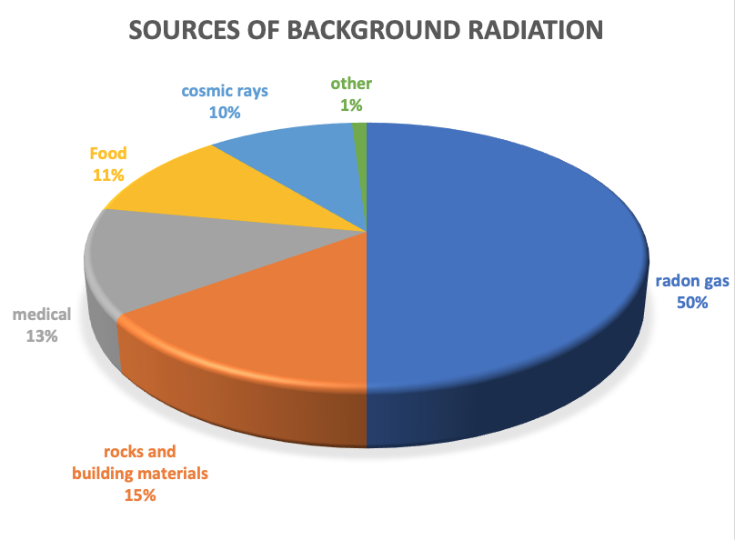
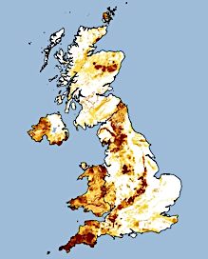
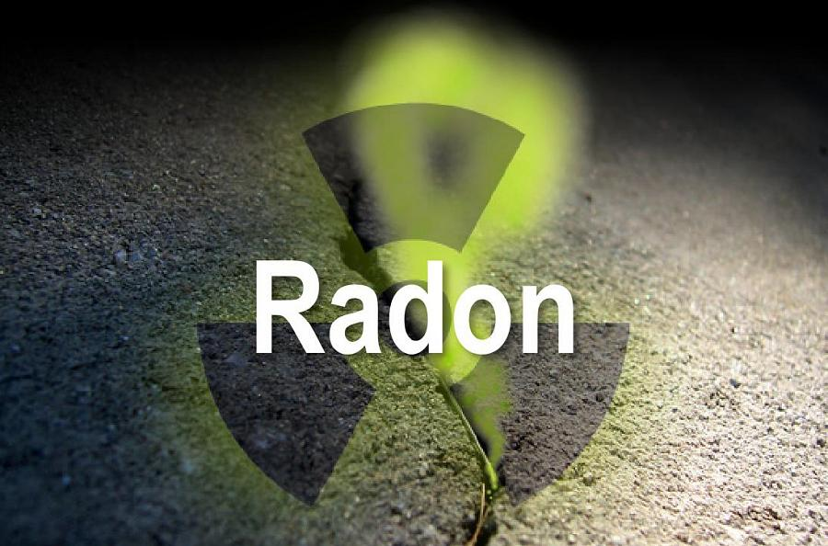
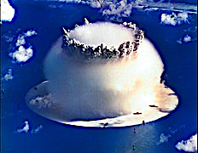
Background radiation
Background radiation is the radiation that is around us all the time at a safe level. It is measured in becquerels or counts per minute. This includes alpha, beta and gamma radiation. Most background radiation comes from radon gas. Other sources include cosmic rays, food and drink, buildings and artificial sources (medical, nuclear power).
Radon gas
Background radiation is the amount of ionising radiation from natural and artificial sources. Background radiation is broken into two main groups; man-made and natural. One of the largest contributors to the UK’s background radiation comes from radon gas.
Radon is a gas that occurs naturally. Granite can contain uranium. Over time, uranium decays into radium which decays to radon. Radon moves through the rock to the surface. The concentration of gas released from these areas is low and is heavily monitored. Radon gas build up is one of the reasons why basements and anywhere underground are heavy ventilated.
Gravitational
field strength
10N/kg
Artificial sources account for about 15 per cent of the average background radiation dose. Nearly all artificial background radiation comes from medical procedures such as receiving x-rays for x-ray photographs. Nuclear weapons testing and nuclear accidents also contribute to the overall background radiation of the world. Weapons testing has mostly stopped now but does still occasionally occur. Nuclear accidents still occur although they are getting rarer.

Slide 2
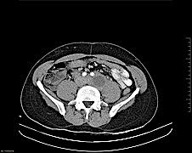
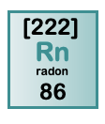

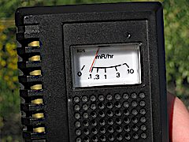
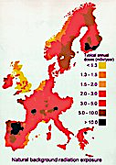
Practice
List examples of man-made radiation. _______________________________________________________________________________________________________________________________________
What factors might affect how much background radiation a person absorbs in one year? ____________________________________________________________________________________________________________________________________________________________________
Research the amount of background radiation you receive from a banana, Why does it release background radiation? How much? ___________________________________________________________________________________________________________________________
How many x-rays would be considered dangerous? ___________________________________________________________________________________________________________________________
Which gas causes 50% of annual background radiation? What is the source of this gas? What measures are taken to monitor levels? __________________________________________________________________________________ ___________________________

Slide 3
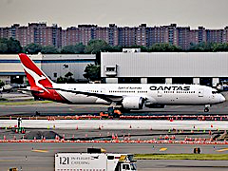
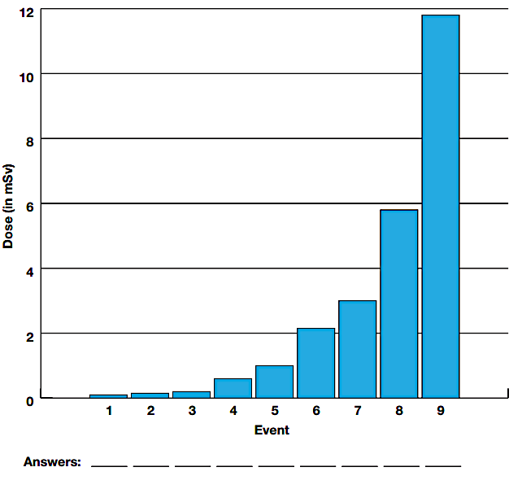
Calculate background radiation
The UK average does of radiation is 2.5 mSv. Flying to Australia gives an average dose of 0.1 mSv from cosmic rays. Make a reasoned estimate as to how much annual radiation a pilot making regular long haul flights absorbs. List the assumptions you had to make
________________________________________________________________________________________________________________________________________________________________________________________________________________________________
Read the statements below in the table and study the graph. Relate the dose reading by event number to the table:-
 | Event description | No.
A | Nine days on the moon
B | One single CAT scan of the body
C | One single chest x-ray
D | Eight days in the space station
E | A single dental x-ray exposure to your arm, hand, foot or leg
F | A single upper gastrointestinal x-ray
G | A single skull/neck x-ray
H | A single pelvis/hip x-ray
I | One year of normal radiation on earth

