Slide 1
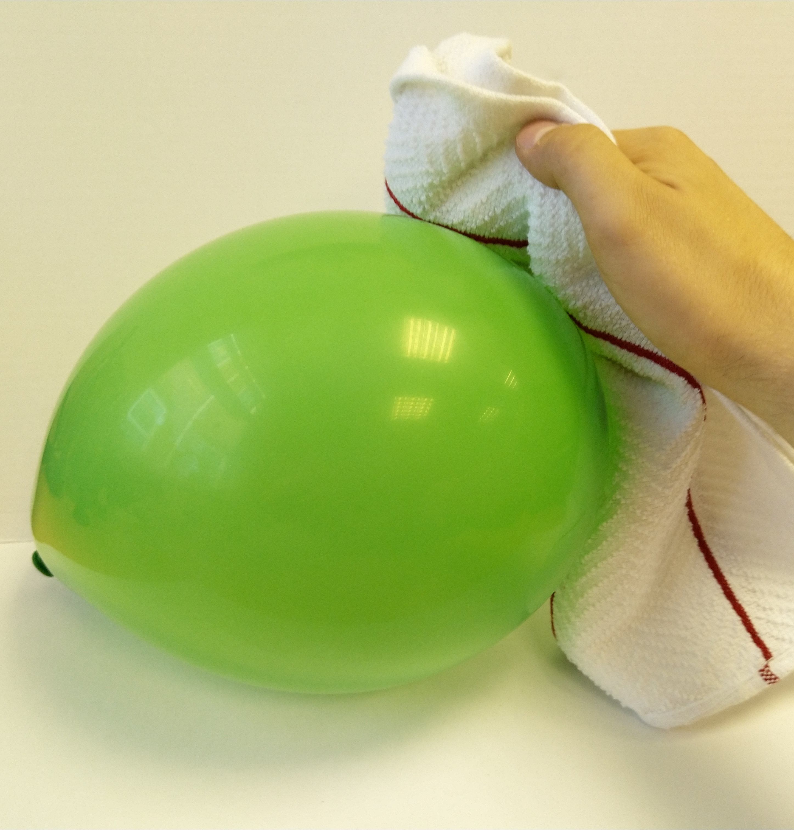
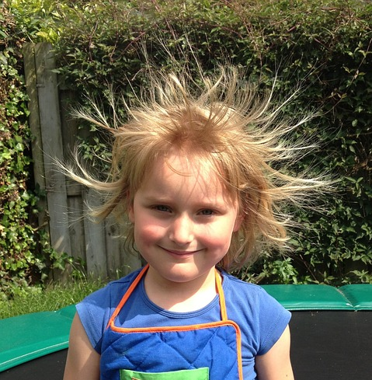
You are going to test different materials to see which
will generate the largest electrostatic force.
Method
Place the shredded tissue paper evenly over a table.
Standing clear of the table, rub the cloth over a balloon for approximately 10 seconds.
Hold the balloon approximately 5cm over the tissue paper with the area that has been rubbed pointing towards the tissue paper.
Count how many pieces of tissue paper are picked up and stick to the balloon, record this number in your table.
Reset the tissue paper and repeat steps 2-4 using a different object. You have space in your table to try your own objects too.
Equipment
Fabric cloth
Balloon
Plastic ruler
Wooden ruler
PVC pipe
Aluminium foil
Shredded tissue paper
Material | Number of pieces of tissue paper picked up.
balloon
plastic ruler
wooden ruler
PVC pipe
aluminium foil

Slide 2
Read the text then explain, using a labelled diagram,
explain how static electricity is generated.
How does static electricity work? Electrons are tiny particles which make up an atom, along with protons and neutrons. Everything we come into contact with has electric charge – which mixes negative and positive charges. These are usually balanced out, to there is no overall effect.
When two things are rubbed together, such as a balloon and your hair, electrons are removed from one surface and collect on the other. Electrons have a negative charge so where they move to becomes negatively charged. The surface that has lost electrons will now become positive.
When items are charged in this way, they may attract or repel different objects. If two things have opposite charges, they will attract (pull towards) one another. If they have the same charge they will repel (push away) from one another. This is similar to magnets.
Stretch:
Describe an example of static electricity.
Challenge:
What is the total charge of a proton and an electron together?

