Slide 1


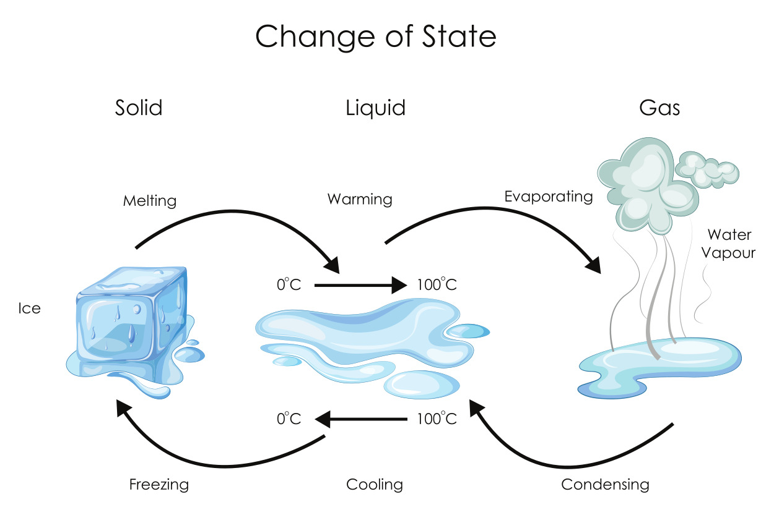
Mission Assignment: Explain changes of state using a particle model
KS3-02-02
Investigating changes in state
Label the four arrows on the following diagram to show the names for the changes in state.
Developing Experts Copyright 2023 All Rights Reserved

Slide 2
Mission Assignment: Explain changes of state using a particle model
KS3-02-02
Investigating changes in state
Complete the flow chart. Include descriptions of the energy of the particles during their change of state. In the centre boxes include an appropriate particle diagram.
The energy of the particles __________________________________________________________________This causes the particles to __________________________________________________________________
The energy of the particles __________________________________________________________________
This causes the particles to __________________________________________________________________
Ice is a _________
Water is a _________
Steam is a _________
The energy of the particles _____________________________________________________________________
This causes the particles to ____________________________________________________________________________________________
The energy of the particles _____________________________________________________________________
This causes the particles to ____________________________________________________________________________________________
Challenge
Look at the diagrams that you have drawn. Can you use these diagrams to explain the observations made during these transitions? Can you explain why the physical properties of the material changes?
Developing Experts Copyright 2023 All Rights Reserved

Slide 3
Mission Assignment: Explain changes of state using a particle model
KS3-02-02
Investigating changes in state
Cooling curve for stearic acid as it changes from a liquid to a solid
Method :
Put about 150 cm³ of water into a beaker
Place in the water a boiling tube a quarter filled with stearic acid.
Place the beaker on a tripod and gauze.
Heat the water using a Bunsen burner until the stearic acid melts.
Use test tube holder to remove the boiling tube from the beaker to a rack and put in a thermometer.
Record the temperature every minute until it reaches 50 °C.
Record the temperature at which you see the stearic acid solidify here:
Time (minutes) | Temperature °C | Time (minutes) | Temperature °C
0 |  | 8
1 |  | 9
2 |  | 10
3 |  | 11
4 |  | 12
5 |  | 13
6 |  | 14
7 |  | 15
Plot a graph with time on the x-axis and temperature on the y axis.
Use the graph to determine the melting point of stearic acid.
Developing Experts Copyright 2023 All Rights Reserved

Slide 4
Mission Assignment: Explain changes of state using a particle model
KS3-02-02
Investigating changes in state
Cooling curve for stearic acid as it changes from a liquid to a solid
Developing Experts Copyright 2023 All Rights Reserved

Slide 5
Mission Assignment: Explain changes of state using a particle model ANSWERS
KS3-02-02
Investigating changes in state
Label the four arrows on the following diagram to show the names for the changes in state.
melting
Boiling/evaporating
Freezing/solidifying
condensing
Developing Experts Copyright 2023 All Rights Reserved

Slide 6
Mission Assignment: Explain changes of state using a particle model ANSWERS
KS3-02-02
Investigating changes in state
Complete the flow chart. Include descriptions of the energy of the particles during their change of state. In the centre boxes include an appropriate particle diagram.
The energy of the particles __________________________________________________________________This causes the particles to __________________________________________________________________
The energy of the particles __________________________________________________________________
This causes the particles to __________________________________________________________________
increases
increases
vibrate more and break apart
Move faster over each other breaking free
solid
liquid
gas
Ice is a _________
Water is a _________
Steam is a _________
The energy of the particles _____________________________________________________________________
This causes the particles to ____________________________________________________________________________________________
The energy of the particles _____________________________________________________________________
This causes the particles to ____________________________________________________________________________________________
decreases
decreases
Move slower until fixed in position and can only vibrate
Move slower and closer together moving over each other
Challenge
Look at the diagrams that you have drawn. Can you use these diagrams to explain the observations made during these transitions? Can you explain why the physical properties of the material changes?
Developing Experts Copyright 2023 All Rights Reserved

Slide 7
Mission Assignment: Explain changes of state using a particle model ANSWERS
KS3-02-02
Investigating changes in state
Cooling curve for stearic acid as it changes from a liquid to a solid
Method :
Put about 150 cm³ of water into a beaker
Place in the water a boiling tube a quarter filled with stearic acid.
Place the beaker on a tripod and gauze.
Heat the water using a Bunsen burner until the stearic acid melts.
Use test tube holder to remove the boiling tube from the beaker to a rack and put in a thermometer.
Record the temperature every minute until it reaches 50 °C.
Record the temperature at which you see the stearic acid solidify here:
Students’ own results
Time (minutes) | Temperature °C | Time (minutes) | Temperature °C
0 |  | 8
1 |  | 9
2 |  | 10
3 |  | 11
4 |  | 12
5 |  | 13
6 |  | 14
7 |  | 15
Plot a graph with time on the x-axis and temperature on the y axis.
Use the graph to determine the melting point of stearic acid.
Expected to be in range of 55-57 °C. See how calculated on next page
Developing Experts Copyright 2023 All Rights Reserved

Slide 8
Mission Assignment: Explain changes of state using a particle model ANSWERS
KS3-02-02
Investigating changes in state
Cooling curve for stearic acid as it changes from a liquid to a solid
Example results – note students’ line may not be horizontal as stearic acid may be impure.
Melting point 56 °C
Developing Experts Copyright 2023 All Rights Reserved

