Slide 1
Mission Assignment: Describe the properties of polymers
KS3-17-04
Examine samples of different polymers and complete the table below with your observations. Include a description about what makes each plastic unique.
Unique properties
Observable physical properties
What is this polymer used for?
Describe the polymers appearance
Polymer | Polystyrene | Polyvinyl Chloride (PVC) | Nylon | Polythene | Clear Acrylic
Developing Experts Copyright 2023 All Rights Reserved

Slide 2
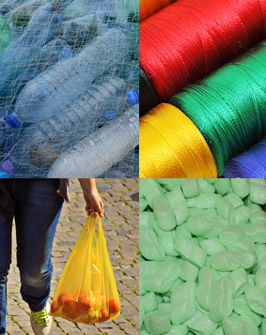
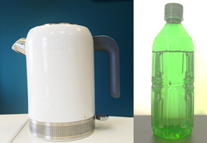
Mission Assignment: Describe the properties of polymers
KS3-17-04
What is meant by the term ‘polymer’? ___________________________________________________________________________________________________________________________________________________________________________________________________________________________________________________
List three properties all polymers have in common. __________________________________________________________________________________________________________________________________________________________________
Polymers are made by combing monomers into a long chain. They are named by taking the name of the monomer and adding the prefix poly; e.g. polymerising butene forms polybutene. Name the polymers formed from the following monomers.
Describe how the properties of the polymer in the kettle are different from the properties of the polymer in the bottle.
____________________________________________________________
____________________________________________________________
____________________________________________________________
____________________________________________________________
Challenge: In the 20th century plastics transformed how the world lived. Suggest why plastics were a popular material used to make products. ________________________________________________________________________________________________________________________________________________________________________
In the 21st century the use of plastics to manufacture products is not as popular. Explain why? ________________________________________________________________________________________________________________________________________________________________________
Monomer | Polymer
Styrene
Ethene
Propene
Vinyl chloride
Tetrafluoroethene
Developing Experts Copyright 2023 All Rights Reserved

Slide 3
Mission Assignment: Describe the properties of polymers
ANSWERS
KS3-17-04
Examine samples of different polymers and complete the table below with your observations. Include a description about what makes each plastic unique.
Unique properties | Heat resistant | Good electrical insulator / durable | High strength | Flexible | High transparency, scratch-resistant transparency,
Observable physical properties | Lightweight, heat resistant, some can be flexible | Durable, resistant to abrasion and chemicals, good electrical insulator | High strength, good abrasion resistance | Lightweight, good chemical resistance, flexible | High transparency, good impact resistance
What is this polymer used for? | Packaging, insulation, disposable utensils, toys | Pipes, flooring, electrical cable insulation, medical tubing | Clothing, carpets, toothbrush bristles, fishing line | Packaging, bags, films, pipes | Signs, displays, lighting fixtures, lenses
Describe the polymers appearance | brittle, rigid | Rigid or flexible, white or clear | Tough, flexible, translucent | translucent or opaque | Clear, transparent
Polymer | Polystyrene | Polyvinyl Chloride (PVC) | Nylon | Polythene | Clear Acrylic
Developing Experts Copyright 2023 All Rights Reserved

Slide 4
Mission Assignment: Describe the properties of polymers
ANSWERS
KS3-17-04
What is meant by the term ‘polymer’? ___________________________________________________________________________________________________________________________________________________________________________________________________________________________________________________
List three properties all polymers have in common. __________________________________________________________________________________________________________________________________________________________________
Polymers are made by combing monomers into a long chain. They are named by taking the name of the monomer and adding the prefix poly; e.g. polymerising butene forms polybutene. Name the polymers formed from the following monomers.
Describe how the properties of the polymer in the kettle are different from the properties of the polymer in the bottle.
____________________________________________________________
____________________________________________________________
____________________________________________________________
____________________________________________________________
Challenge: In the 20th century plastics transformed how the world lived. Suggest why plastics were a popular material used to make products. ________________________________________________________________________________________________________________________________________________________________________
In the 21st century the use of plastics to manufacture products is not as popular. Explain why? ________________________________________________________________________________________________________________________________________________________________________
A large chain molecule made up joining small molecules called monomers
Chemically unreactive, solid at room temp and easily molded into shape
Monomer | Polymer
Styrene | Polystyrene
Ethene | polyethene
Propene | Polypropene
Vinyl chloride | Polyvinyl chloride (PVC)
Tetrafluoroethene | polytetrafluorothene
Polymer in kettle has higher melting temperature and is
rigid and opaque, whereas the polymer in the bottle is
flexible and transparent.
Plastics were popular in the 20th century because they are lightweight, durable, versatile, and can be easily molded into different shapes. They are also cheaper to produce compared to traditional materials like glass, metal, and wood.
In the 21st century, there is growing concern about the environmental impact of plastics, particularly their contribution to plastic pollution and microplastic contamination. This has led to increased regulation and public pressure to reduce plastic use and increase recycling and waste management efforts.
Developing Experts Copyright 2023 All Rights Reserved

