Slide 1

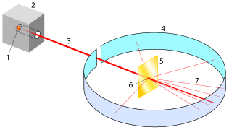
0001.01
Mission Assignment
Task | Draw a fully labelled diagram of Rutherford’s alpha scattering experiment, showing possible pathways of the alpha particles.
Developing skills | Ensure that you understand how the three particles – protons, electrons and neutrons – were discovered and by whom.
Think about… | How particle physics is discovering ever smaller particles – Google ‘quarks’.
KS4-21-03:
Explore the history of atomic models

