Slide 1

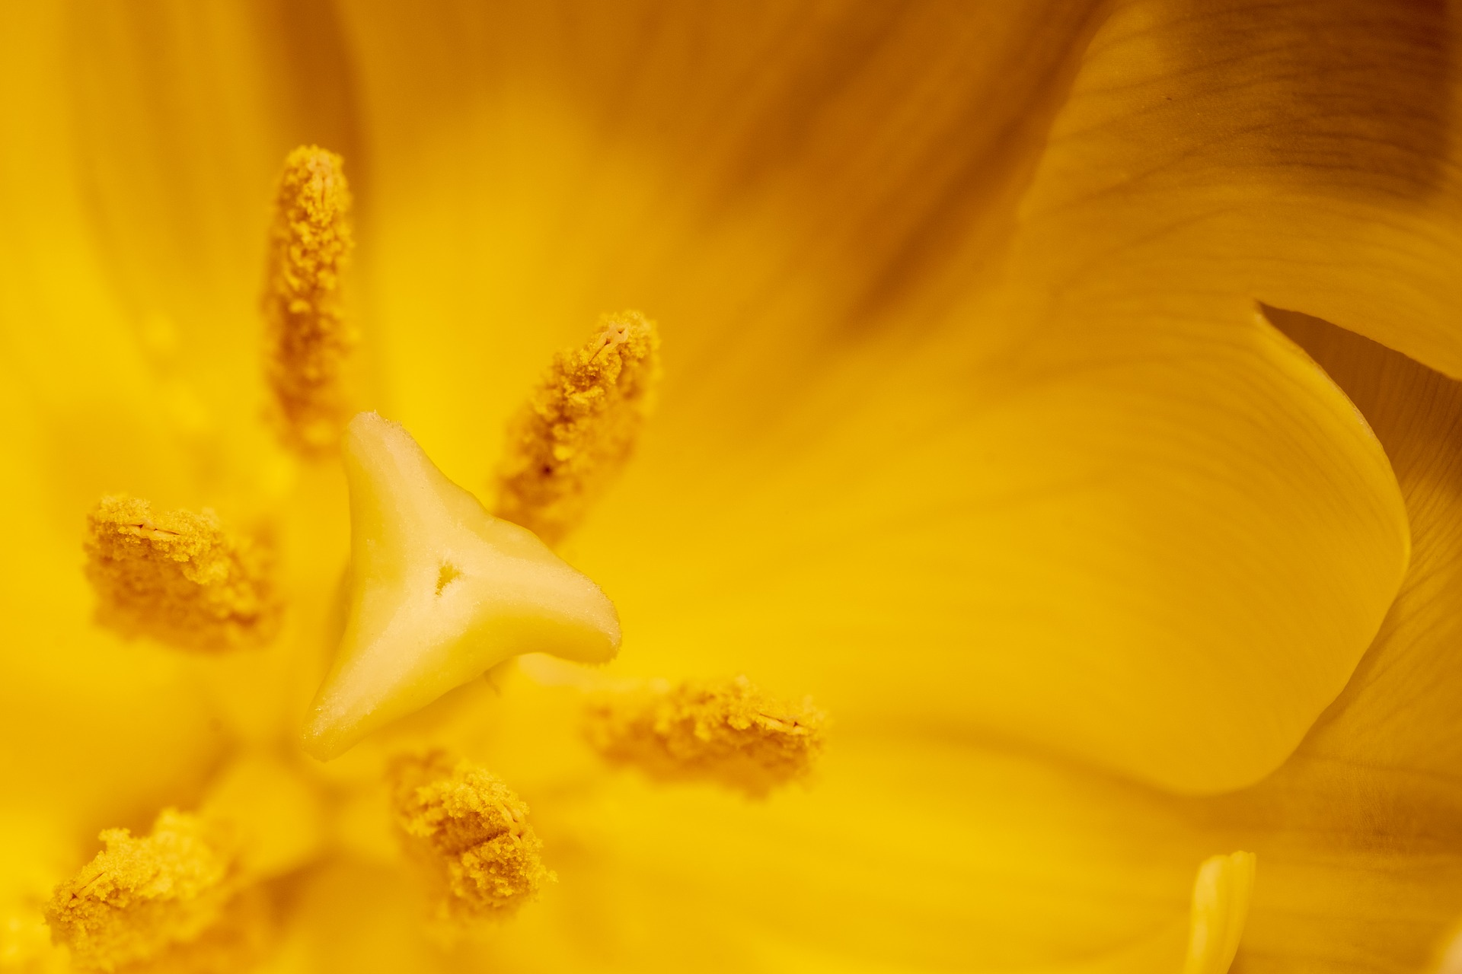
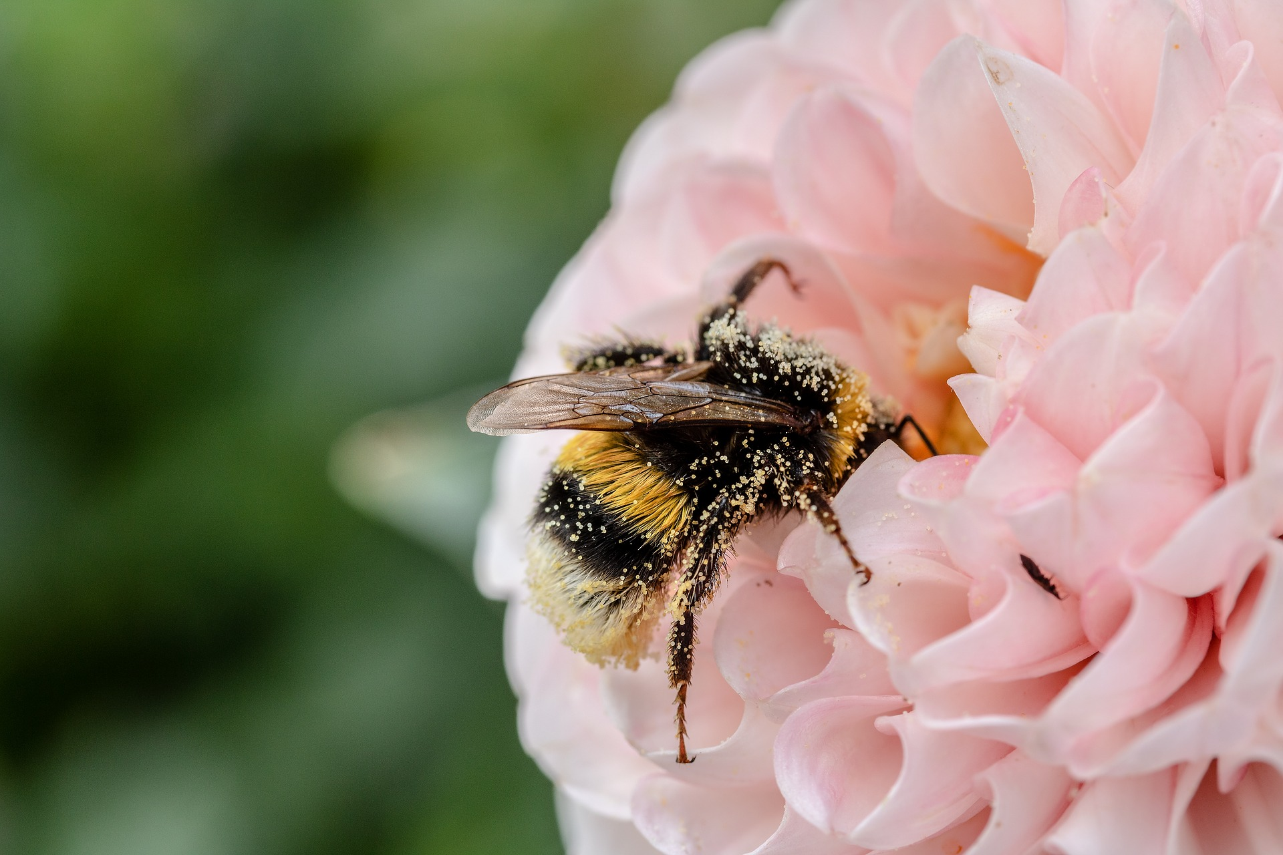
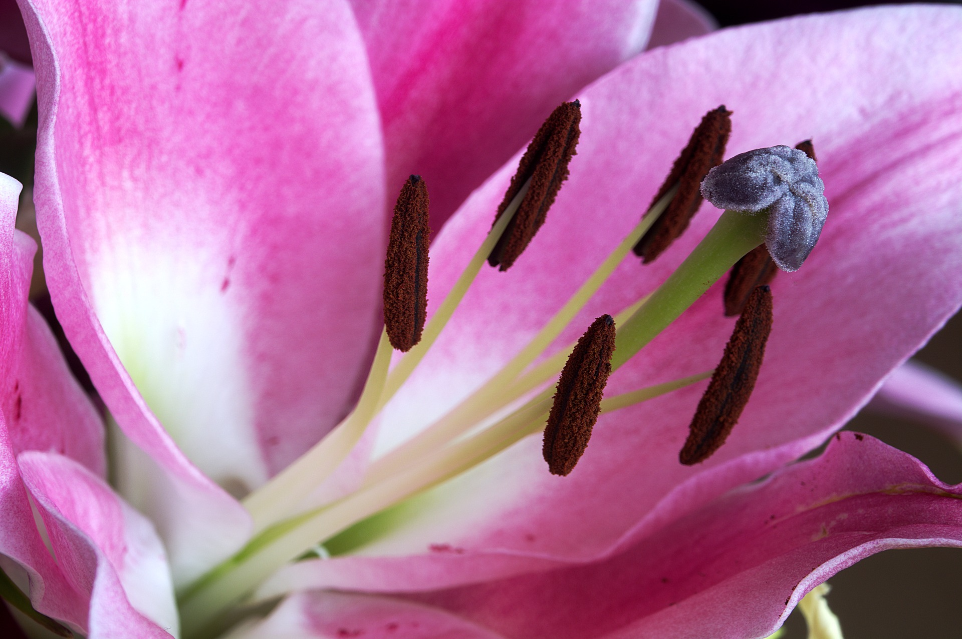
Mission Assignment: Explain how plants are fertilised and seeds are formed
KS3-09-07
For your mission assignment, you should observe the process of pollination, either in your garden or a local park, and record your observations. Examples of information you can record include the types of pollinator observed, the different properties of the flowers being pollinated, and how many flowers each pollinator has visited.
Once you have made observations in the field, produce a documentary outlining the pollination process and what happens to the pollen inside the flower during seed formation. You can film this using a camera or a mobile phone or present it as a demonstration using props.
Using the knowledge you have gained from the lesson and your research in the field, have a go at answering the following questions:
1. What part of the flower receives the pollen?
____________________________________________________________________________________________________________________________________________________________________
2. List three different examples of animal pollinators.
  a. __________________________________________________________________________
  b. __________________________________________________________________________
  c. __________________________________________________________________________
3. How do the male sex cells in pollen reach the female sex cells in the ovary of a flower?
______________________________________________________________________________________________________________________________________________________________________________________________________________________________________________________
4. Describe how one of the flowers you have observed is adapted to increase the likelihood of pollination.
________________________________________________________________________________________________________________________________________________________________________________________________________________________________________________________________________________________________________________________________________
Developing Experts Copyright 2023 All Rights Reserved

Slide 2
Mission Assignment: Explain how plants are fertilised and seeds are formed ANSWERS
KS3-09-07
For your mission assignment, you should observe the process of pollination, either in your garden or a local park, and record your observations. Examples of information you can record include the types of pollinator observed, the different properties of the flowers being pollinated, and how many flowers each pollinator has visited.
Once you have made observations in the field, produce a documentary outlining the pollination process and what happens to the pollen inside the flower during seed formation. You can film this using a camera or a mobile phone or present it as a demonstration using props.
Using the knowledge you have gained from the lesson and your research in the field, have a go at answering the following questions:
1. What part of the flower receives the pollen?
____________________________________________________________________________________________________________________________________________________________________
2. List three different examples of animal pollinators.
  a. __________________________________________________________________________
  b. __________________________________________________________________________
  c. __________________________________________________________________________
3. How do the male sex cells in pollen reach the female sex cells in the ovary of a flower?
______________________________________________________________________________________________________________________________________________________________________________________________________________________________________________________
4. Describe how one of the flowers you have observed is adapted to increase the likelihood of pollination.
________________________________________________________________________________________________________________________________________________________________________________________________________________________________________________________________________________________________________________________________________
The female part – the stigma
Insects, e.g. bees
Birds
Monkeys
Firstly, they get transferred to a different flower by a pollinator. Then, the pollen grain sticks to the stigma. The pollen then forms a pollen tube down the style to the ovary where the gametes (pollen and ovule) can fuse in fertilisation.
Insect pollinated: bright colours, interesting smell, UV light, anthers close to nectar, pollen is sticky.
Wind pollinated: anthers and stigma hang outside of the flower, flowers are less colourful or less perfumed, pollen is lighter.
Developing Experts Copyright 2023 All Rights Reserved

