Slide 1

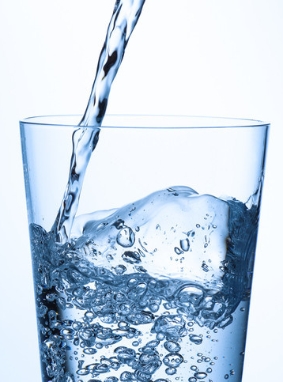
0001.01
Mission Assignment
Task
Developing skills
Think about…
Explain the differences between potable and pure water and distillation and distillation.
Give reasons for the steps used to produce potable water.
Describe the differences in treatment of ground water and salty water.
KS4-17-09:
Using Resources - Explore water safe to drink

