Slide 1

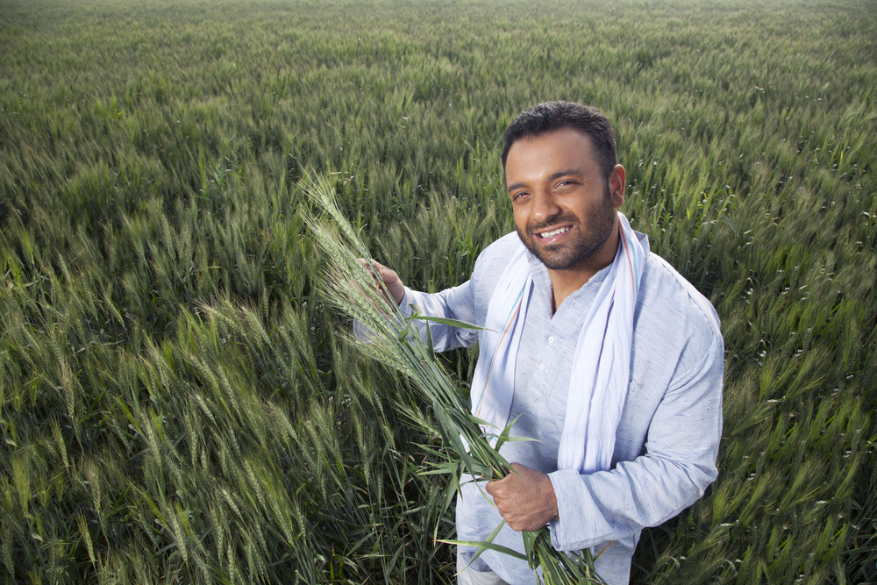



S06.02.05 Handout
Describe the process of genetic modification.
Read the case studies to use as the basis of your debate.
Produce arguments both for and against for each character.
Jaheem the Farmer
Jaheem is an arable farmer. He uses genetically modified crops to increase his crop yields.
He is worried that by using GM crops he will be contributing to increasing the number of plants in a habitat with the same characteristics. That means that if some deadly disease was introduced to the population, it would affect all the plants and animals and not just a few individuals.
Danielle is a scientist who has just written a publication which will be sold to farmers.
The title of the book is called ‘Why GM is the Way Forward.’ Her boss has asked her to sell as many copies as possible. She believes that GM crops are better as they resist drought, diseases and insect pests; therefore creating a larger yield of crops – making more money for farmers and scientists.
Danielle the Scientist
Jan the Neurologist
Jan is a neurologist, a scientist who studies the brain and nervous system. She doesn’t think that GM crops are beneficial to our planet or its inhabitants. She feels the use of chemicals in GM crops are toxic to the environment and humans due to filtering into food and water supplies. She thinks these chemicals could destroy soil and will actually increase diseases in crops.
Jing is an exporter and trader. He needs to ensure crops get to places all over the world in good condition to be eaten or used. He is a supporter of GM crops, not only because they produce a higher yield, but they have a longer shelf life, enabling exporters to ship crops across a wider area with longer sell-by dates.
Jing the Exporter
Developing Experts Ltd. © 2022
.

Slide 2
S06.02.05 Handout
Describe the process of genetic modification.
Plan and structure your argument about the use of GM crops.
Pros of growing and consuming GM crops | Cons of growing and consuming GM crops
Persuasive Speech Map
Detail
Key Points
Goal
Developing Experts Ltd. © 2022
.

