Slide 1


KS4-17-02: Using Resources - Explore life Cycle Assessments
● Describe what's meant by a lifecycle assessment
● Discuss the life cycle assessments for a plastic shopping bag and a paper shopping bag
● Describe the problems with life cycle assessments
Definition: A life-cycle assessment (LCA) is an analysis of the overall environmental impact that a product may have throughout its lifetime.
The cycle is broken down into four main stages which are:
  Raw Materials
  Manufacture
  Usage
  Disposal
In your own words write a sentence which explains the definition of life-cycle assessment.
________________________________________________________________________________________________________________________________________________________________________________________________________________________________________________________________________________________________________________________________________
Key Facts
Obtaining the necessary raw materials has an impact on the environment which may include:
  Using up limited resources such as ores and crude oil.
  Damaging habitats through deforestation or mining.
Manufacturing processes also have an impact on the environment which may include:
  Using up land for factories.
  The use of fossil fuelled machines for production and transport.
Usage of a product may also affect the environment although it depends on the type of product. For example, a wooden desk has very little impact whereas a car will have a significant impact (air pollution).
The disposal of outdated products has an impact on the environment which may include:
  Using up space at landfill sites.
  Whether the product or its parts can be recycled.
A life cycle assessment is carried out using the data of a given product and the criteria of the assessment.
Rarely is there a perfect product with zero environmental impact, so often a compromise is made between environmental impact and economical factors.
Life Cycle Assessment of Shopping Bags
 | Plastic | Paper
Raw Materials | Crude oil which is a finite resource which requires a lot of energy to process. | Recycled paper or trees. Making paper requires more energy than recycling paper but much less than making plastics.
Manufacture | Fractional distillation, cracking & polymerization, not much waste as crude oil is completely used & cheap to manufacture. | Pulping paper uses a lot of energy, sulfur dioxide & produces waste.
Usage | Is reusable. | Most are not reusable.
Disposal | Can be recycles but is costly and produces pollution. Can be stored in a landfill, take up space and is not biodegradable. | Biodegradable, non-toxic & can be recycled.
Conclusion
Considering both life-cycle assessments, the plastic bag is the better option. Even though they aren’t biodegradable, they do have a much longer lifespan and thus are less harmful than paper bags.
Developing Experts All rights reserved © 2021

Slide 2
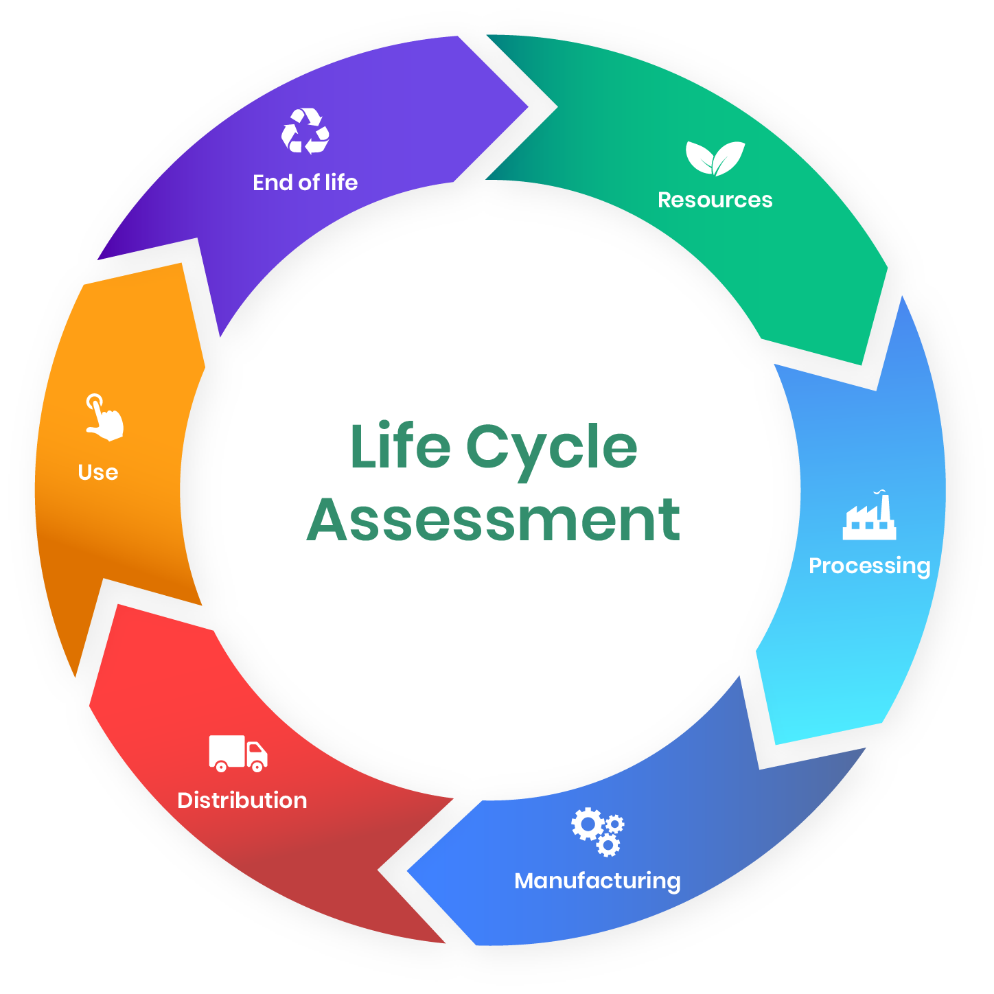
KS4-17-02: Using Resources - Explore life Cycle Assessments
● Describe what's meant by a lifecycle assessment
● Discuss the life cycle assessments for a plastic shopping bag and a paper shopping bag
● Describe the problems with life cycle assessments
Ethene is used to make poly(ethene). Poly(ethene) is used to make plastic bags. The table below shows data from a Life-Cycle Assessment (LCA) for a plastic bag and a paper bag.
 | Plastic bag | Paper bag
Raw materials | Crude oil or natural gas | Wood
Energy used in MJ | 1.5 | 1.7
Mass of solid waste in g | 14 | 50
Mass of CO₂ produced in kg | 0.23 | 0.53
Volume of fresh water used in dm³ | 255 | 4520
A company stated: 'A Life-Cycle Assessment shows that using plastic bags has less environmental impact than using paper bags’. Evaluate this statement. Use the language set out in the key fact on the previous page, your knowledge and the information from the table.
[6 marks]
________________________________________________________________________________________________________________________________________________________________________________________________________________________________________________________________________________________________________________________________________________
________________________________________________________________________________________________________________________________________________________________________________________________________________________________________________________________________________________________________________________________________________
________________________________________________________________________________________________________________________________________________________________________________________________________________________________________________________________________________________________________________________________________________
________________________________________________________________________________________________________________________________________________________________________
Developing Experts All rights reserved © 2021

Slide 3
KS4-17-02: Using Resources - Explore life Cycle Assessments
● Describe what's meant by a lifecycle assessment
● Discuss the life cycle assessments for a plastic shopping bag and a paper shopping bag
● Describe the problems with life cycle assessments
The UK government has advised supermarkets to stop using plastic bags due to their environmental impact. Most plastic bags are made from polythene.
The table below shows ways to deal with large numbers of waste shopping bags.
Use the information in the table and your knowledge to give one advantage and one disadvantage for each of the methods used to deal with plastic bags in the table above.
[8 marks]
________________________________________________________________________________________________________________________________________________________________________________________________________________________________________________________________________________________________________________________________________________
________________________________________________________________________________________________________________________________________________________________________________________________________________________________________________________________________________________________________________________________________________
________________________________________________________________________________________________________________________________________________________________________________________________________________________________________________________________________________________________________________________________________________
________________________________________________________________________________________________________________________________________________________________________
________________________________________________________________________________________________________________________________________________________________________________________________________________________________________________________________________________________________________________________________________________
________________________________________________________________________________________________________________________________________________________________________________________________________________________________________________________________________________________________________________________________________________
________________________________________________________________________________________________________________________________________________________________________
________________________________________________________________________________________________________________________________________________________________________________________________________________________________________________________________________________________________________________________________________________
________________________________________________________________________________________________________________________________________________________________________
Method | What happens to the plastic bag
Burned | Collected, transported and burnt to release energy
Reused | Customer uses the bag again
Dumped | Mixed with other household waste, collected, transported and disposed of at a landfill
Recycled | Collected, transported washed and melted to make new plastic items
Developing Experts All rights reserved © 2021

