Slide 1

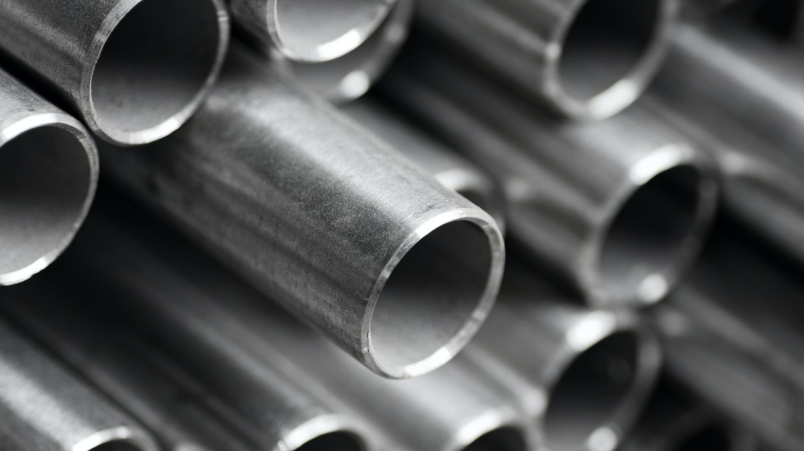
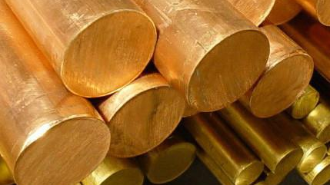
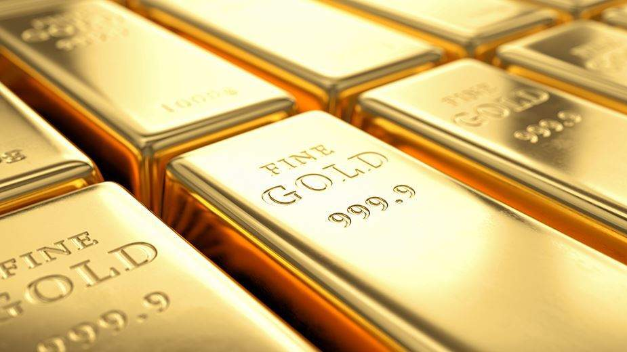
bronze
steel
brass
gold
Developing Experts All rights reserved © 2021

Slide 2
Bronze: A brown metal made of copper and tin.
Steel: A strong metal that is a mixture of iron and carbon.
Gold: A dense lustrous yellow precious metal and chemical element of Group 11.
Brass: A yellow alloy of copper and zinc.
Developing Experts All rights reserved © 2021

Slide 3
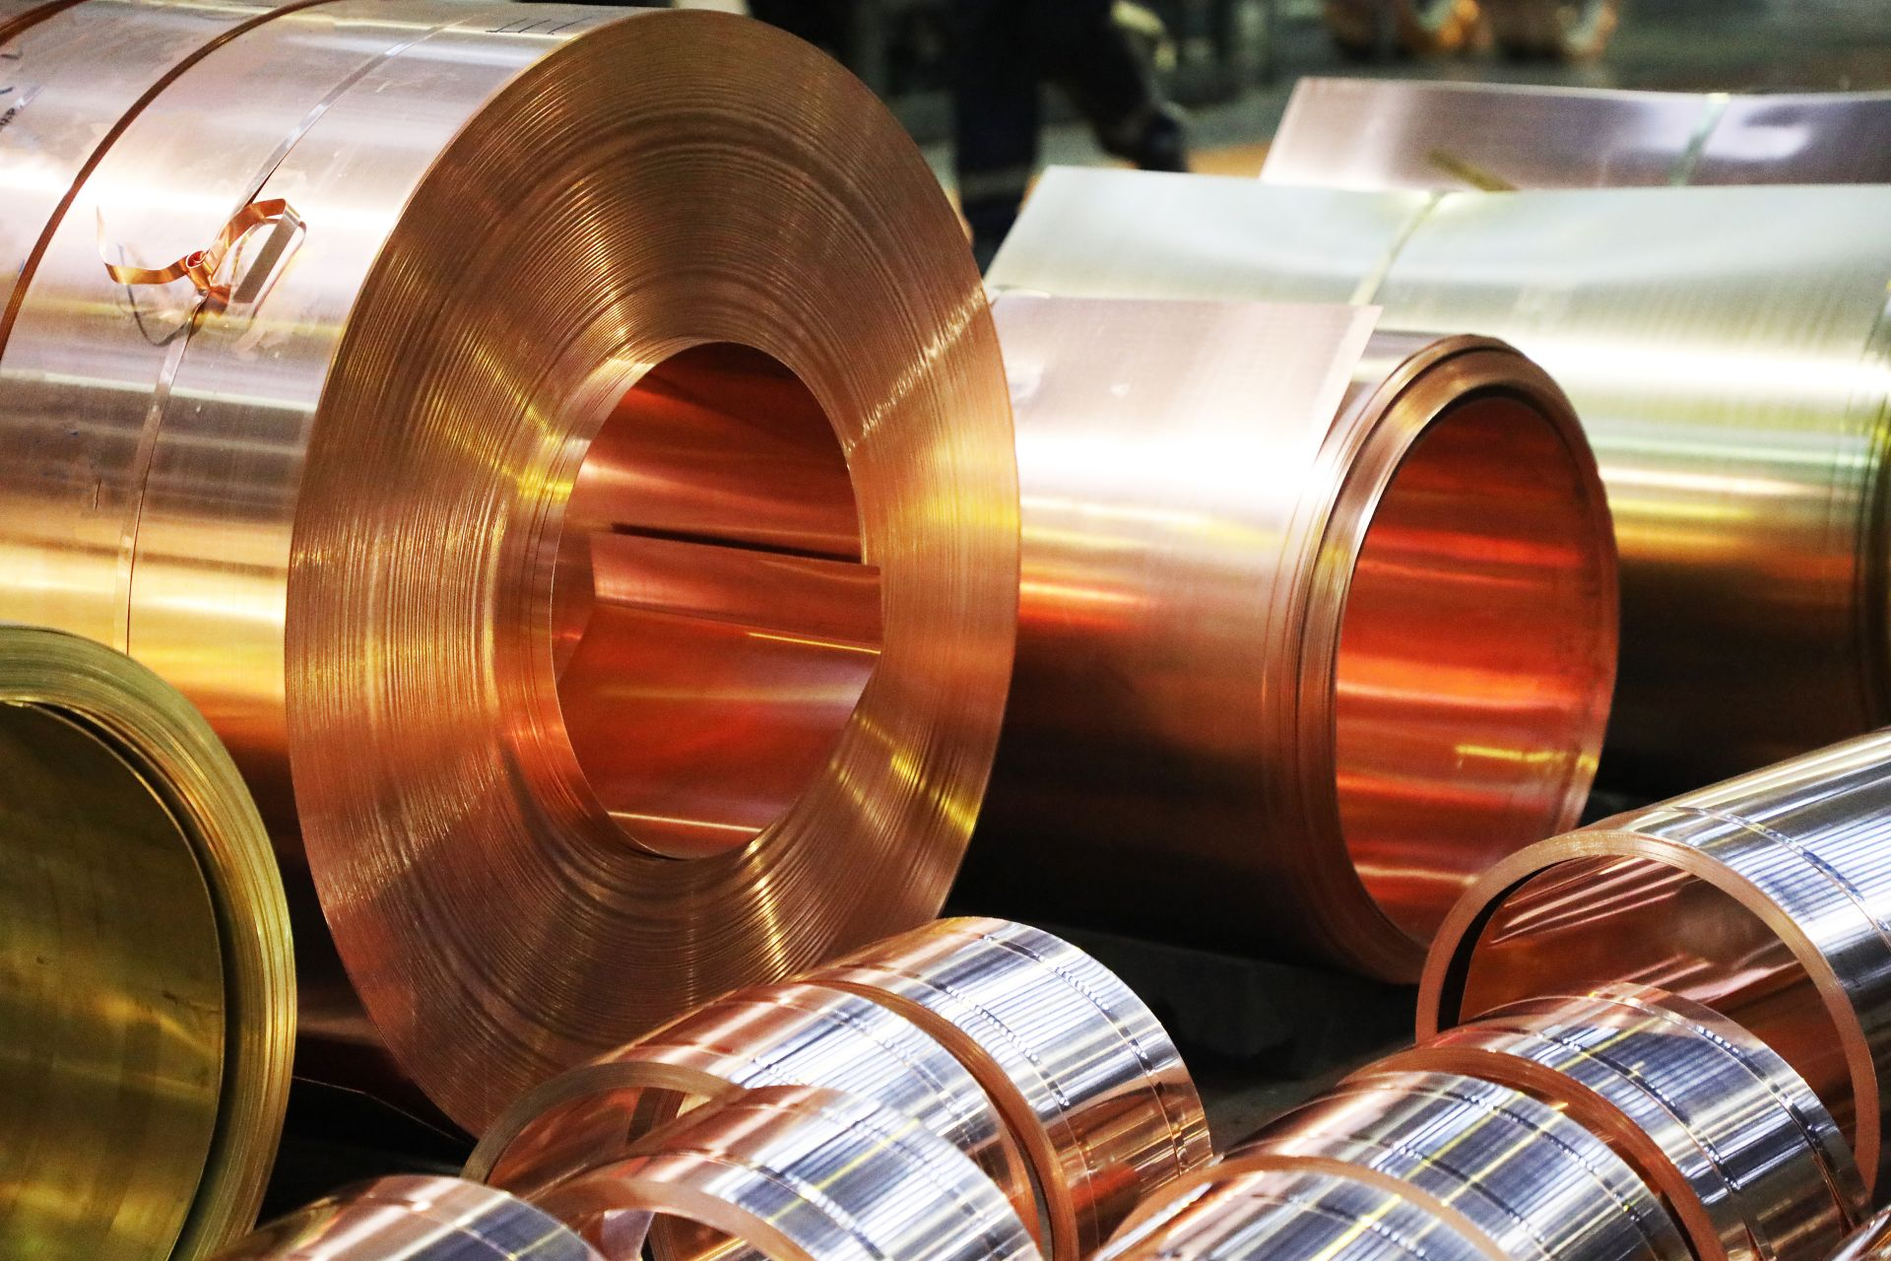
Explore alloys
Describe what's meant by the word alloy and state the properties of alloys.
State the metals present in the alloys bronze, brass and alloys of gold.
State the uses of these alloys.
Describe uses of different forms of steel and alloys of aluminium.
Developing Experts All rights reserved © 2021

Slide 4
An alloy contains a metal blended with other elements.
Developing Experts All rights reserved © 2021

Slide 5
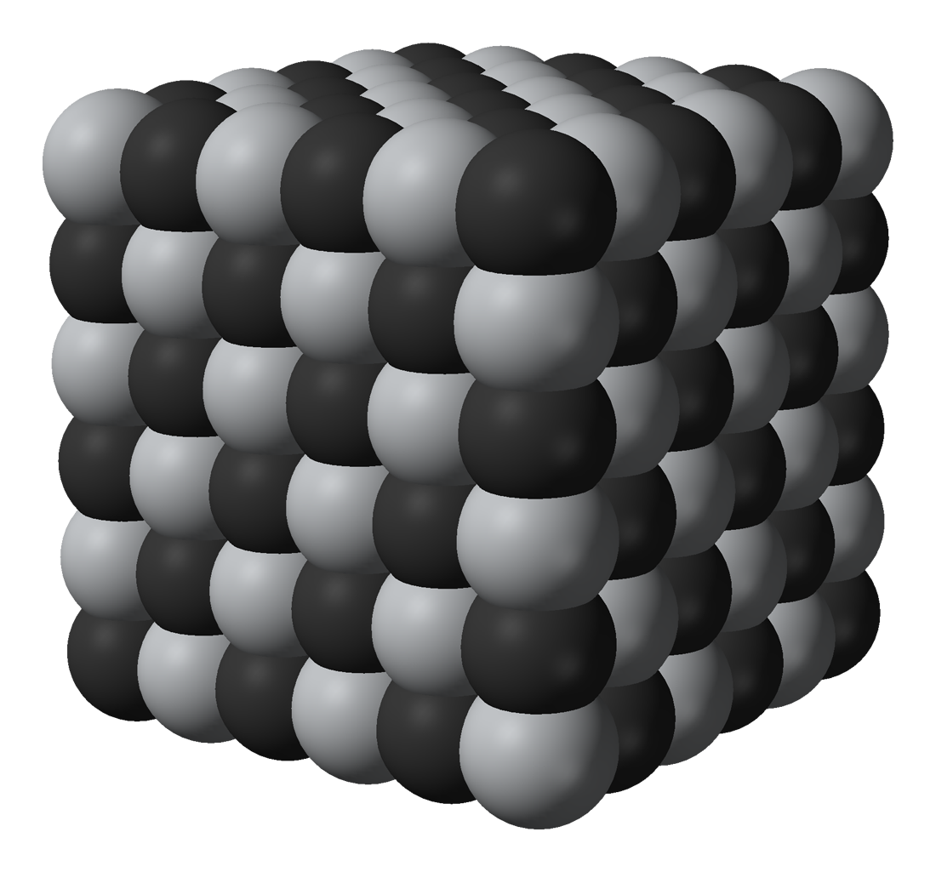
Developing Experts All rights reserved © 2021

Slide 6
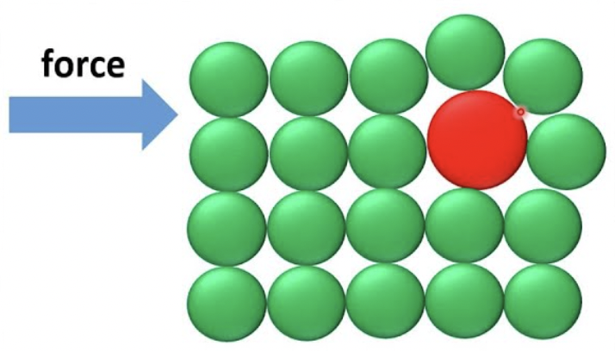
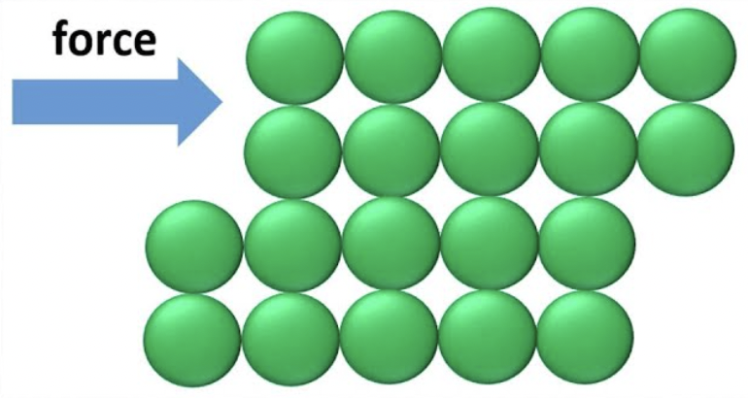
pure metal
alloy
Developing Experts All rights reserved © 2021

Slide 7
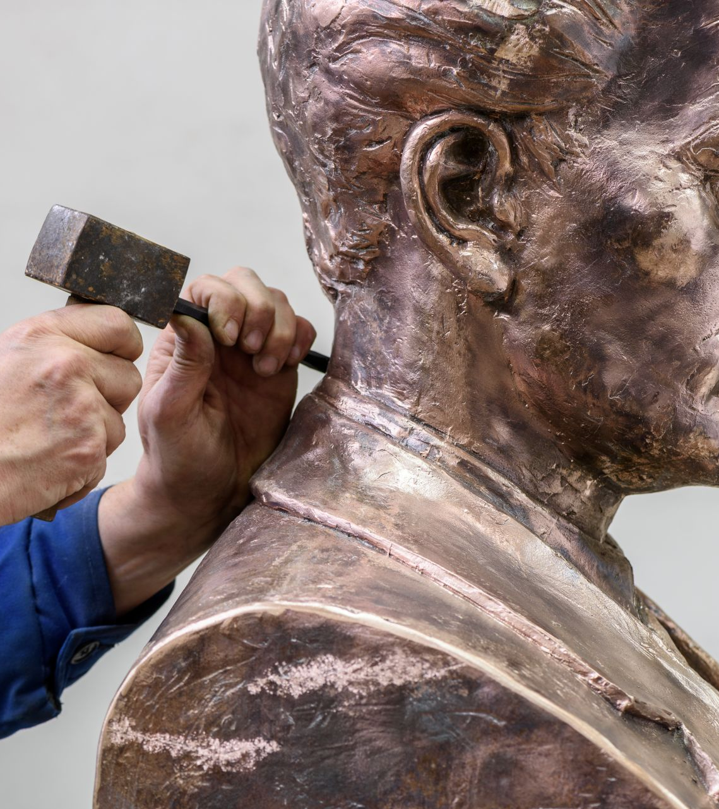
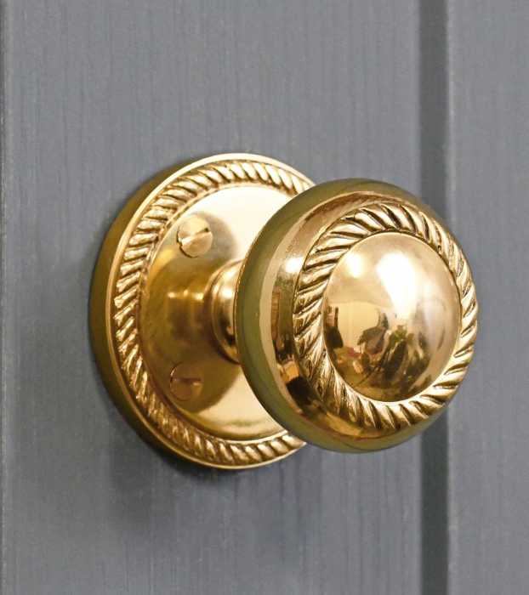
bronze
brass
Developing Experts All rights reserved © 2021

Slide 8
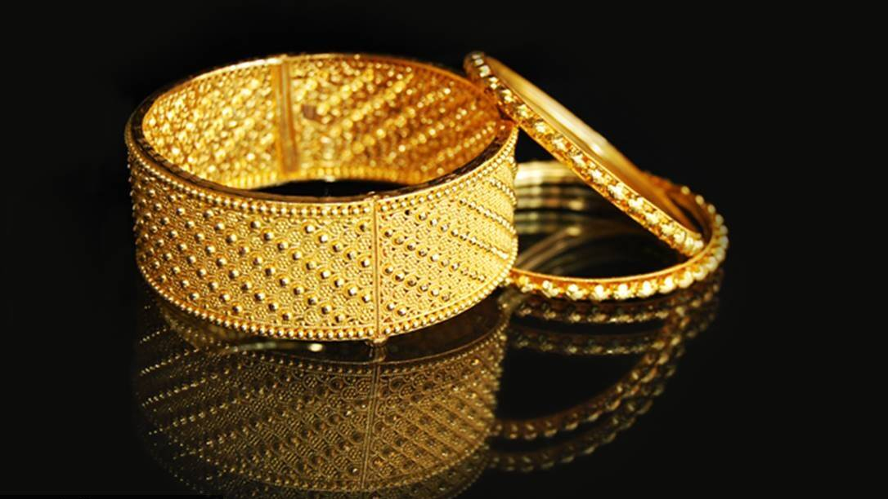

Slide 9
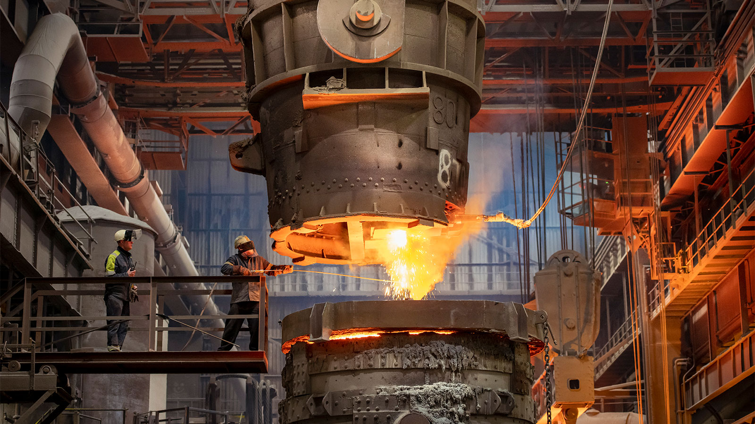

Slide 10
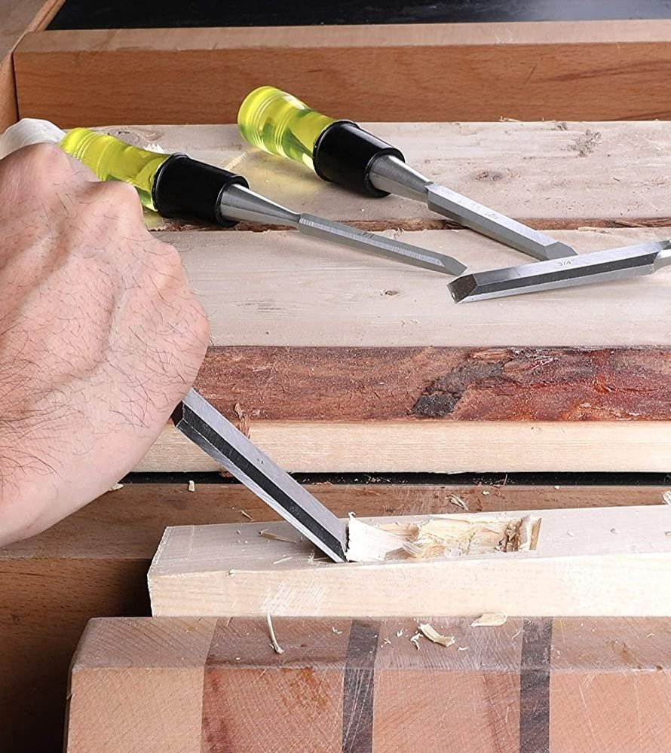

high carbon steel
low carbon steel

Slide 11
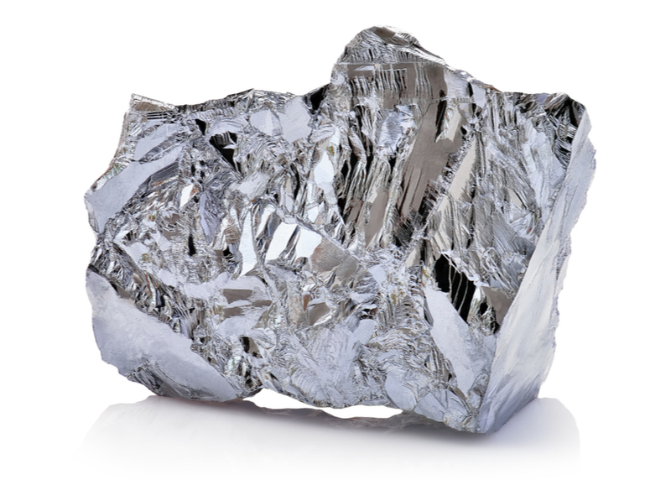
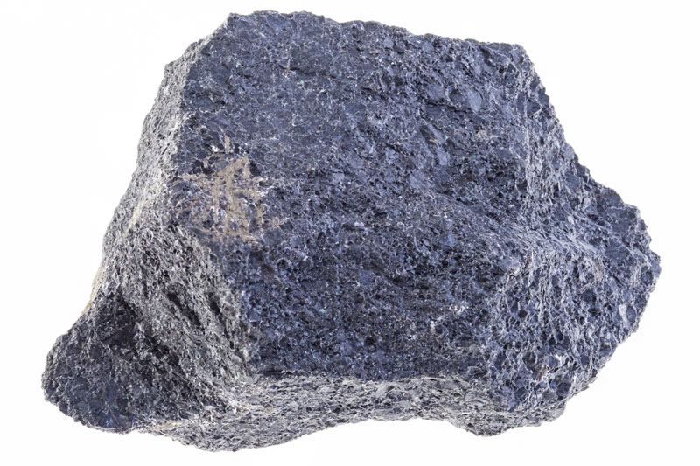
chromium
nickel
Developing Experts All rights reserved © 2021

