Slide 1
S05.06.07 Handout
Know the difference between elements, compounds and mixtures
Make three models of your choice using different coloured balls and cocktail sticks.
Drawing of model 1:
Stretch:
Make a model showing a mixture of elements and a model showing a mixture of compounds.
Drawing of model 2:
Challenge: Suggest which of your models is the purest.
Drawing of model 3:
Developing Experts Ltd. © 2018, 2019

Slide 2
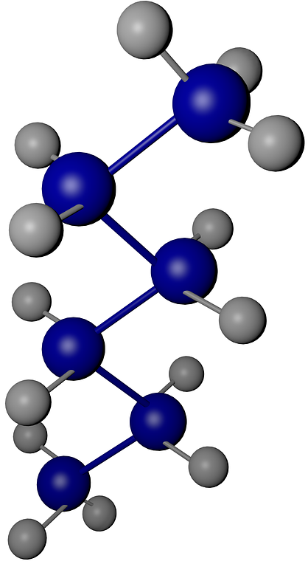
S05.06.07 Handout
Know the difference between elements, compounds and mixtures
Explain your models.
What was model 1? Justify your answer. ____________________________________________________________________________________________________________________________________________________________________________________________________________________________________________________________________
What was model 2? Justify your answer. ____________________________________________________________________________________________________________________________________________________________________________________________________________________________________________________________________
What was model 3? Justify your answer. __________________________________________________________________________________________________________________________________________________________________________________________________________________________________________________________________________________________________________________
Developing Experts Ltd. © 2018, 2019

