Slide 1
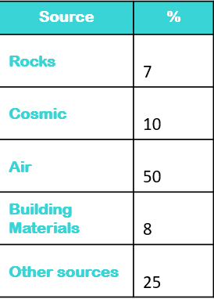
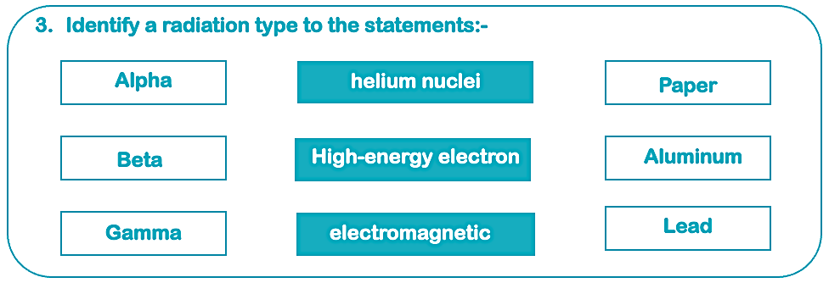
Teacher answers
(These values are approximate – expect student answers to vary)
The largest percentage of radiation in the air is from radon gas. The next largest source is made up of all the living things and materials in the environment and cosmic rays. 15% of our exposure to background radiation is due to artificial sources, such as X-rays, defence, and so on.
(Students should associate the type of radiation with the shield material)
⍺ = Alpha
Alpha radiation has a range of approximately 5cm in the air and will not pass through a piece of paper.
    Β = Beta
    Beta radiation has a range of approximately 1m in the air and will not pass through a 5mm sheet of aluminium.
    𝜸 = Gamma
        Gamma radiation has an unlimited range. Lead several centimeters thick will offer protection.

Slide 2
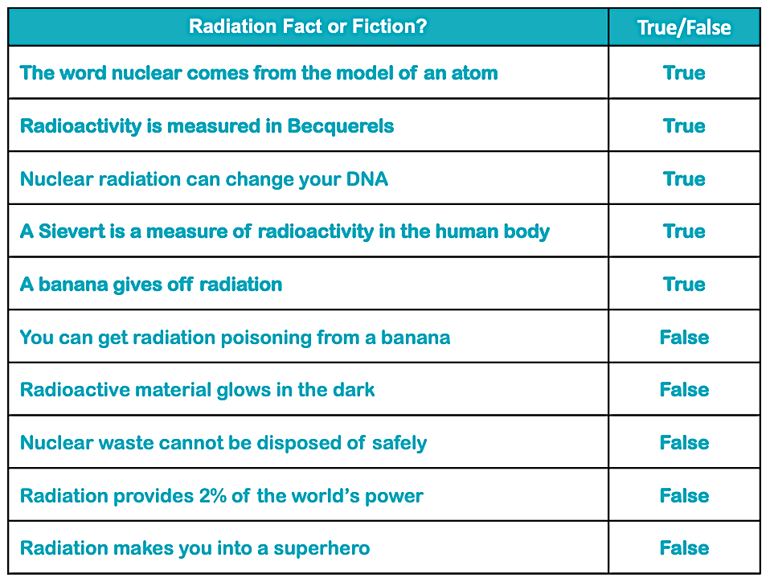
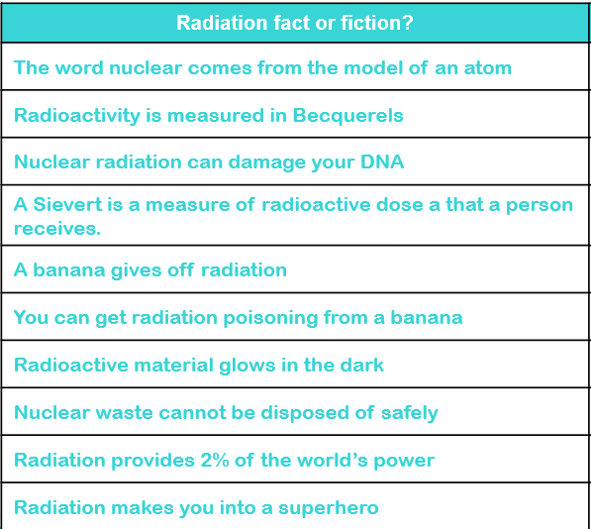
Teacher answers
Metal
  Around
  Under
  Through

