Slide 1



Year 4: Volcanoes, Mountains and Earthquakes
Mission Assignment: What is the equator?
1. What are mountains?
Use the word bank to label the mountain range.
Word bank:
peak valley river formation steep side
ridge base tree line
1
Developing Experts Copyright 2025 All Rights Reserved
Developing Experts Copyright 2022 All Rights Reserved
Developing Experts Copyright 2024 All Rights Reserved

Slide 2
Year 4: Volcanoes, Mountains and Earthquakes
Mission Assignment: What is the equator?
1. What are mountains?
Draw a mountain range in the space below. Use the word bank to label your drawing.
Word bank:
peak valley river formation steep side
ridge base tree line
2
Developing Experts Copyright 2025 All Rights Reserved
Developing Experts Copyright 2022 All Rights Reserved
Developing Experts Copyright 2024 All Rights Reserved

Slide 3
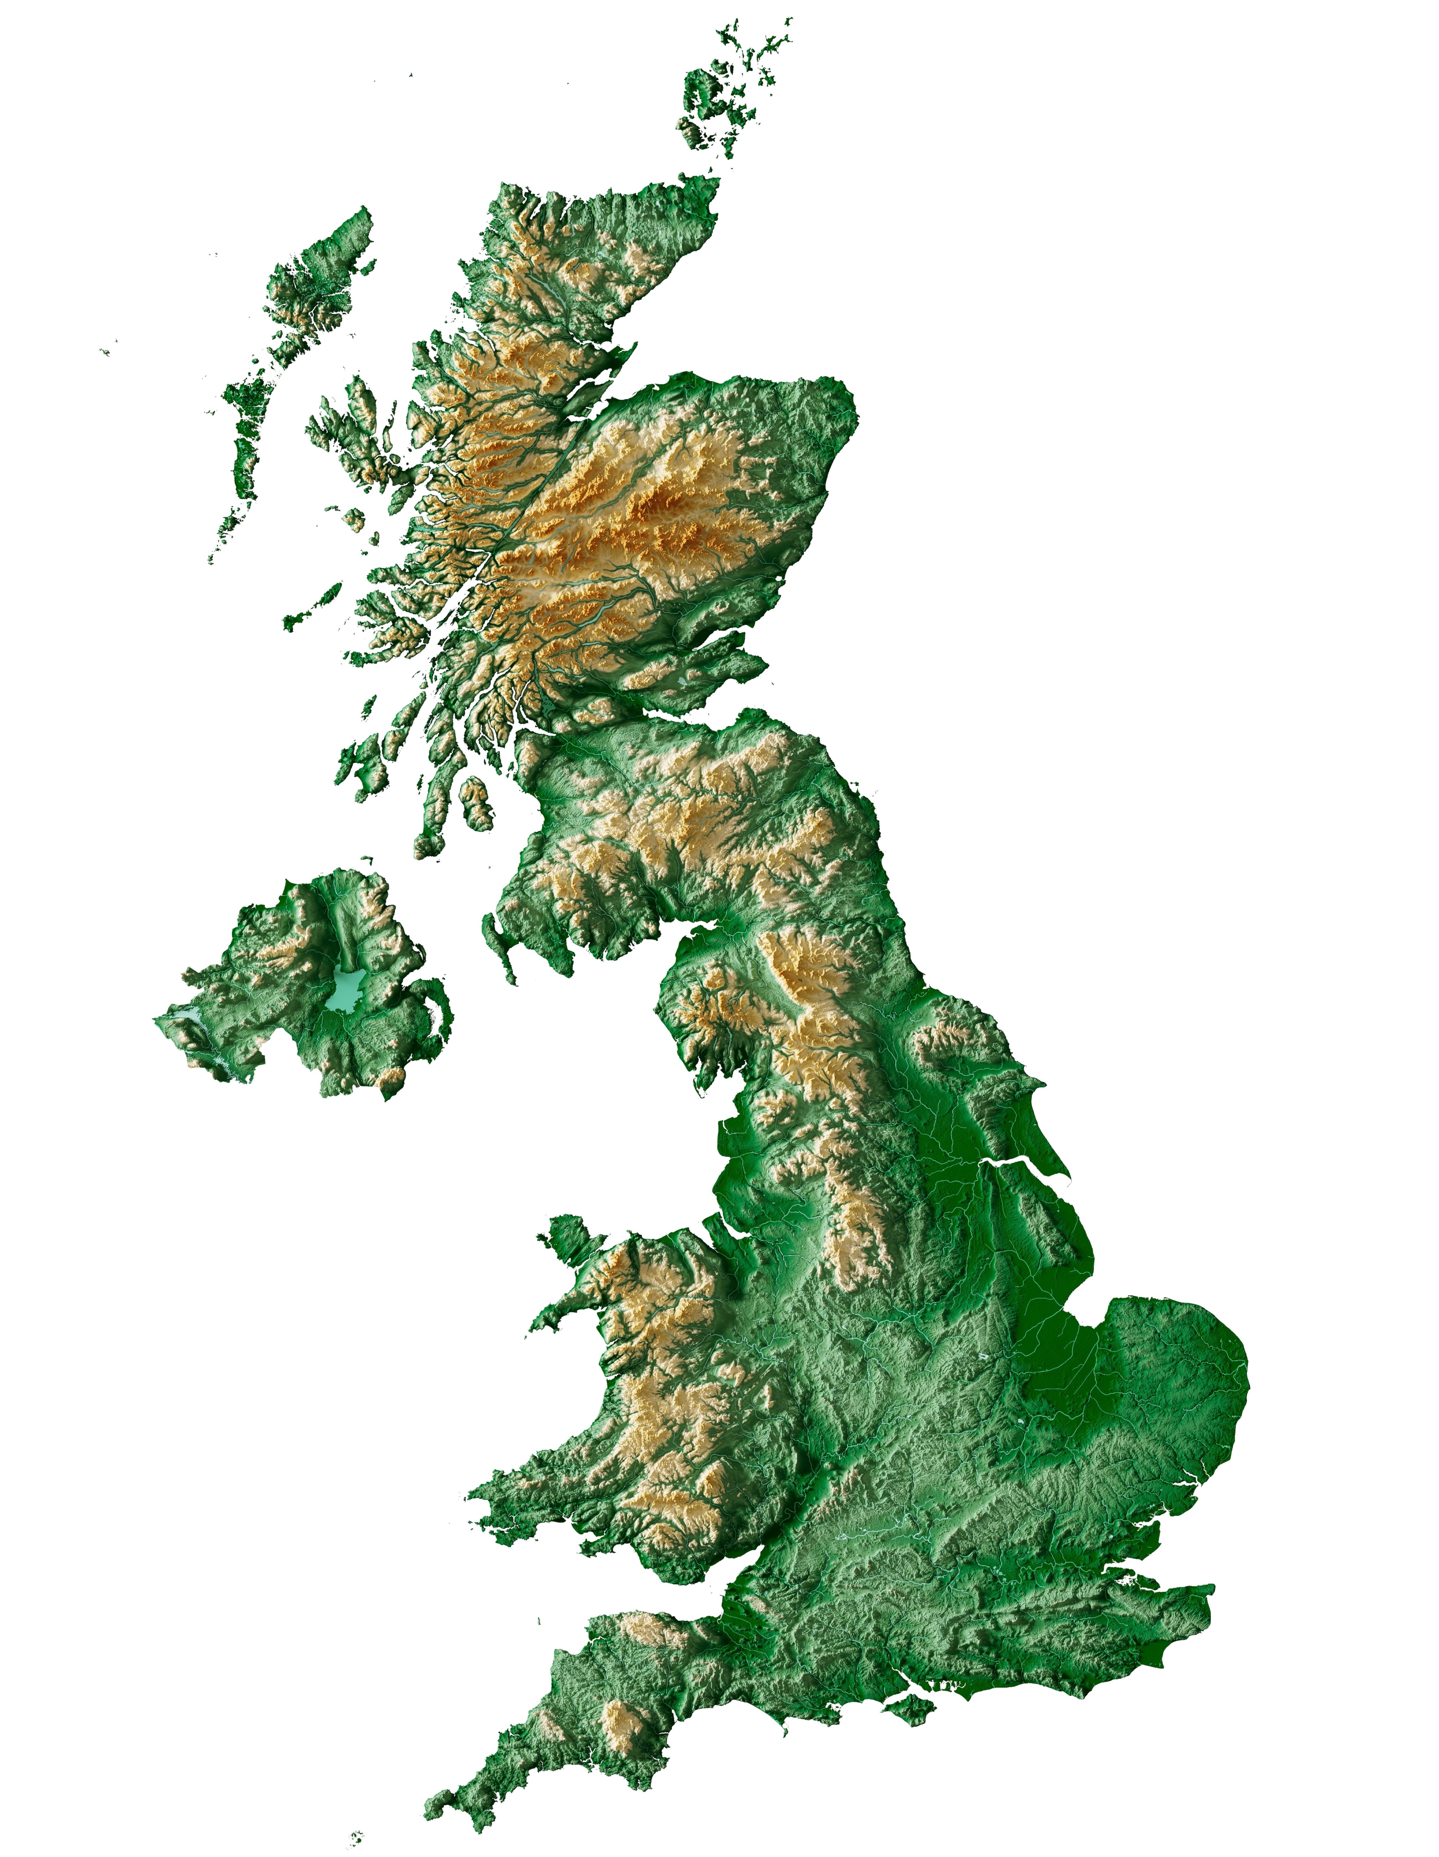
Year 4: Volcanoes, Mountains and Earthquakes
Mission Assignment: What is the equator?
1. What are mountains?
Challenge
What features can you see on the relief map? Can you point out the valleys, the peaks and the low-lying areas on the map?
3
Developing Experts Copyright 2025 All Rights Reserved
Developing Experts Copyright 2022 All Rights Reserved
Developing Experts Copyright 2024 All Rights Reserved

