Slide 1


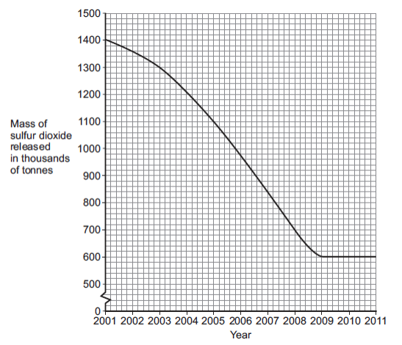
Mission Assignment: Explore waste management
Code: KS4_07_16
Interpret graphs showing increased waste production following human population growth
Task 1: The human population is increasing and more household waste is being produced
(A) Give one way in which an increase in household waste affects our environment.
____________________________________________________________________________________________________________________________________________________________________
(B) The release of sulfur dioxide affects our environment. The graph shows how the mass of sulfur dioxide released in the UK has changed from 2001 to 2011.
(i) Describe the pattern shown in the graph.
__________________________________________________________________________________________________________________________________________________________________________________________________________________________________________________________________________________________________________________________________________________________________________________________________________________________
(ii) In 2001, 1400 thousand tonnes of sulfur dioxide were released. By which year had the amount of sulfur dioxide released reduced to half of this amount?
____________________________________________________________________________________________________________________________________________________________________
Developing Experts Copyright 2022 All Rights Reserved

Slide 2
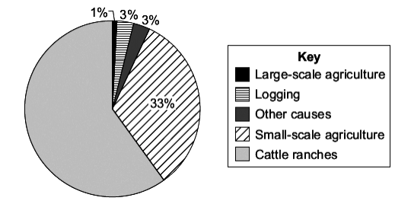
Mission Assignment: Explore waste management
Code: KS4_07_16
(iii) Give one problem caused when sulfur dioxide gas is in the air.
______________________________________________________________________________________________________________________________________________________________________________________________________________________________________________________
(C) Carbon dioxide is another gas that affects the environment. Which two of the following help to reduce the levels of carbon dioxide in the atmosphere by storing carbon dioxide? Tick two boxes.
  Animals respiring
  Carbon dioxide being absorbed in oceans and lakes
  Photosynthesis by trees
  The production of biogas
Task 2: Large-scale deforestation is taking place in Brazil. The pie chart shows the causes of deforestation in Brazil.
(A) Calculate the percentage of forest that has been destroyed for cattle ranches. Show clearly how you work out your answer.
____________________________________________________________________________________________________________________________________________________________________
(B) Cattle give off large amounts of methane into the atmosphere. The methane causes the Earth’s temperature to increase. Give two effects of the temperature increase on the environment.
1.____________________________________________________________________________________________________________________________________________________________________________________________________________________________________________________2.____________________________________________________________________________________________________________________________________________________________________________________________________________________________________________________
Developing Experts Copyright 2022 All Rights Reserved

