Slide 1

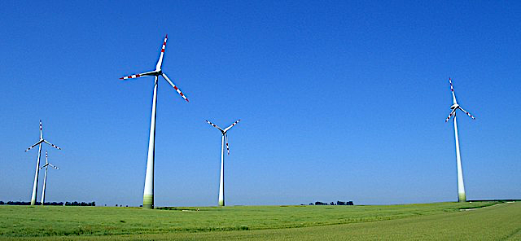
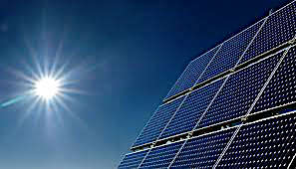
Renewable energy
The urgent problem of climate change has focused the world towards the need to drastically reduce carbon emissions. Carbon dioxide absorbs the reflected radiation from the sun and forms an insulating blanket around the earth. This has led to a subsequent rise in global temperatures, year on year. We now suffer extremes in weather and climate conditions annually, which lead to environmental problems. The use of fossil fuels have caused the greatest damage, as such, we are moving towards using renewable energy resources for the majority of the power demand for the world.
Wind energy is becoming one of the largest sources of renewable energy, particularly offshore where wind turbines can be much larger. The kinetic energy of the wind can be converted to electricity with relative ease.
Solar energy is transferred through photovoltaic technology; energy absorbed from the sun provides large quantities of renewable power. This is particularly successful in countries and zones that have high quantities of sunshine annually.
Hydroelectric power can be gathered in several ways: through hydro-electric dams on inland reservoirs, by using tidal barrage in the estuaries of rivers and by oscillating turbines – Salter’s Ducks - using wave power of the sea.
Gravitational
field strength
10N/kg
Biofuels are fuels that are made from organisms that have been living. These are considered renewable because plants, animals and waste-matter are a consistent resource. They are viewed as carbon neutral because although they release carbon dioxide when burnt, they also absorbed carbon dioxide during photosynthesis when they grew.

Slide 2
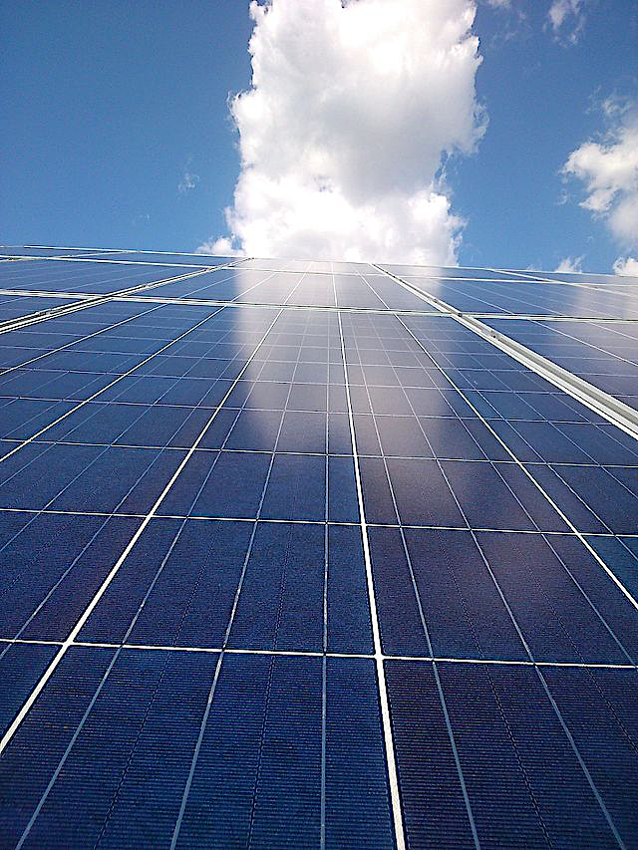
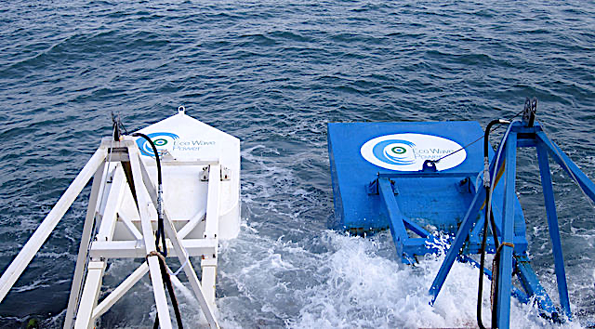
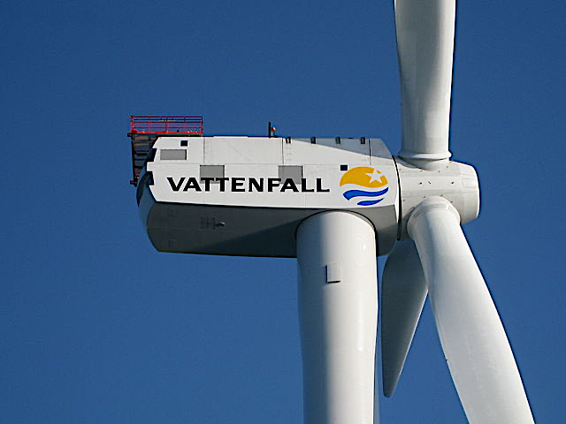
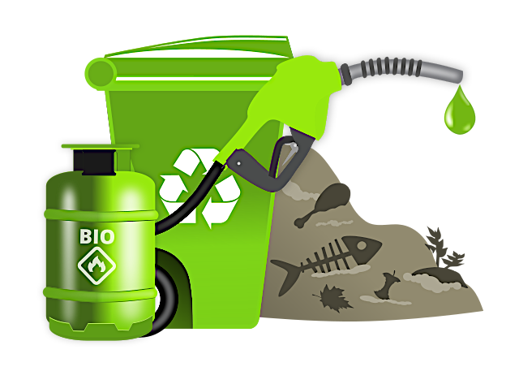
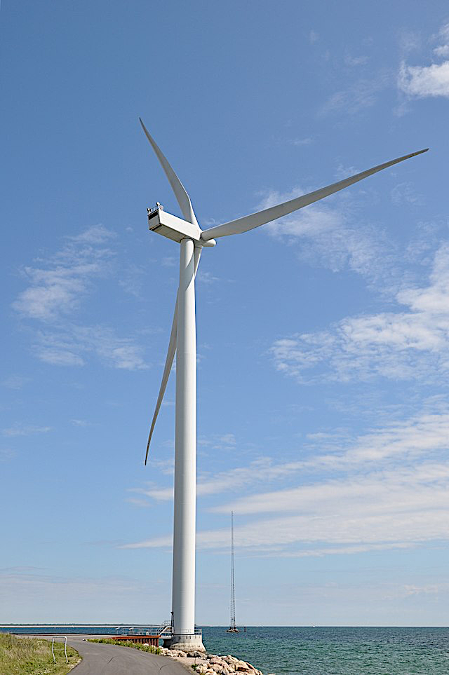
Practice
A data storage server has a supplemental bank of PV solar panels to supply power for lighting. Each panel is 2 x 2 meters and are rated 400 watts. There are 20 panels. Each cell in each panel generates 0.2 W. Calculate how many cells are in each panel. ________________________________________________________________________________________________________________________________________________________________________________________________________________________________________________
Renewable sources of energy include wind, hydro, biofuel and solar energy. What are the advantages and disadvantages of using renewable energy? Use three renewable energy sources for comparison in your answer. _____________________________________________________________________________________________________________________________________________________________________________________________________________________________________________________
A wind turbine can only be a maximum of 59% efficient - why is this? ________________________________________________________________________________________________________________________________________________________________________________________________________________________________________________

Slide 3
Geothermal energy
Geothermal energy is another technology for reusing a renewable energy resource of the earth. The diagram illustrates the process.
No. | Geothermal questions
4 | The above plant has a power output of 350,000 W. How many kilowatt-hours of energy does this station generate in 24 hours?
5 | Give one advantage of geothermal energy as opposed to solar energy.
6 | Give one disadvantage of geothermal energy as opposed to wind energy.

