Slide 1


KS4-17-10: Using Resources - Explore potable water - practical
● Describe methods of producing potable water from salty water
● Describe how to carry out the distillation of a water sample
● Describe the differences between the water samples before and after distillation and how to test for these
You must write in full sentences and use a minimum of 23 words.
Suggest how we could test the pH of a substance.
__________________________________________________________________________________________________________________________________________________________________________
__________________________________________________________________________________________________________________________________________________________________________
Suggest how we could test the presence of dissolved solids in a substance.
__________________________________________________________________________________________________________________________________________________________________________
__________________________________________________________________________________________________________________________________________________________________________
In this investigation you will test 3 water samples from different sources of pH and the presence of dissolved solids. After distillation of the sea water, you will test the water again to check that dissolved solids have been removed, making the water fit to drink.
Water | pH | Mass in grams
 |  | Watch glass | Watch glass and dissolved solids | Dissolved solids
Sea
Spring
Rain
Compare potable and pure water.
Define particulate and suggest their effect on our health.
Suggest how we could separate a mixture of salt and water.
Explain why carbon monoxide is so dangerous.
Developing Experts All rights reserved © 2021

Slide 2
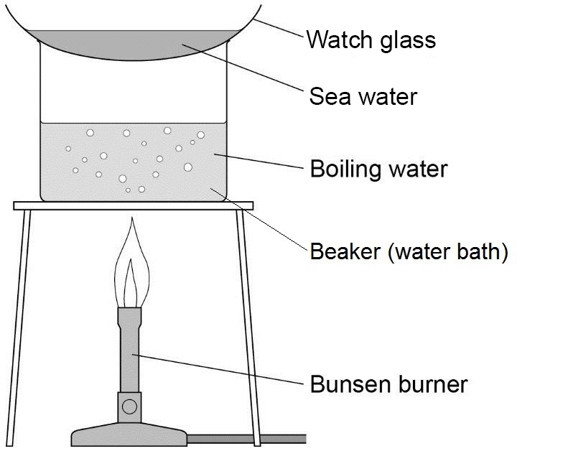
KS4-17-10: Using Resources - Explore potable water - practical
● Describe methods of producing potable water from salty water
● Describe how to carry out the distillation of a water sample
● Describe the differences between the water samples before and after distillation and how to test for these
Hypothesis:
I predict that…
Method:
Detail the steps you will take during your investigation…
Equipment:
List the equipment you will be using…
Results table:
Construct a suitable table for your results.
You will be doing the test 3 times and then calculating an average.
The IV (independent variable) goes in the left column.
Variables:
Control variables: (what you keep the same)
Independent variable: (what you change)
Dependent variable:
(what you measure)
Watch Glass Evaporation – Sea Water
1)Weigh a dry watch glass. Record its mass in the table. Pour 4 cm³ sea water (less if your watch glass is small) into it and place it above a beaker acting as a water bath as shown in the diagram.
2) Allow all the water to evaporate from the watch glass. Do not let the water bath boil dry.
3) You should see dissolved solids on the glass. Remove the watch glass with tongs and allow to cool. Dry the bottom of the watch glass with a cloth and reweigh it. Record the new mass in the table. Subtract the mass of the watch glass alone and record the mass of the dissolved solids.
Wash the watch glass and dry it.
BE CAREFUL AS THE EQUIPMENT IS HOT AND MAY NOT BE STABLE.
Watch Glass Evaporation – Spring Water
1)Weigh a dry watch glass. Record its mass in the table. Pour 4 cm³ sea water (less if your watch glass is small) into it and place it above a beaker acting as a water bath as shown in the diagram.
2) Allow all the water to evaporate from the watch glass. Do not let the water bath boil dry.
3) You should see dissolved solids on the glass. Remove the watch glass with tongs and allow to cool. Dry the bottom of the watch glass with a cloth and reweigh it. Record the new mass in the table. Subtract the mass of the watch glass alone and record the mass of the dissolved solids.
Wash the watch glass and dry it.
Watch Glass Evaporation – Rain Water
1)Weigh a dry watch glass. Record its mass in the table. Pour 4 cm³ sea water (less if your watch glass is small) into it and place it above a beaker acting as a water bath as shown in the diagram.
2) Allow all the water to evaporate from the watch glass. Do not let the water bath boil dry.
3) You should see dissolved solids on the glass. Remove the watch glass with tongs and allow to cool. Dry the bottom of the watch glass with a cloth and reweigh it. Record the new mass in the table. Subtract the mass of the watch glass alone and record the mass of the dissolved solids.
Wash the watch glass and dry it.
Developing Experts All rights reserved © 2021

Slide 3
KS4-17-10: Using Resources - Explore potable water - practical
● Describe methods of producing potable water from salty water
● Describe how to carry out the distillation of a water sample
● Describe the differences between the water samples before and after distillation and how to test for these
Conclusion
The results show…
The investigation has shown…
P- point?
E – evidence from your results
E – explain
A – anything else? PEE again?
Evaluation
Over all the experiment went well because…
The experiment could have been improved by…
If I was to carry out this experiment again I would…
One error present was… I could reduce this by…
What went well?
What didn’t go so well?
How could you improve?
YOU MUST INCLUDE THE WORDS: accuracy, repeatability, ‘X’ error and reliability.
Using the prompts write your conclusion below
________________________________________________________________________________________________________________________________________________________________________________________________________________________________________________________________________________________________________________________________________________
________________________________________________________________________________________________________________________________________________________________________________________________________________________________
________________________________________________________
Using the prompts write your evaluation below
________________________________________________________________________________________________________________________________________________________________________________________________________________________________________________________________________________________________________________________________________________
________________________________________________________________________________________________________________________________________________________________________________________________________________________________
________________________________________________________
Developing Experts All rights reserved © 2021

Slide 4
KS4-17-10: Using Resources - Explore potable water - practical
● Describe methods of producing potable water from salty water
● Describe how to carry out the distillation of a water sample
● Describe the differences between the water samples before and after distillation and how to test for these
Which water sample is most acidic?
____________________________________________________________________________________________
____________________________________________________________________________________________
____________________________________________________________________________________________
Why might this be?
____________________________________________________________________________________________
____________________________________________________________________________________________
____________________________________________________________________________________________
Which water sample contains the most dissolved solids?
____________________________________________________________________________________________
____________________________________________________________________________________________
____________________________________________________________________________________________
Why might this be?
____________________________________________________________________________________________
____________________________________________________________________________________________
____________________________________________________________________________________________
During the distillation step, why is the test tube placed in a beaker of ice water?
____________________________________________________________________________________________
____________________________________________________________________________________________
____________________________________________________________________________________________
Name the piece of equipment that could be used instead of the beaker of ice water.
____________________________________________________________________________________________
____________________________________________________________________________________________
____________________________________________________________________________________________
How did the sea water sample change after being distilled?
____________________________________________________________________________________________
____________________________________________________________________________________________
____________________________________________________________________________________________
In the real world, when is desalination of water necessary?
____________________________________________________________________________________________
____________________________________________________________________________________________
____________________________________________________________________________________________
Developing Experts All rights reserved © 2021

