Slide 1
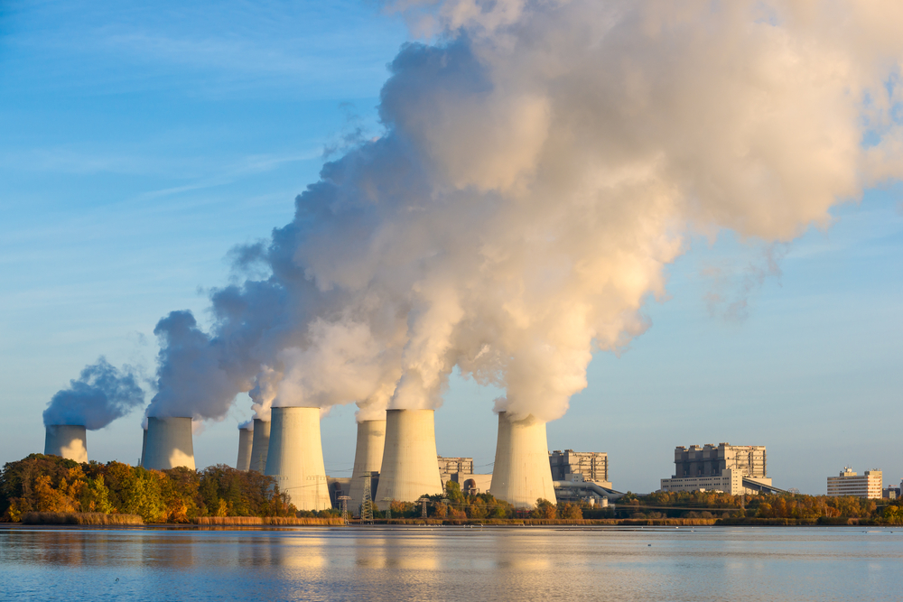
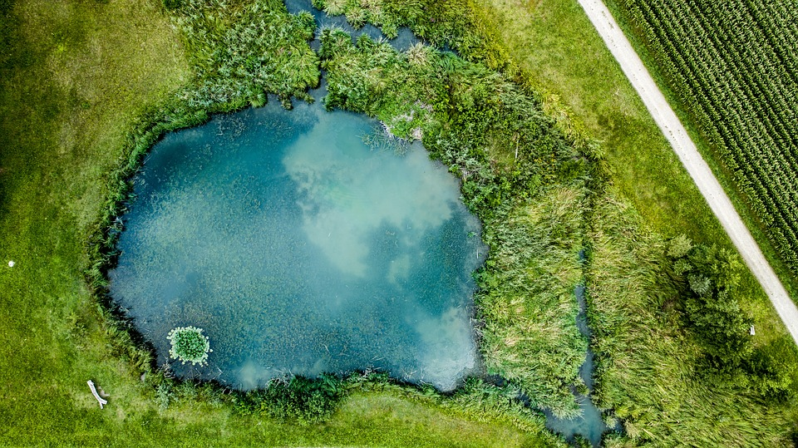
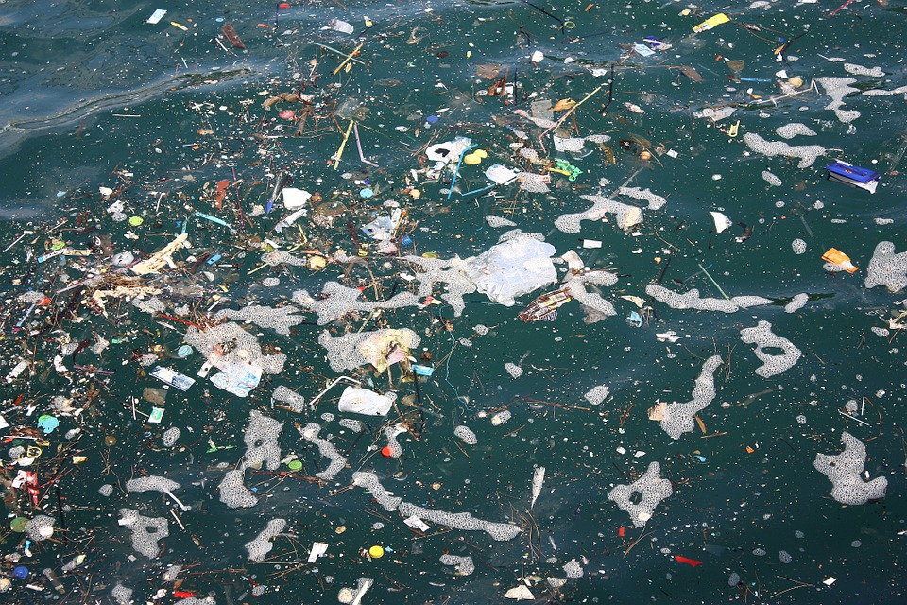
Read the text about the different ways bodies of water can be polluted. Describe the impact this might have on plants, animals and humans.
Rivers & Factory Waste
Rivers are used to dispose of factory chemical waste. The chemicals dissolve easily in the river water and travel wherever the water does.
Factory chemicals can poison wildlife and cause bleaching and acidification.
Lakes & Algal Bloom
Lakes can become contaminated with chemicals from nearby farms. These chemicals can encourage algae to grow very quickly, known as an algal bloom.
The algae will consume all the oxygen in the lake and produce toxic waste chemicals.
Oceans & Litter Islands
The oceans are full of litter. Litter often ends up in water systems and washes out to ocean. Litter is also transported all over the globe in large shipping containers. During transport, it often falls into the ocean.
Ocean litter can build up into large islands which dominate ecosystems. Animals often confuse the litter islands for food.

Slide 2
Describe how pollution in rivers, lakes and the oceans affects nearby plants, animals and humans.
Rivers | plants
 | animals
 | humans
Lakes | Plants
 | animals
 | humans
Oceans | plants
 | animals
 | humans

