Slide 1


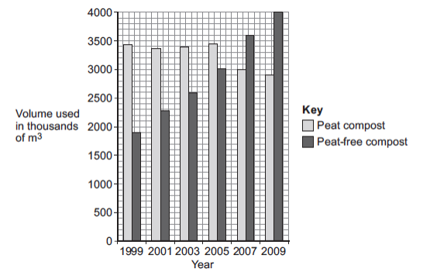
Mission Assignment: Explore land use
Code: KS4_07_17
Investigate the growth of plants in ‘peat free’ and peat-based composts using the data presented in graphs and answer related questions
Task 1: Human activities have many effects on our ecosystem. The graph shows the volume of peat compost and peat-free compost used in gardening from 1999 to 2009.
(A) Describe the trends shown in the graph.
______________________________________________________________________________________________________________________________________________________________________________________________________________________________________________________________________________________________________________________________________________________________________________________________________________________________________________________________________________________________________________________________________________________________________________________________
(B) What effect does the destruction of peat bogs have on the gases in the atmosphere?
____________________________________________________________________________________________________________________________________________________________________
(C) Deforestation is also damaging ecosystems. Describe one effect of deforestation on ecosystems.
______________________________________________________________________________________________________________________________________________________________________________________________________________________________________________________________________________________________________________________________________________________________________________________________________________________________________________________________________________________________________________________________________________________________________________________________
Developing Experts Copyright 2022 All Rights Reserved

Slide 2
Mission Assignment: Explore land use
Code: KS4_07_17
Task 2: .In many areas of the world the mass of household waste produced each year is increasing.
(A) Give two reasons why the mass of household waste is increasing each year.
1.__________________________________________________________________________________________________________________________________________________________________2.__________________________________________________________________________________________________________________________________________________________________
(B) The table below shows how the mass of household waste in the UK has changed from 2004 to 2012
Year | Total mass of household waste in thousands of tonnes (including total household recycling) | Total mass of household recycling in thousands of tonnes | Percentage of household waste recycled
2004 | 25 658 | 5785 | 22.5
2006 | 25 775 | 7976 | 30.9
2008 | 24 334 | 9398 | 38.6
2010 | 23 454 | 9733
2012 | 22 643 | 9782 | 43.2
(i) Calculate the percentage of household waste recycled in 2010.
____________________________________________________________________________________________________________________________________________________________________
(ii) The UK government has been encouraging a ‘zero waste economy’. In a ‘zero waste economy’, we reduce, reuse and recycle as much waste as possible. A newspaper concluded that: ‘The government’s ‘zero waste economy’ has been successful.’ Use information from the table to describe the reasons for and against the newspaper’s conclusion.
________________________________________________________________________________________________________________________________________________________________________________________________________________________________________________________________________________________________________________________________________________________________________________________________________________________________________________________________________________________________________________________________________________________________________________________________________________________________________________________________________________________________________________________________________________________________________________________________________________________________________________________________________________________________________________________________________________________________________________________________________________________
Developing Experts Copyright 2022 All Rights Reserved

