Slide 1
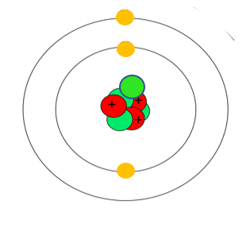
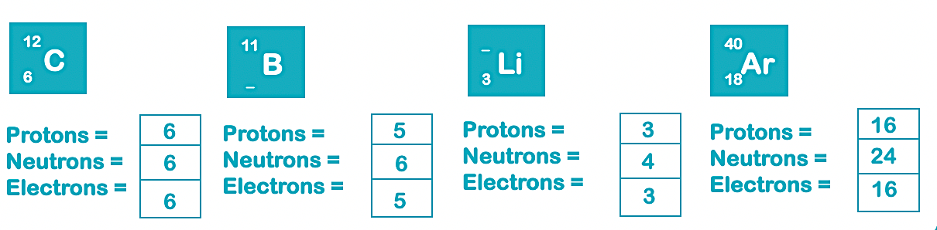
Teacher answers
a) Protons and neutrons in nucleus
b)
i) the number of protons
ii) The number of electrons, because the positive and negative charges are the same.
i) Lithium 6 isotope: P =3, E =3, N = 3
Lithum 7 isotope: P= 3, N =E = 3, N =4
Lithium 8 isotope: P = 3, N= 5, E = 3
ii) They have the same number of protons and electrons
iii) They have different numbers of neutrons

Slide 2
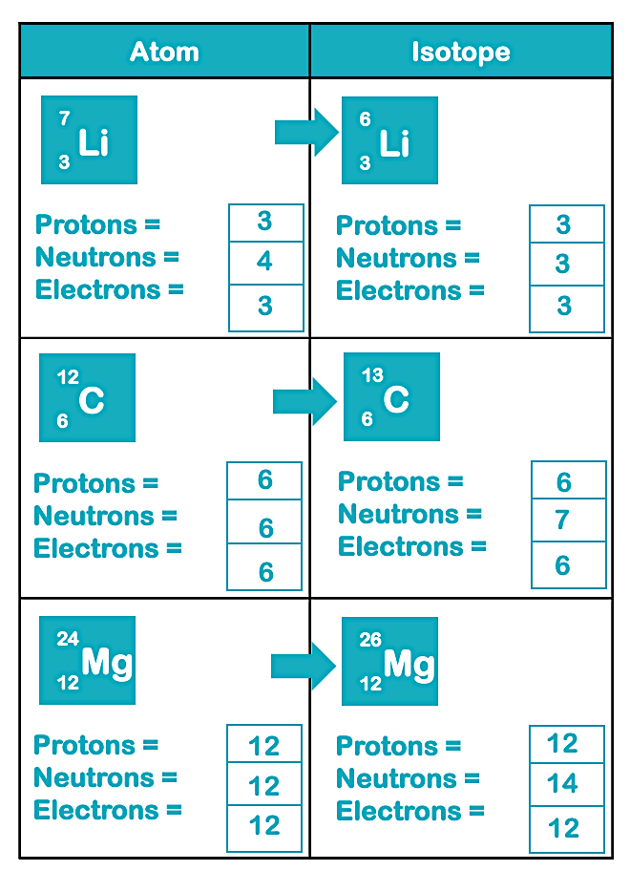
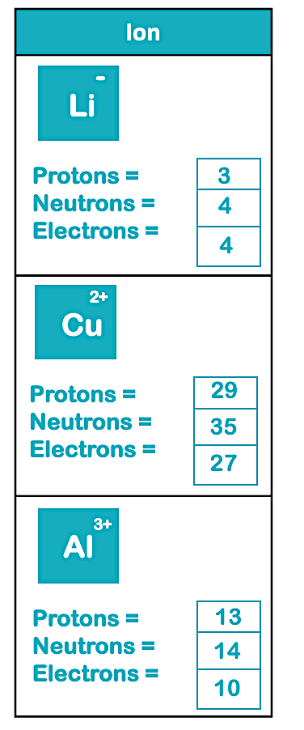

Teacher answers
Complete the table
Complete the table
2

