Slide 1


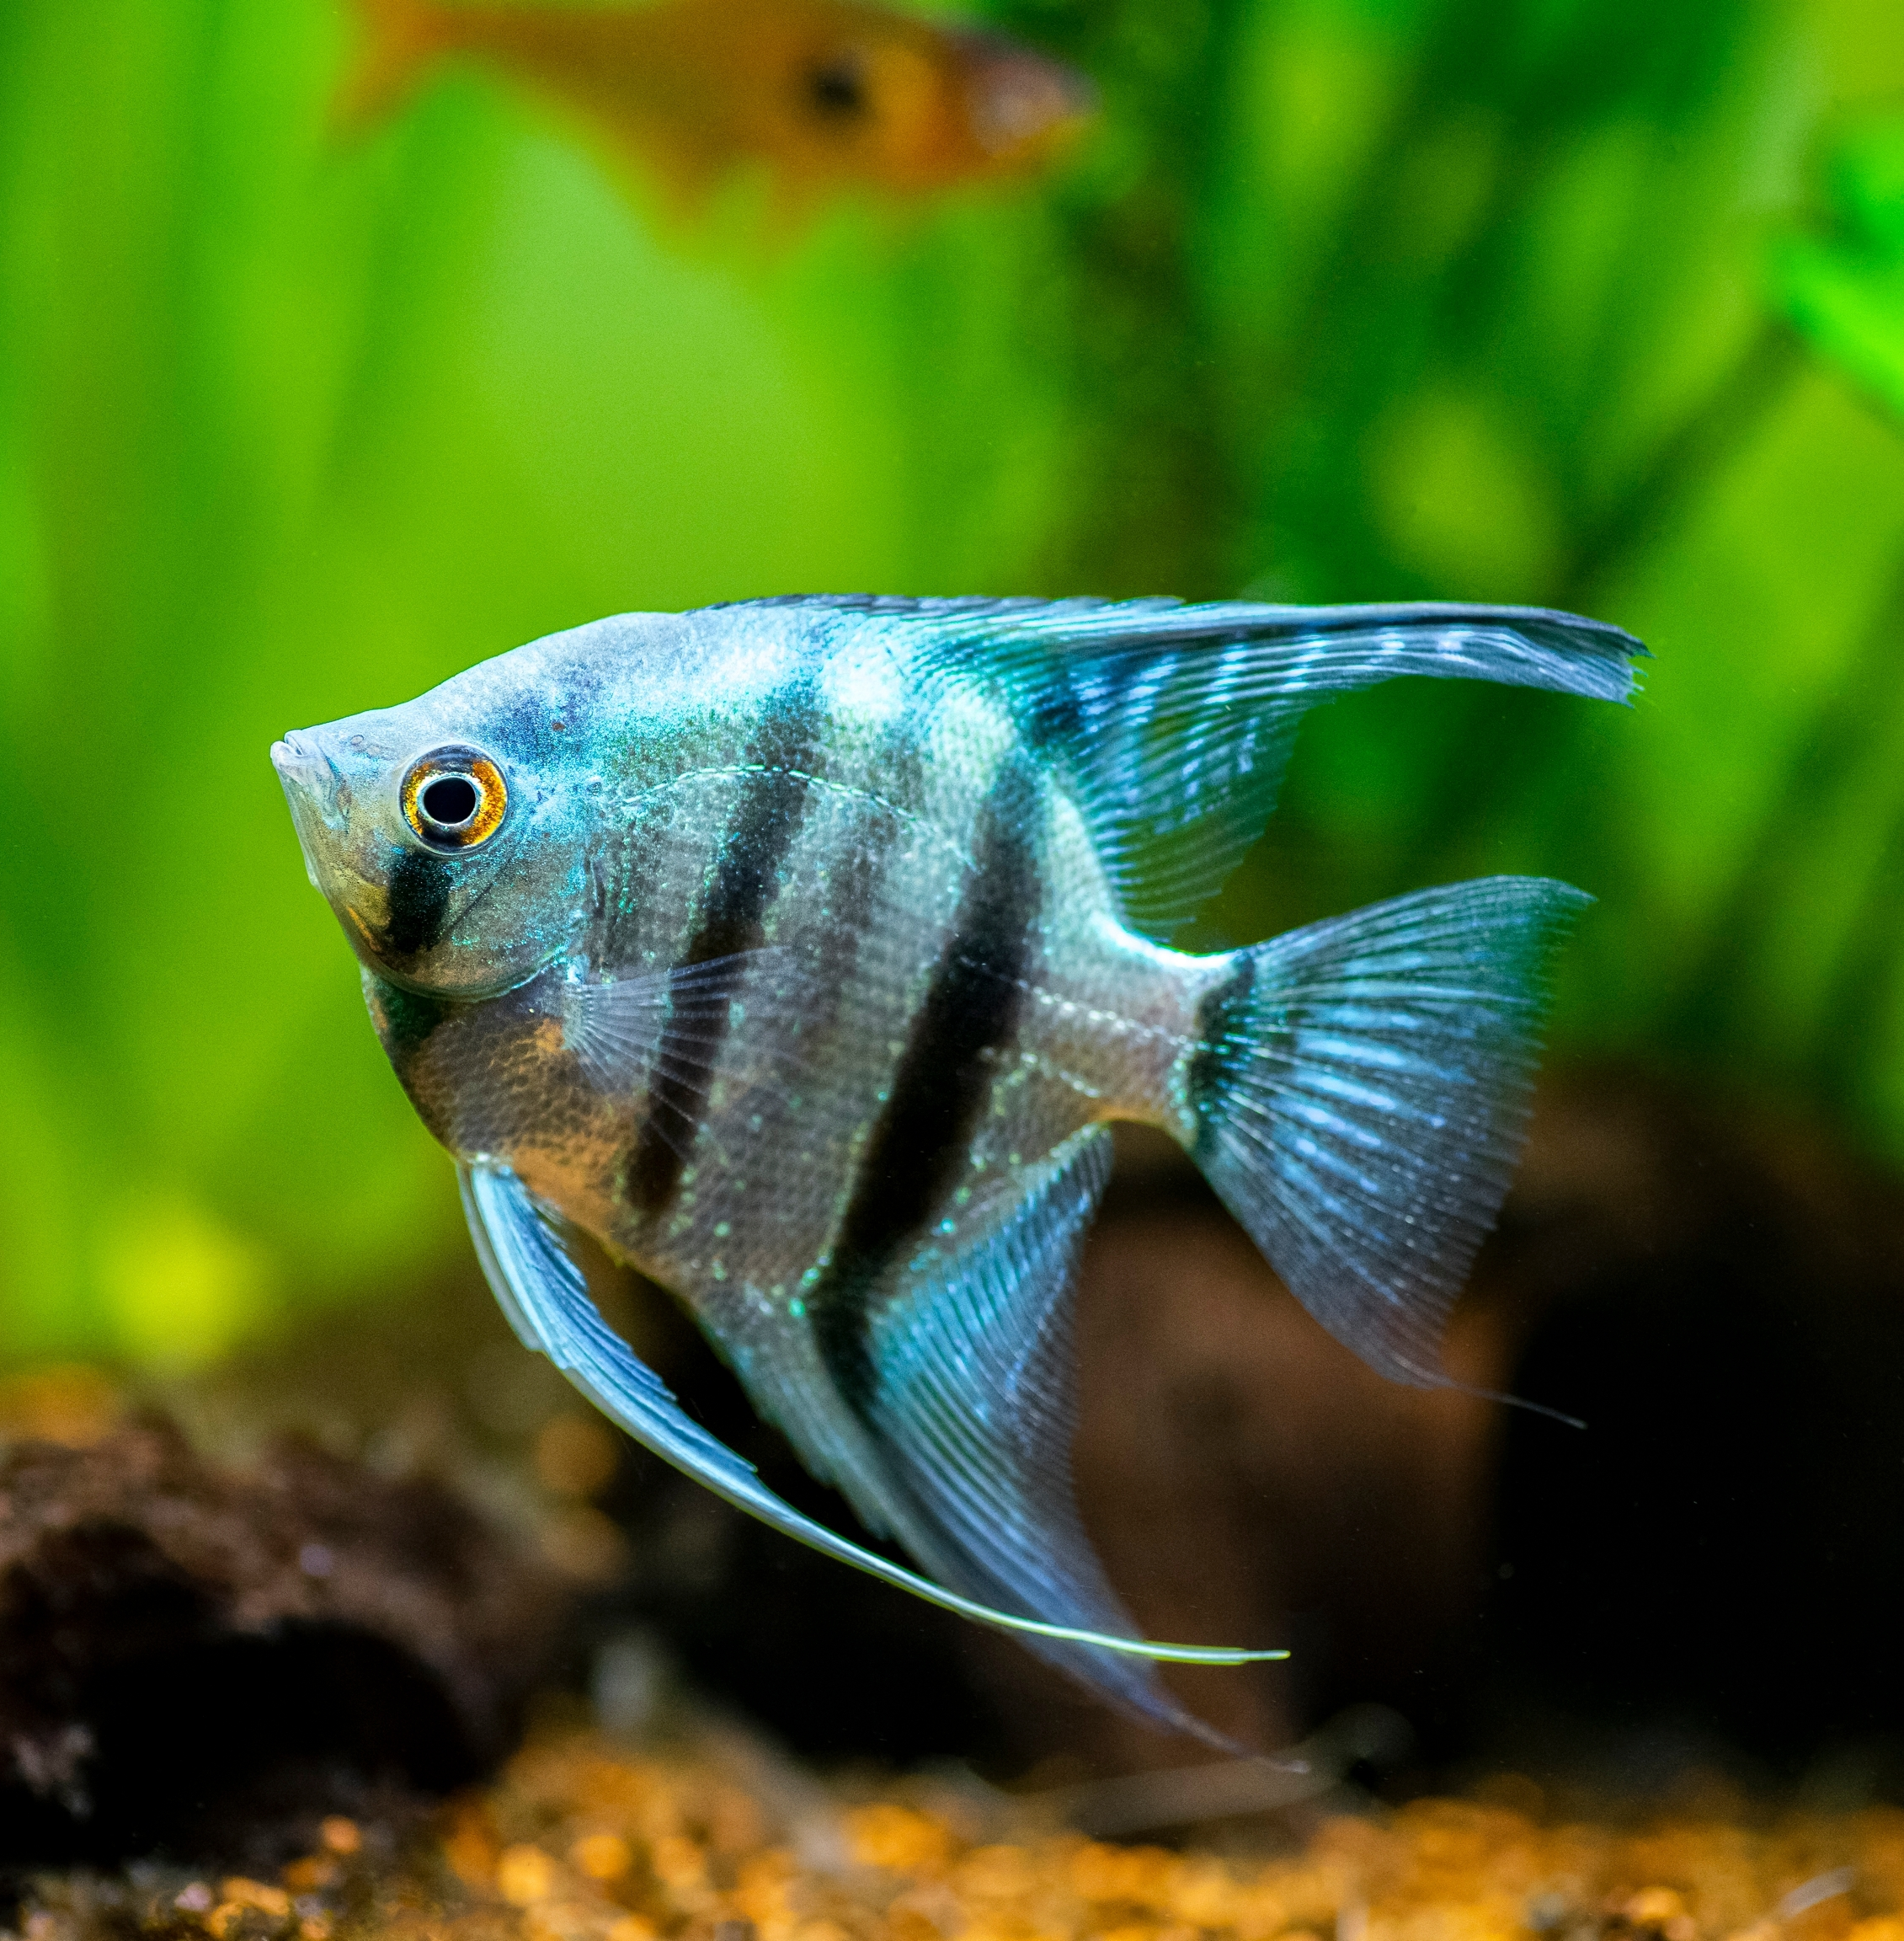
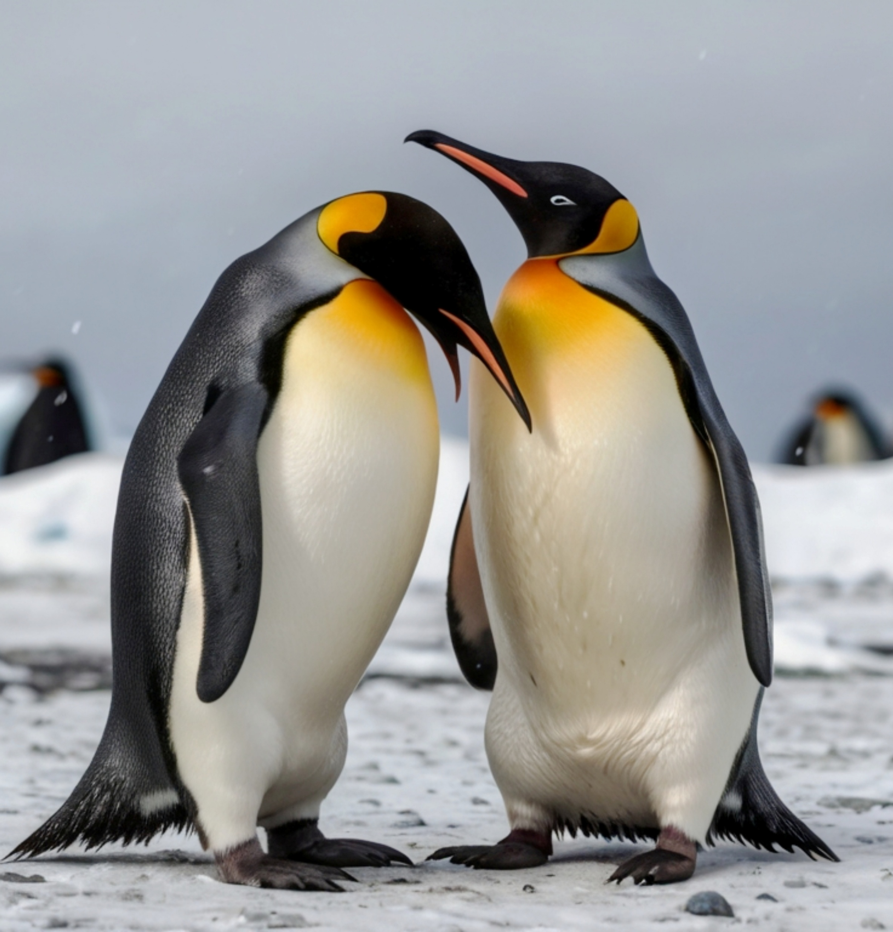
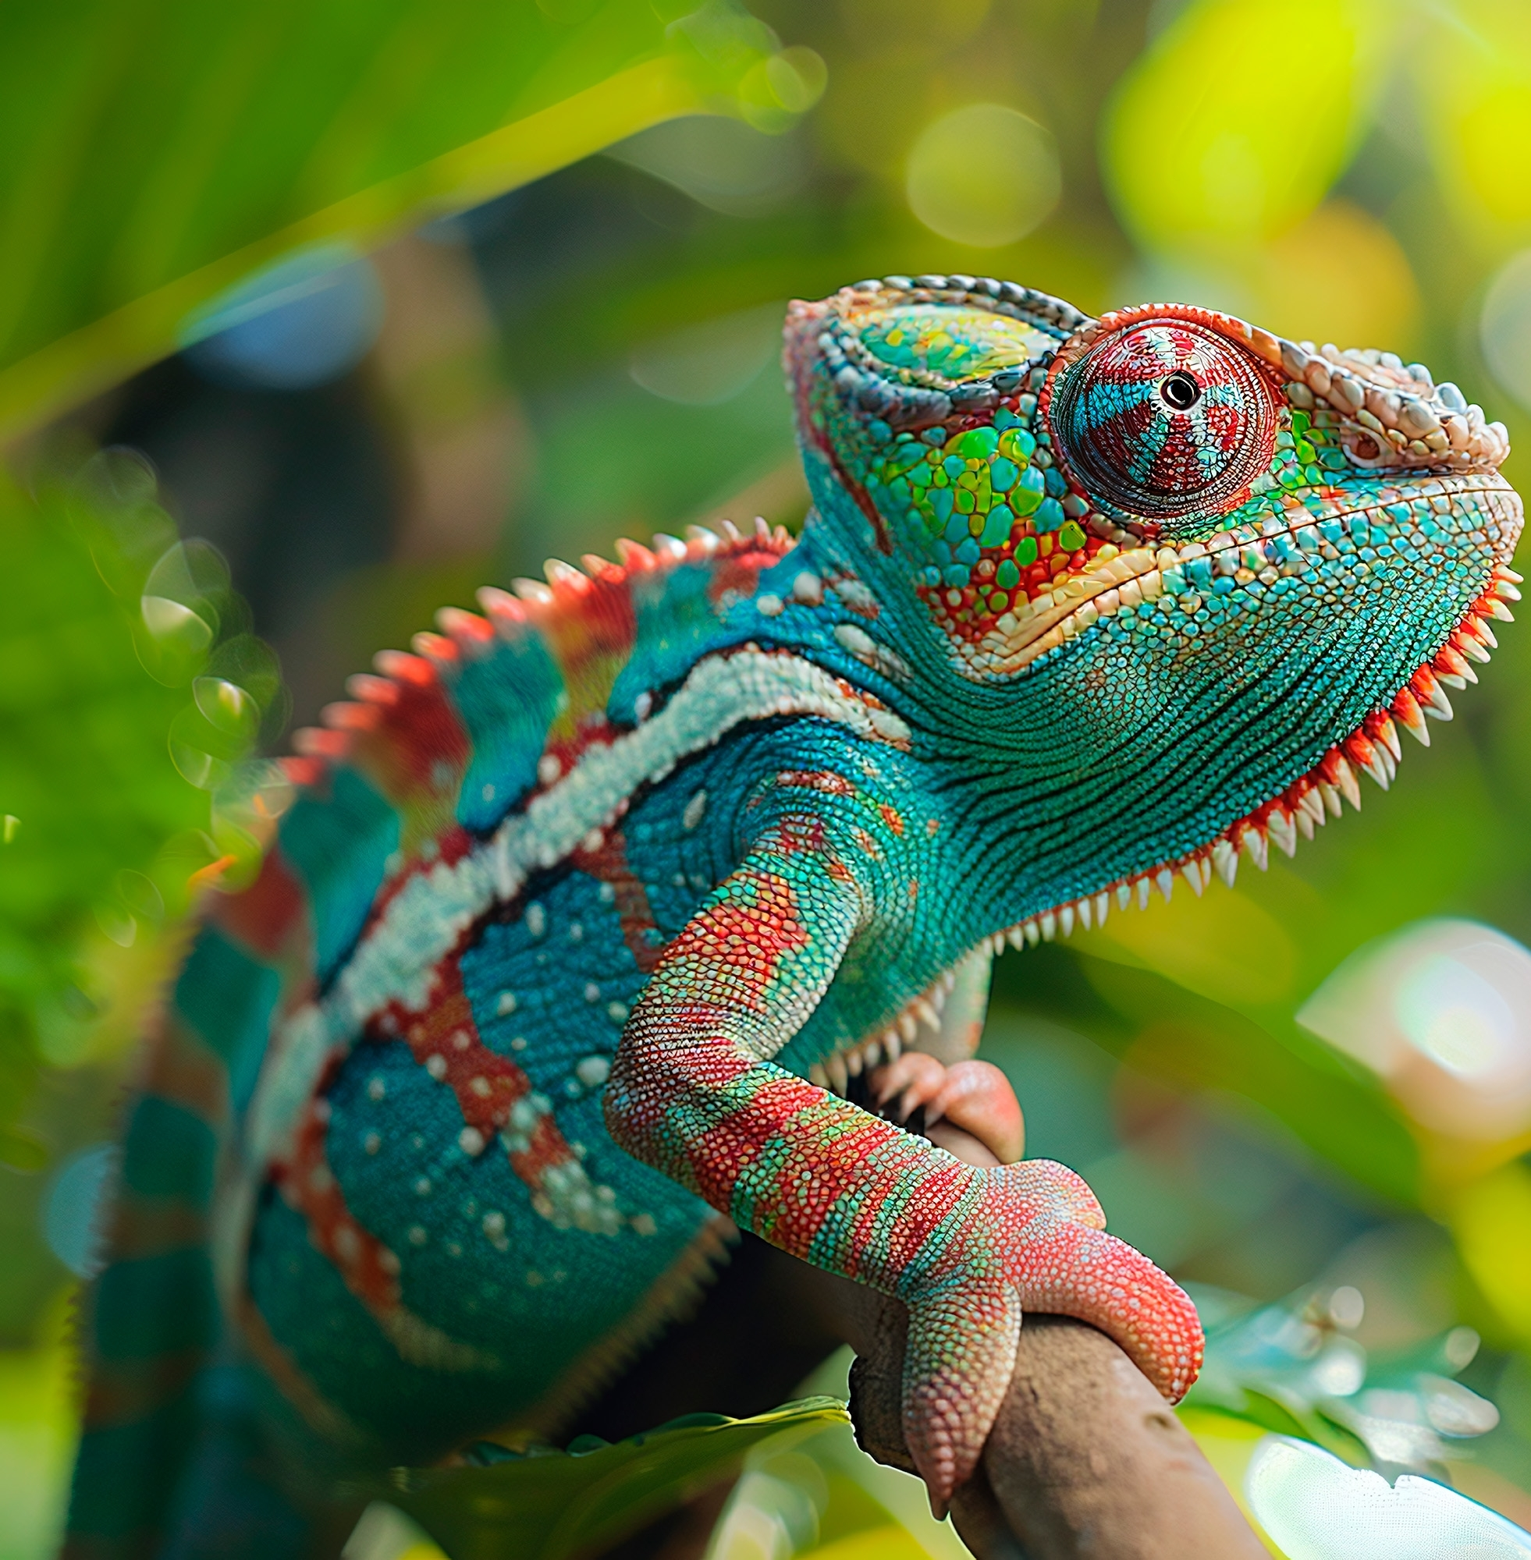
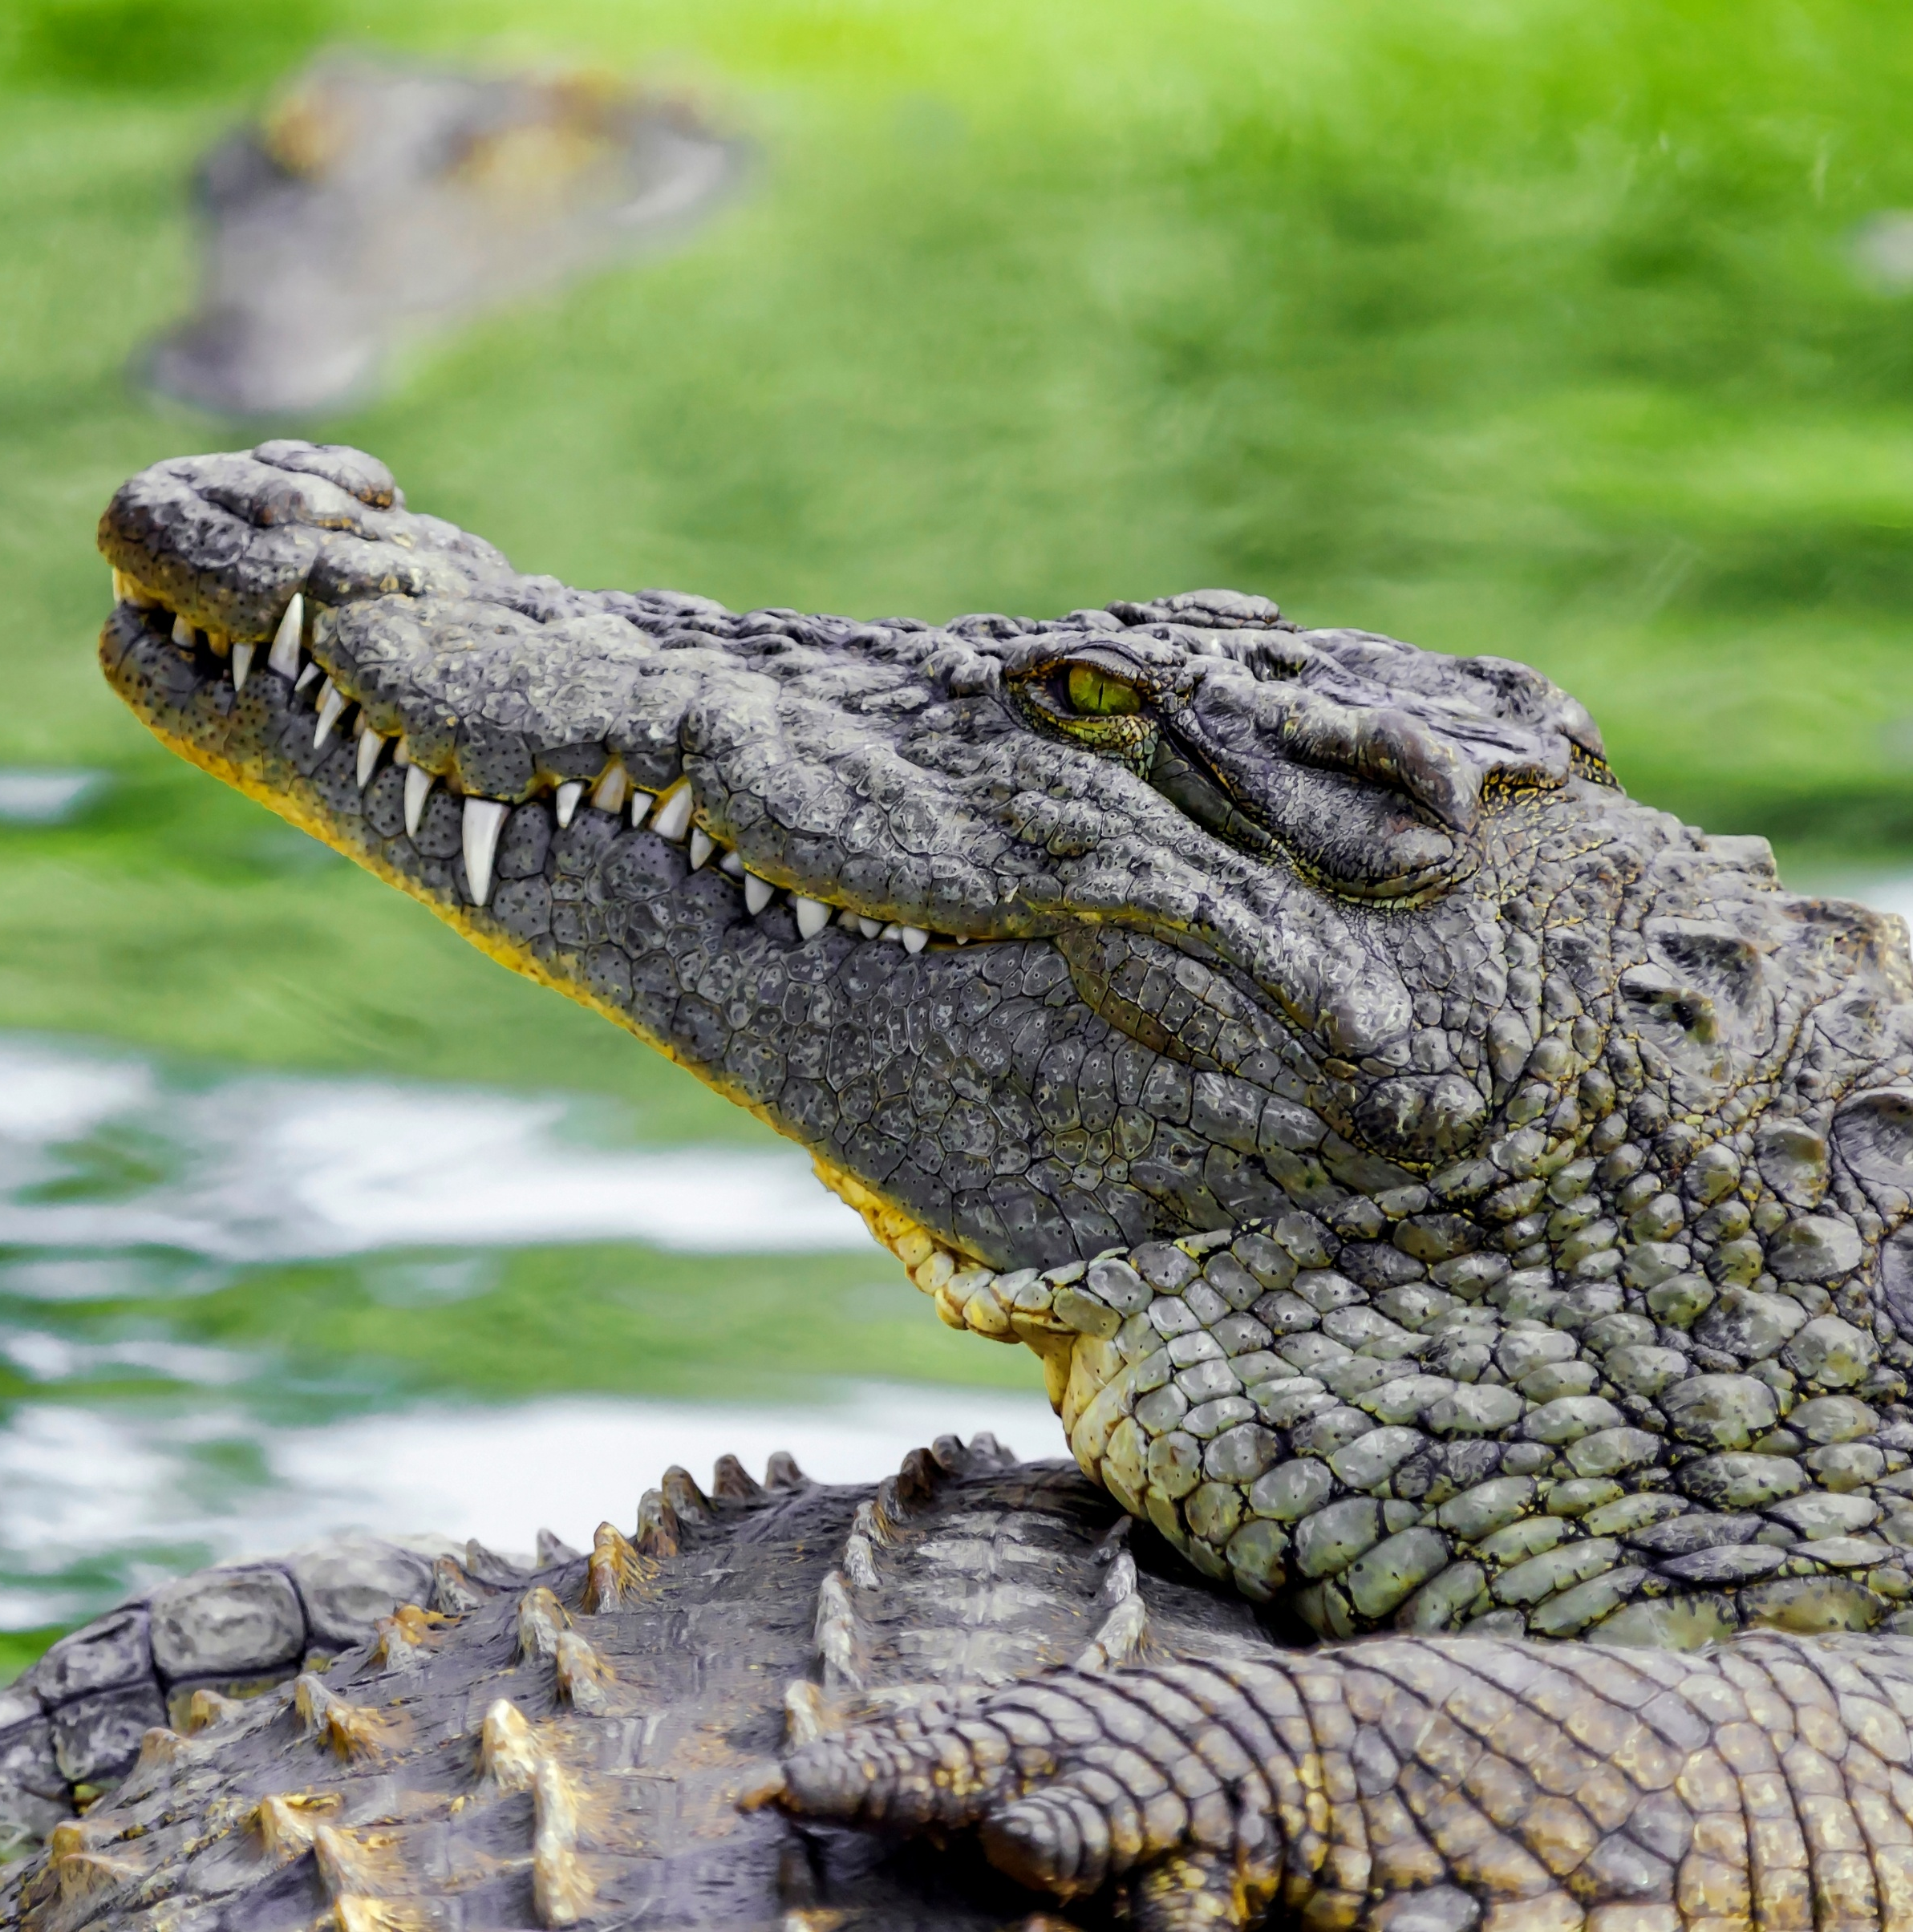
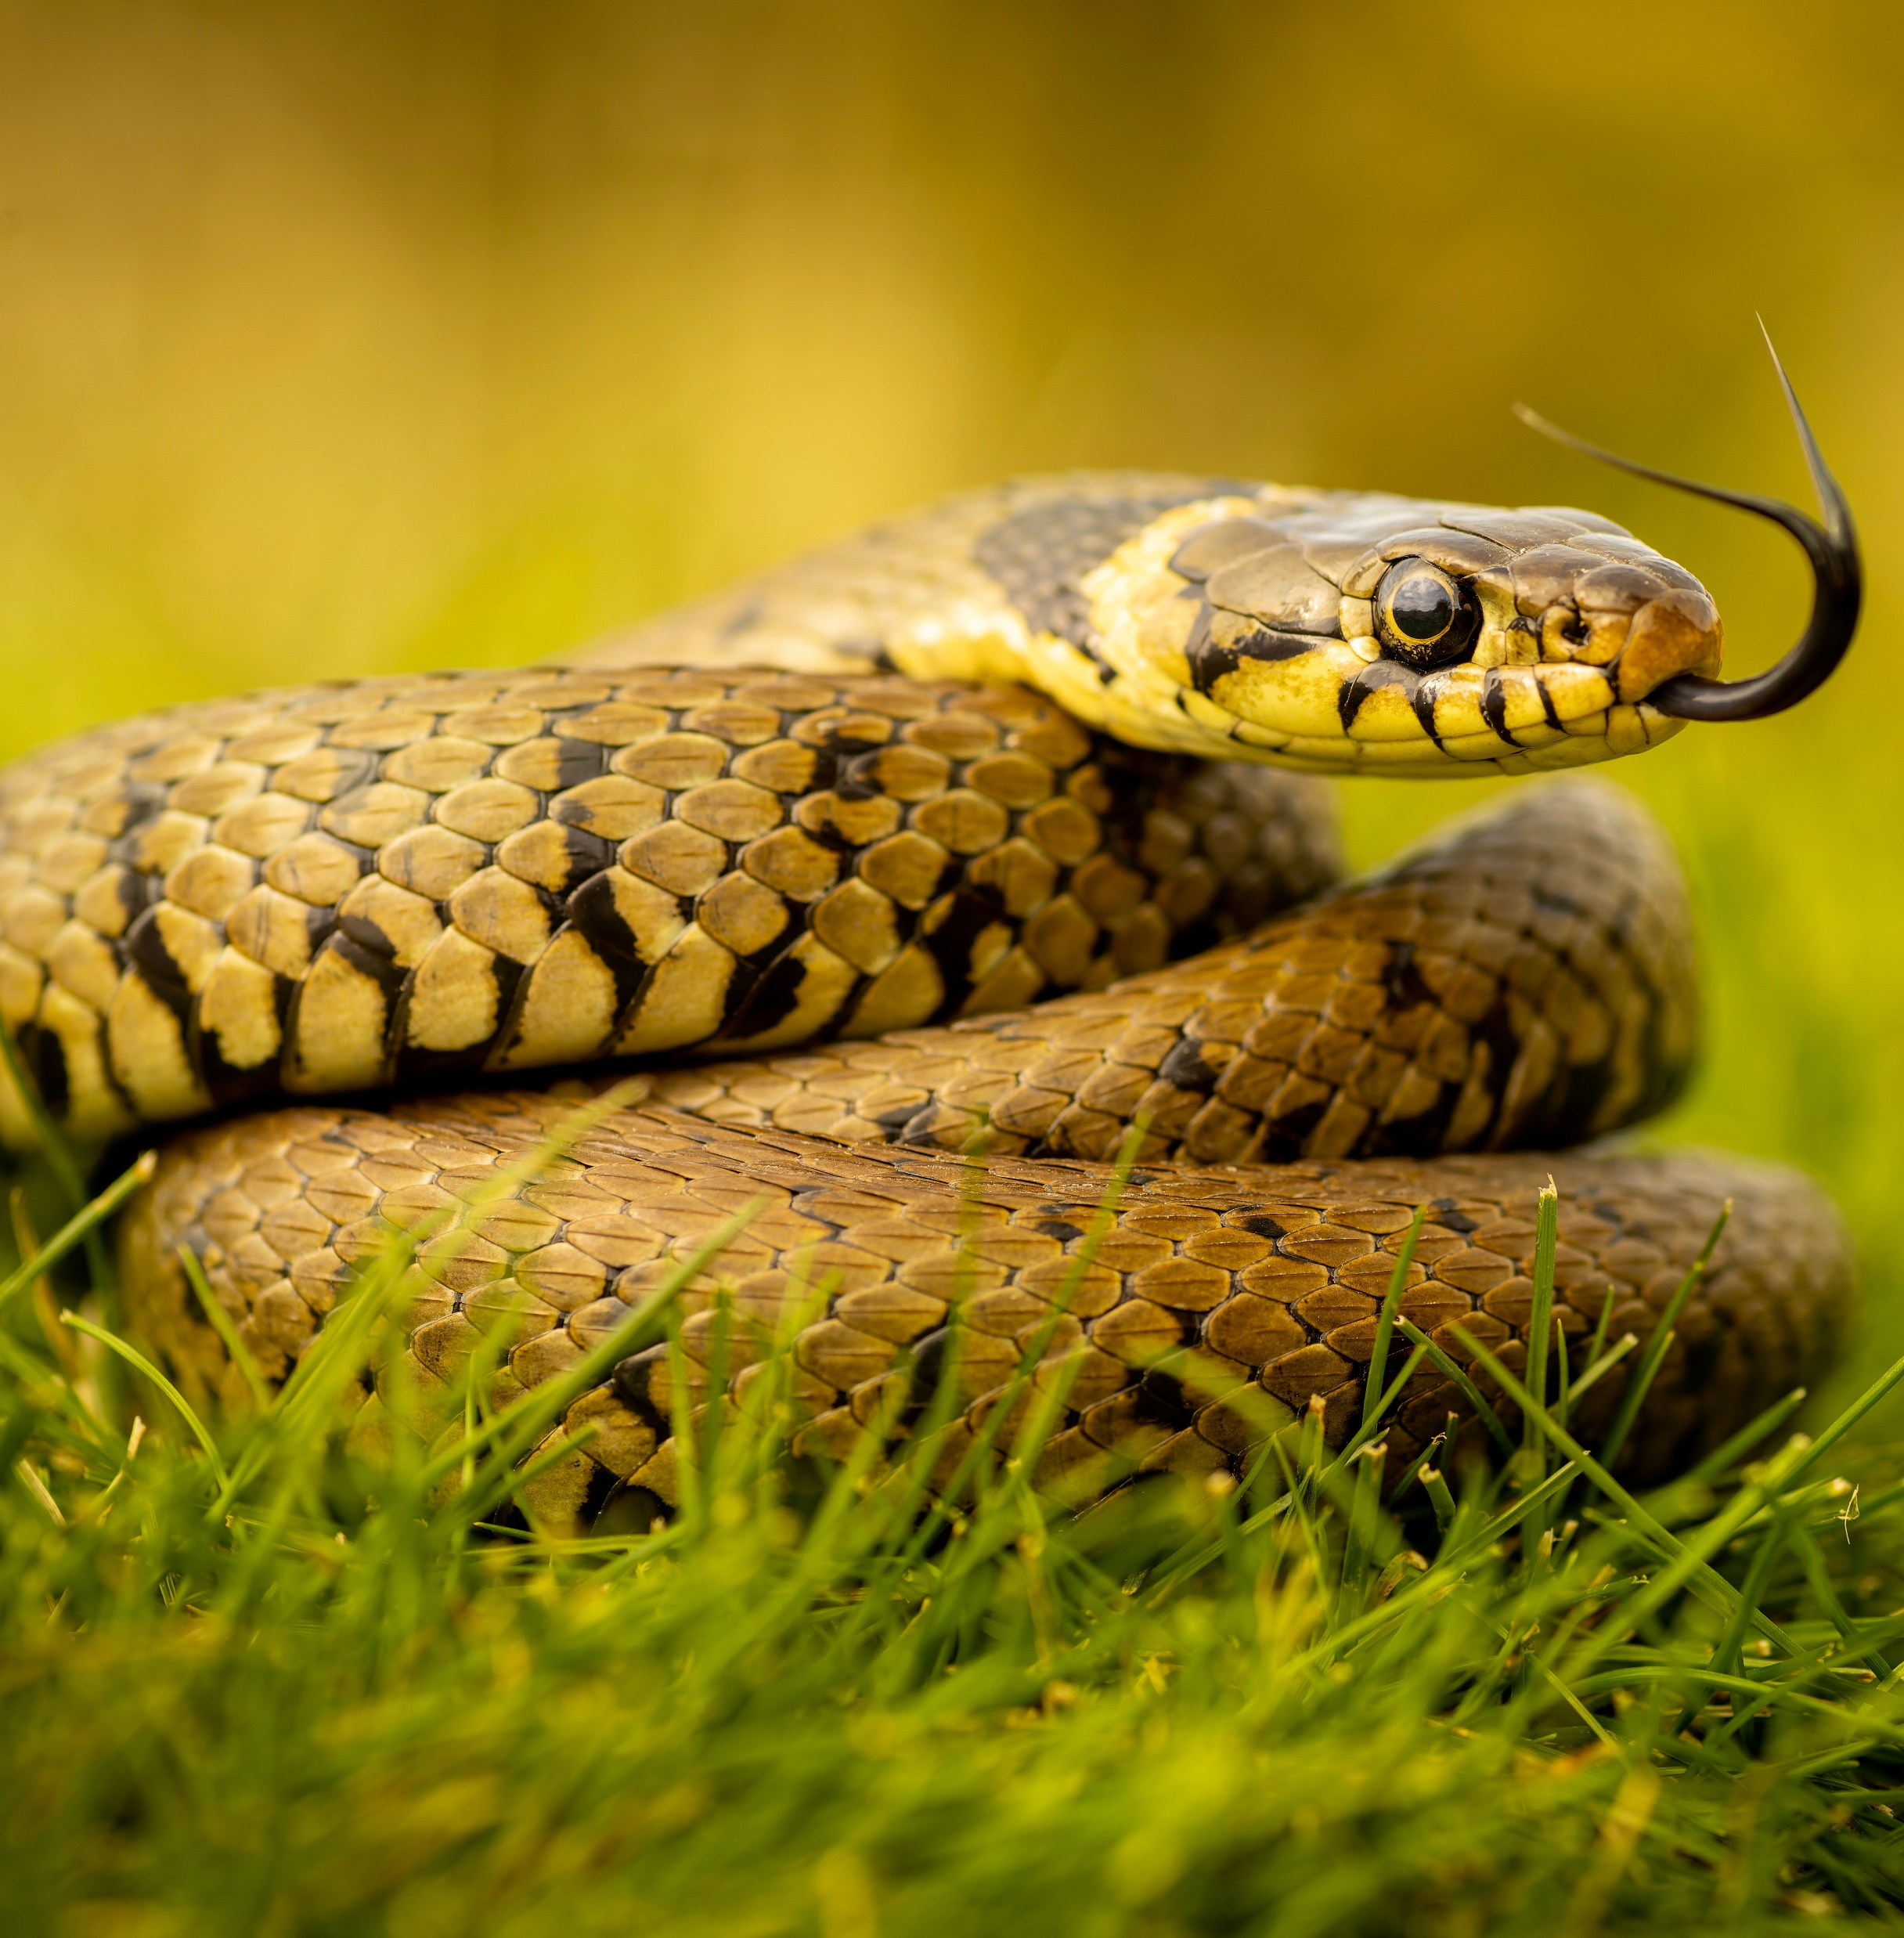
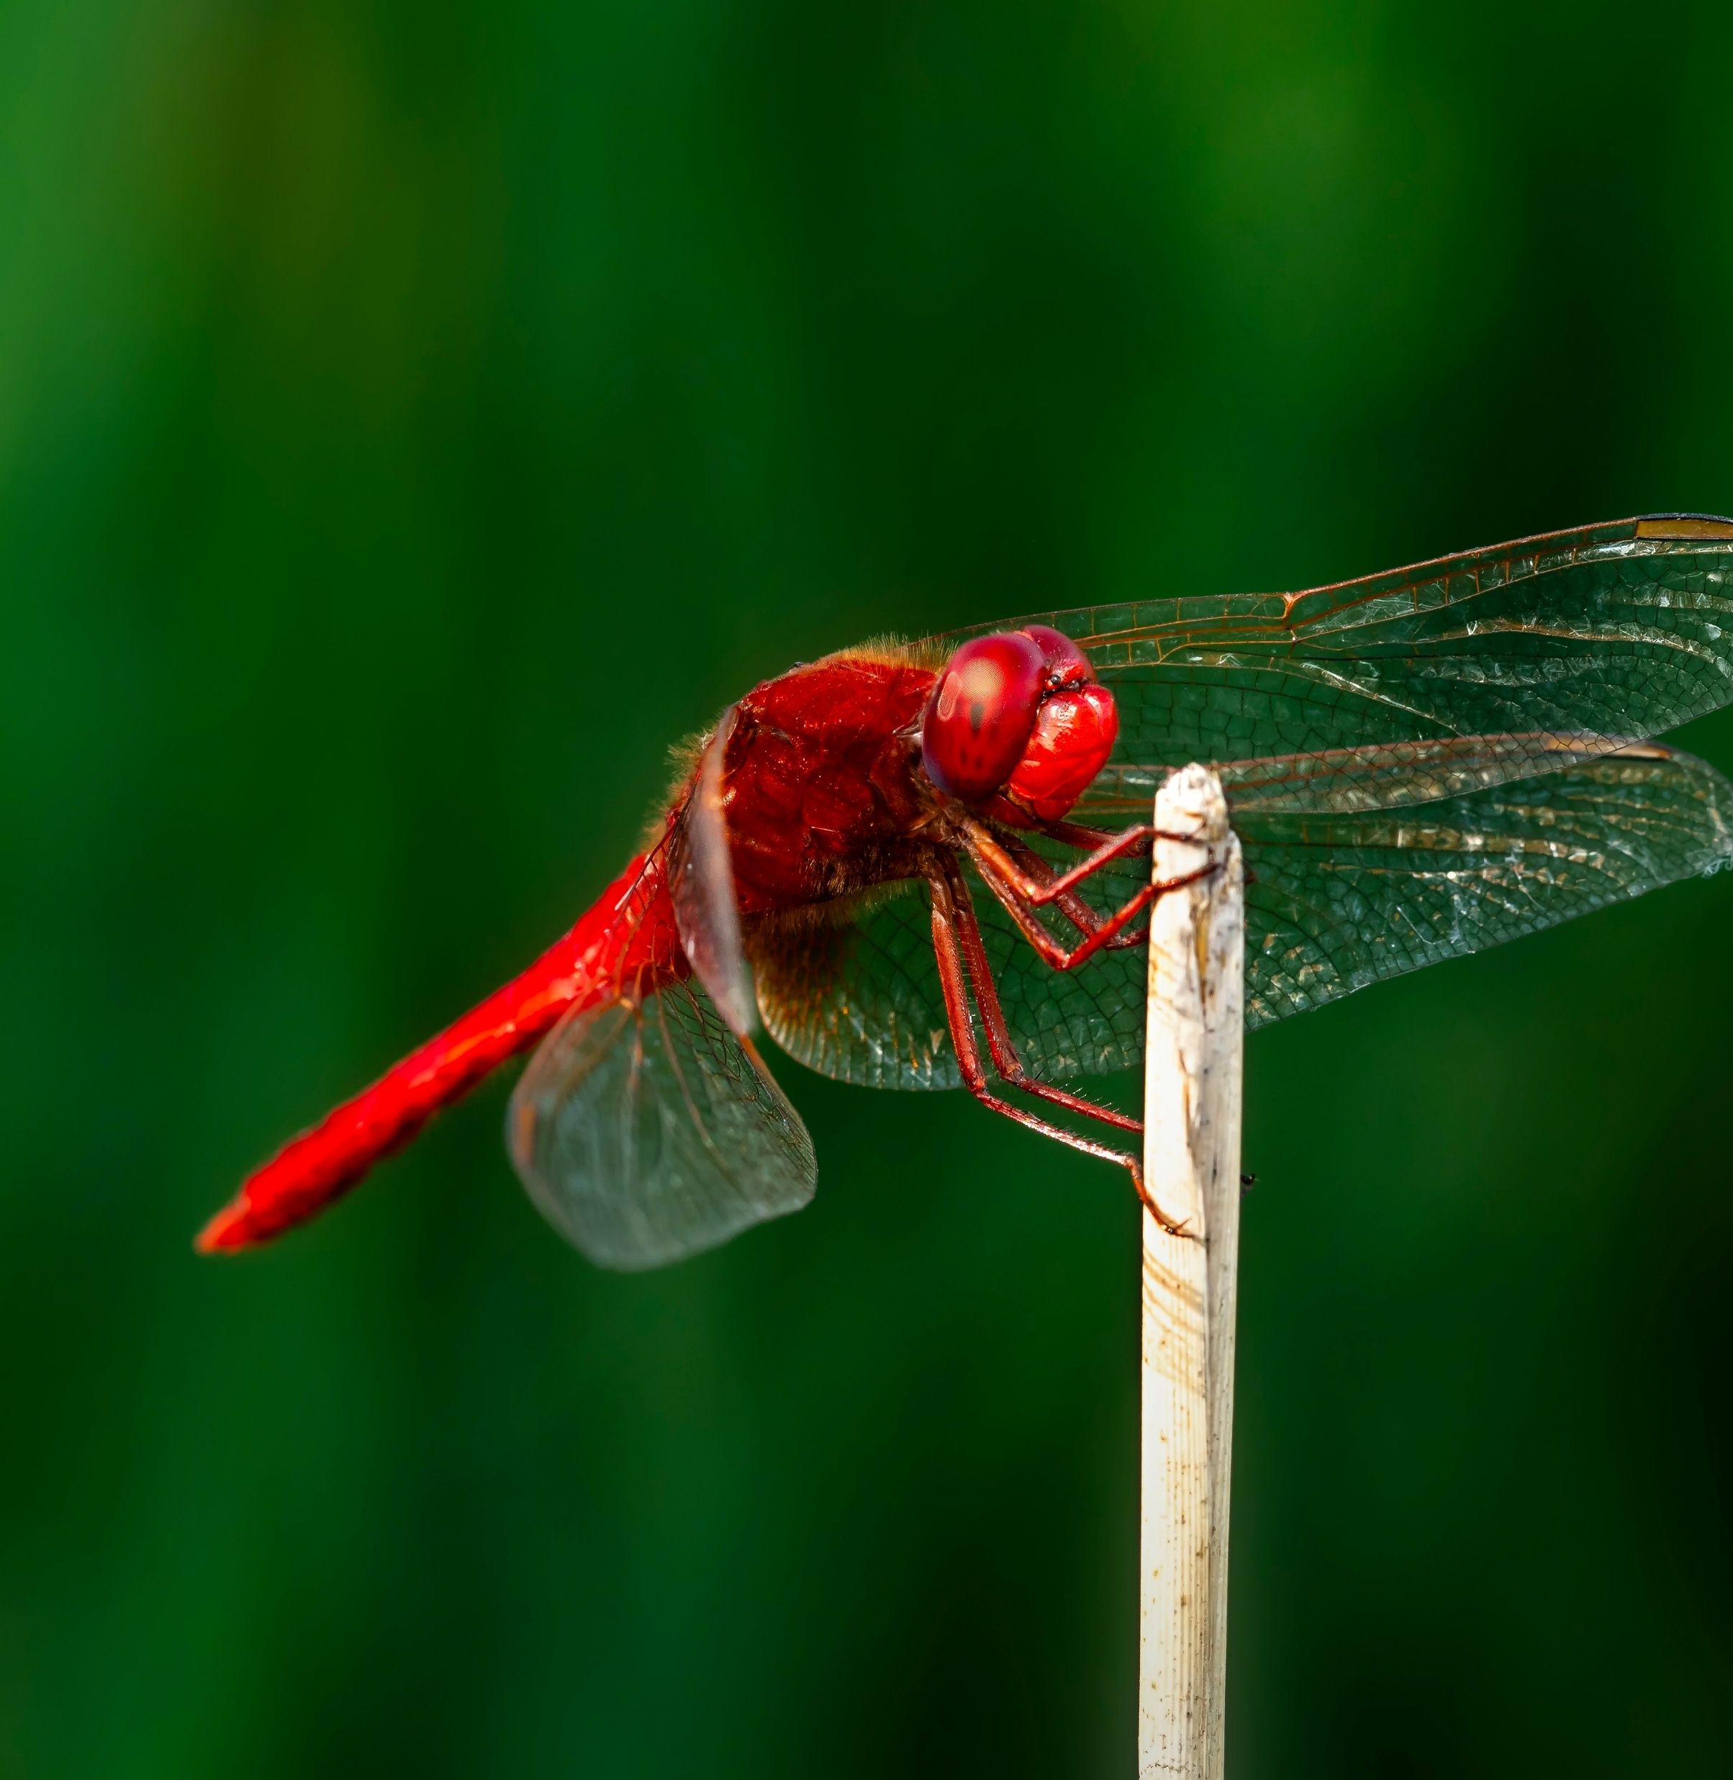
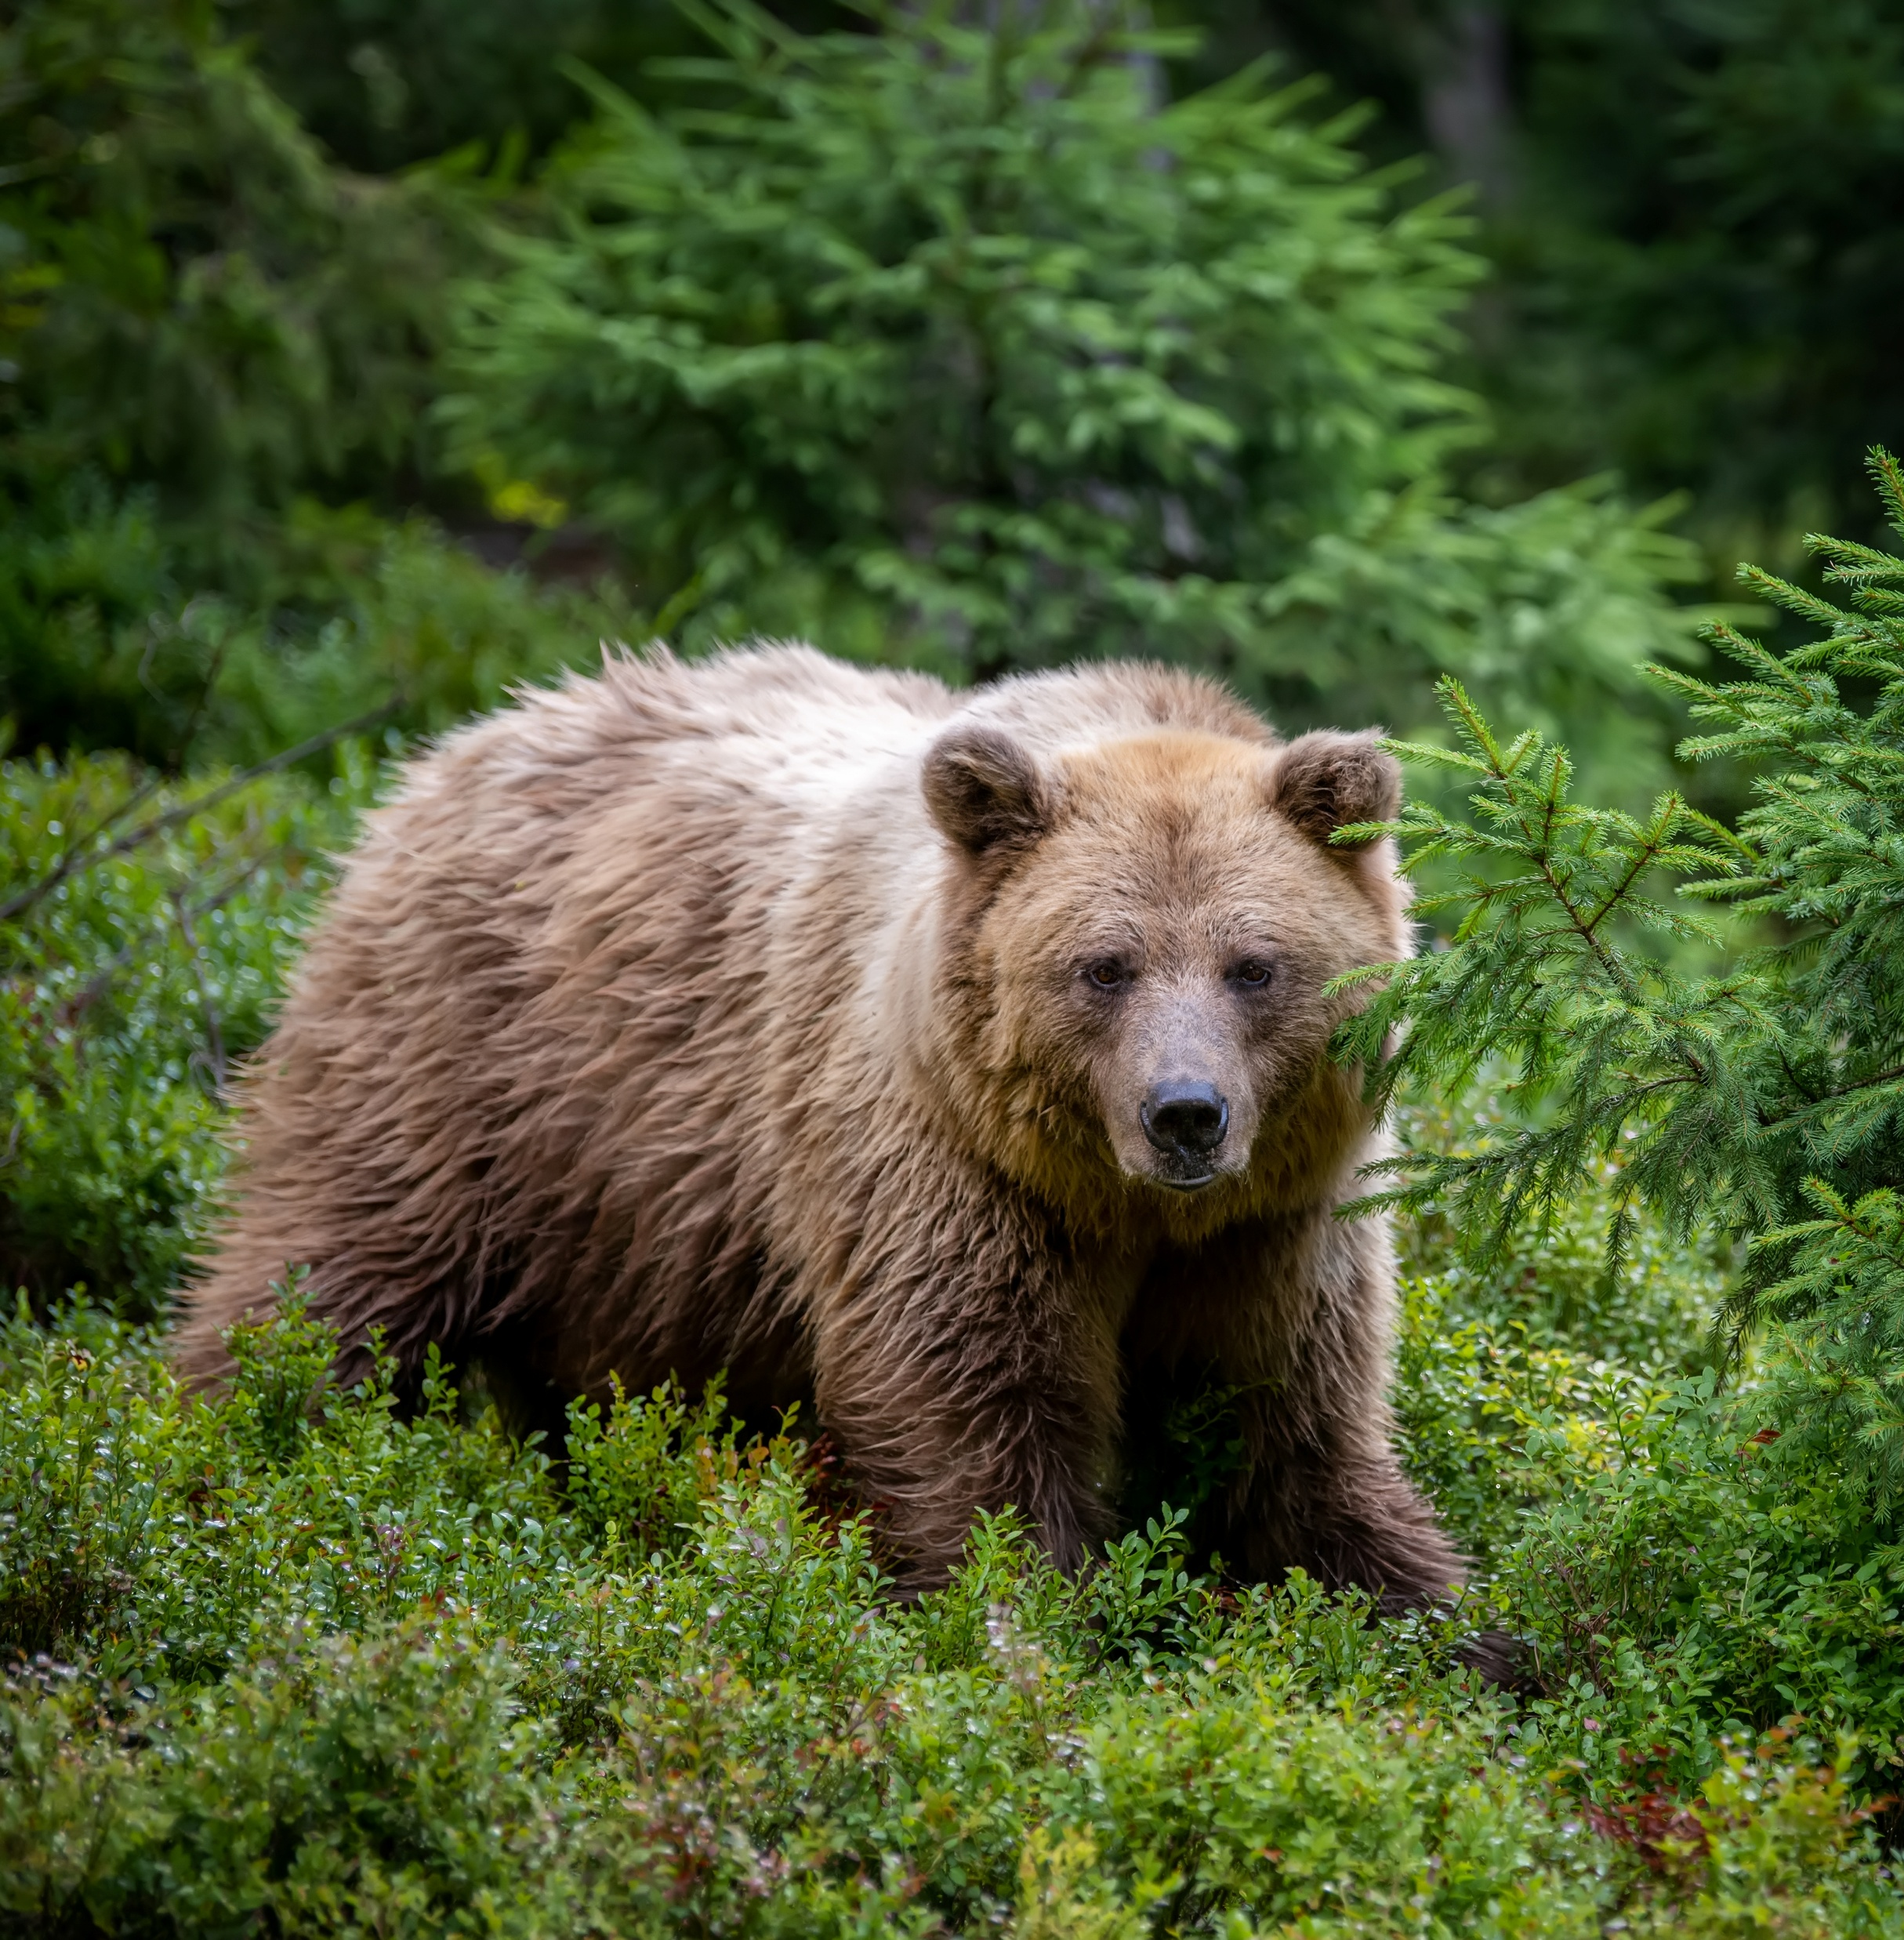
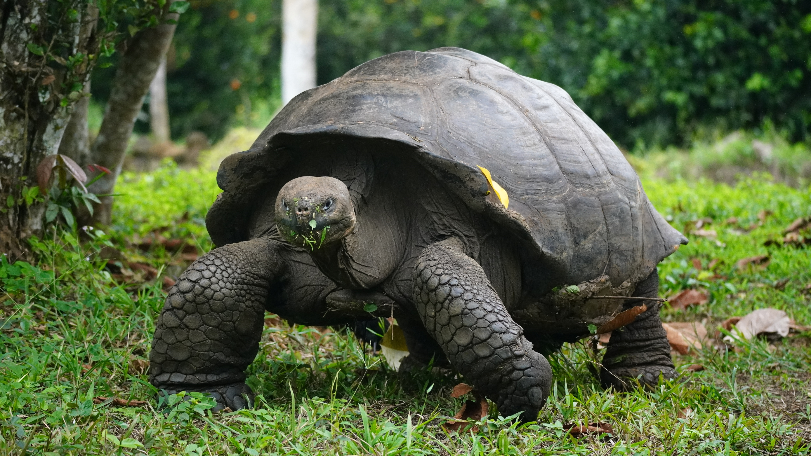
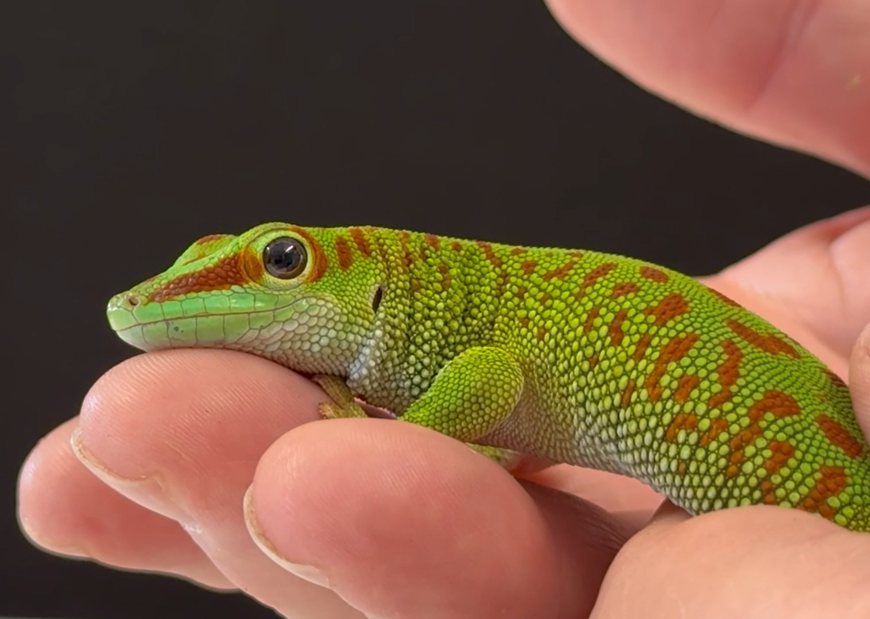
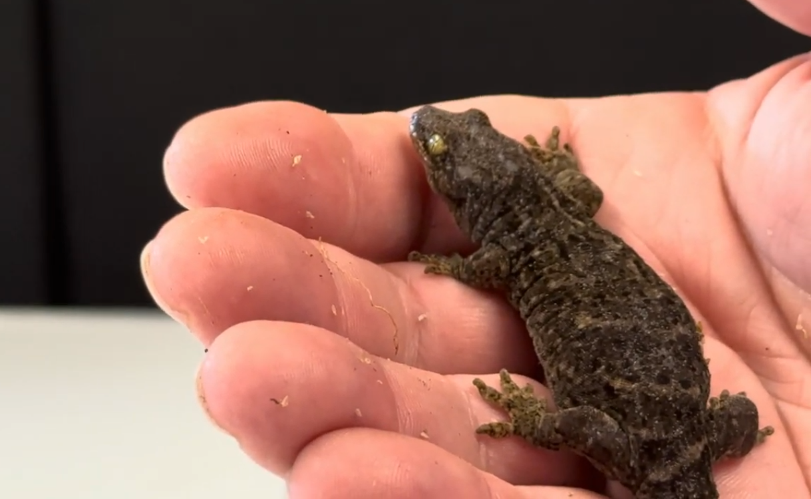
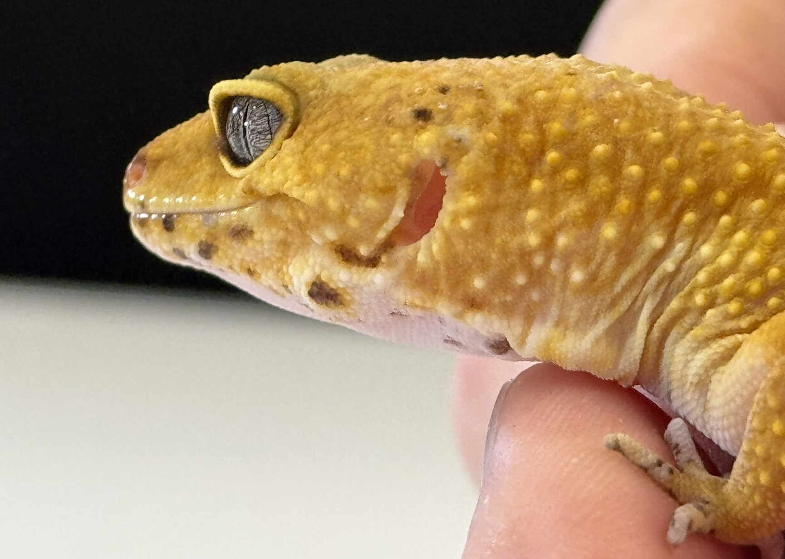
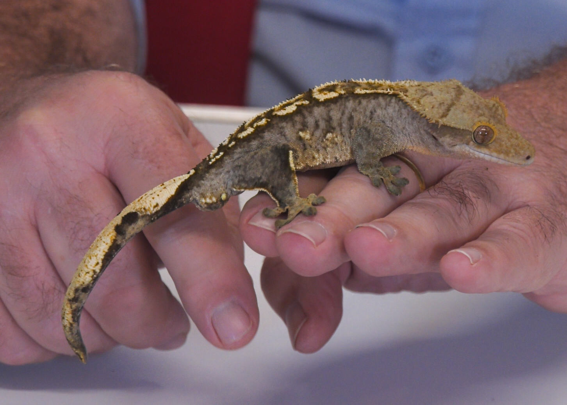
Science Week 2025
Remarkable Reptiles: Their Changes Over Time
KS1 – Teacher Pack and Answers
Session 2
Activity 1: Tick the reptiles. ✓
angelfish
penguins
chameleon
crocodile
✓
✓
snake
dragonfly
brown bear
tortoise
✓
✓
Activity 2: Write the habitat underneath each gecko. ✓
Madagascar day gecko
New Zealand gecko
tropical rainforests
forests
leopard gecko
crested gecko
deserts
tropical rainforests
deserts tropical rainforests forests
1
Developing Experts Copyright 2025 All Rights Reserved

Slide 2
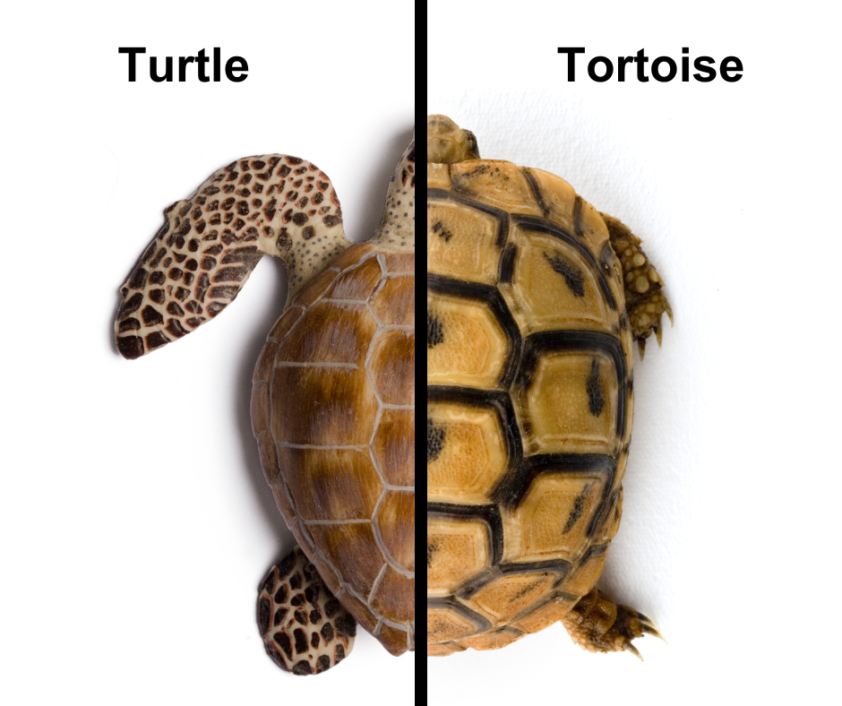
Science Week 2025
Remarkable Reptiles: Their Changes Over Time
KS1 – Teacher Pack and Answers
Session 2
Activity 3: Use the word bank to label the tortoise and turtle. Can you discuss their similarities and differences?
head
leg
flipper
foot
dome-shaped shell
flat shell
claw
tail
Tortoises live on land; turtles live in water and have flippers or webbed feet for swimming. Tortoises have domed, bumpy shells for protection. Turtles have smooth, streamlined shells.
2
Developing Experts Copyright 2025 All Rights Reserved

Slide 3
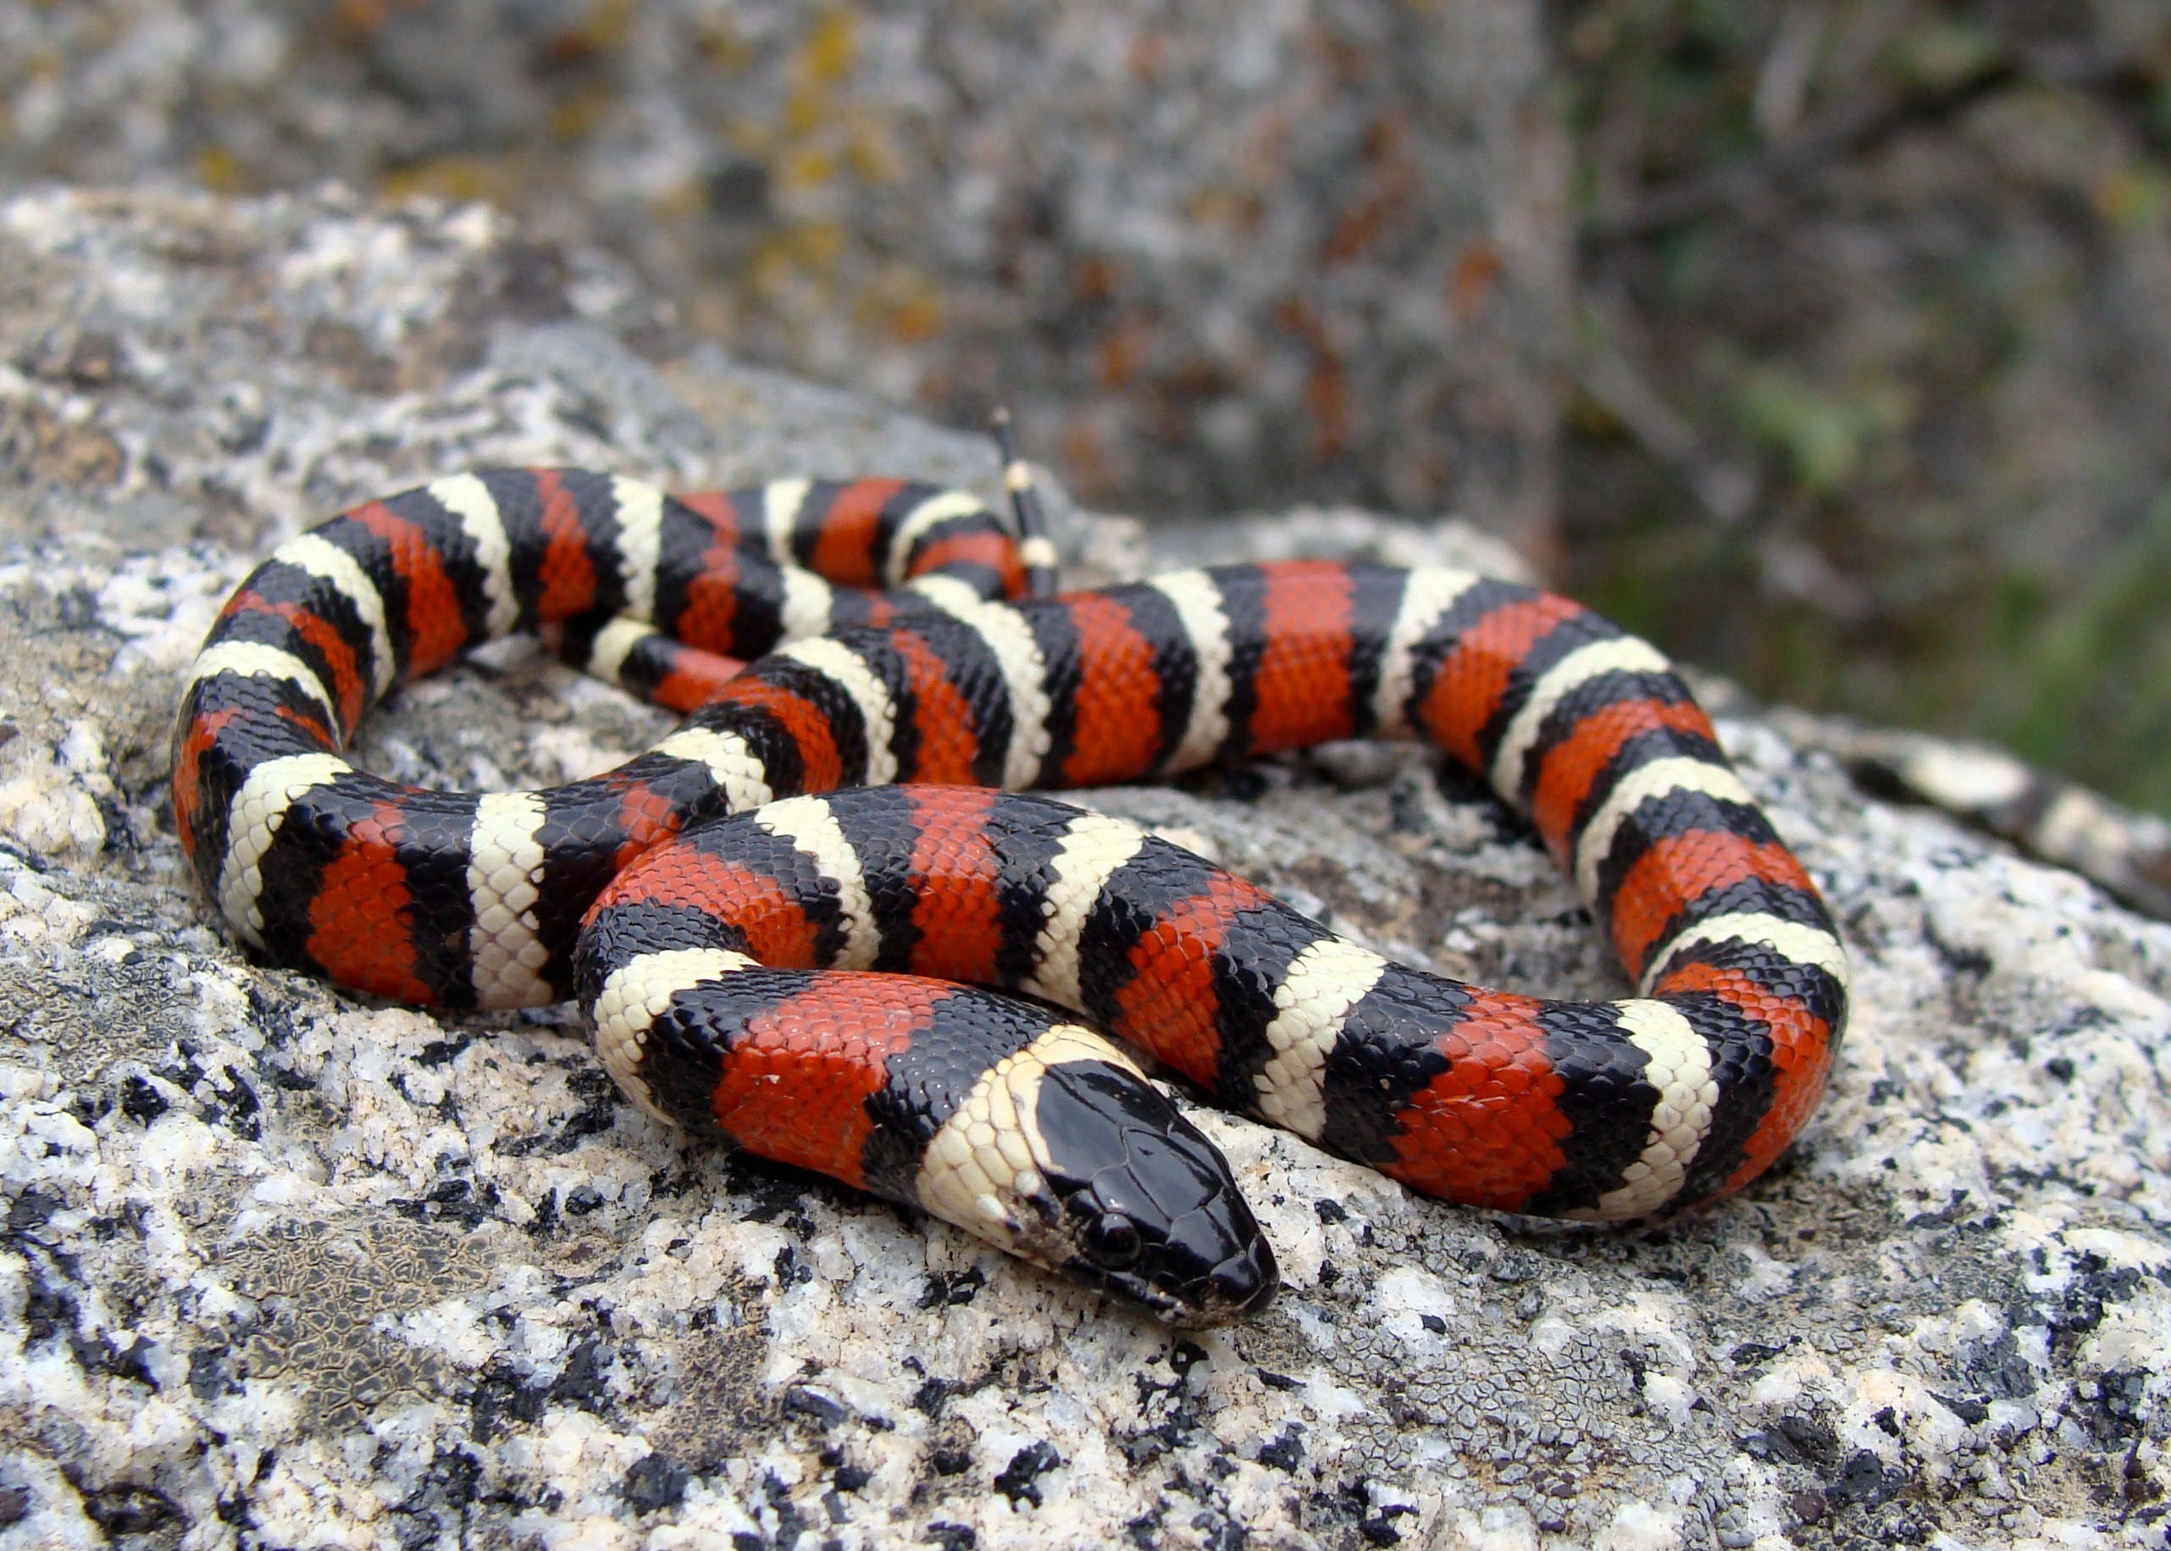
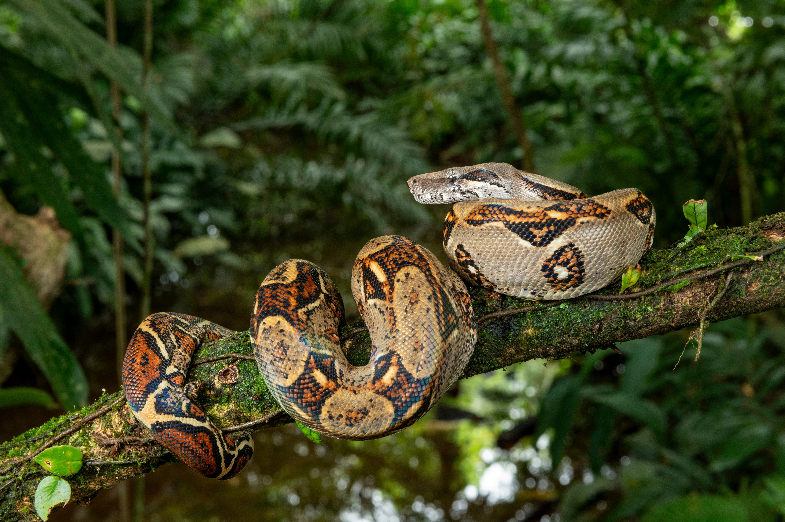
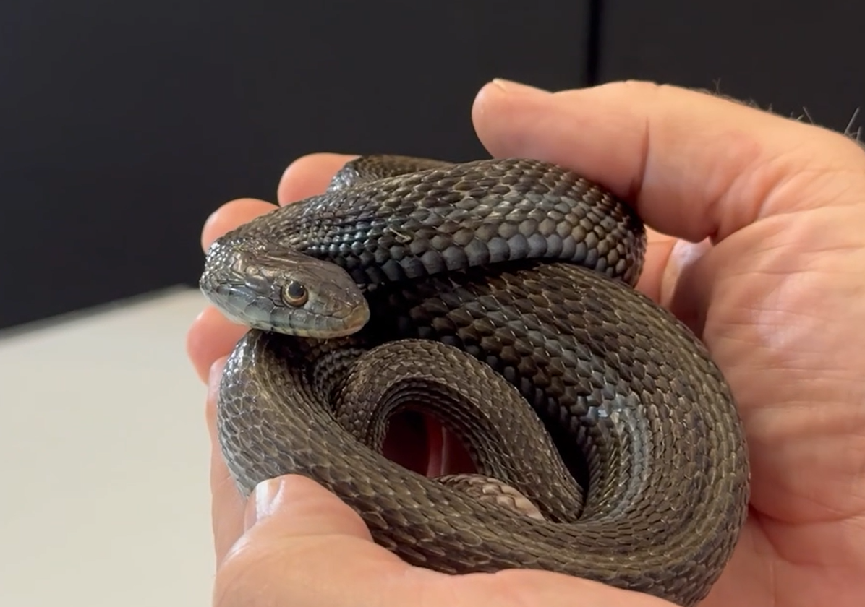
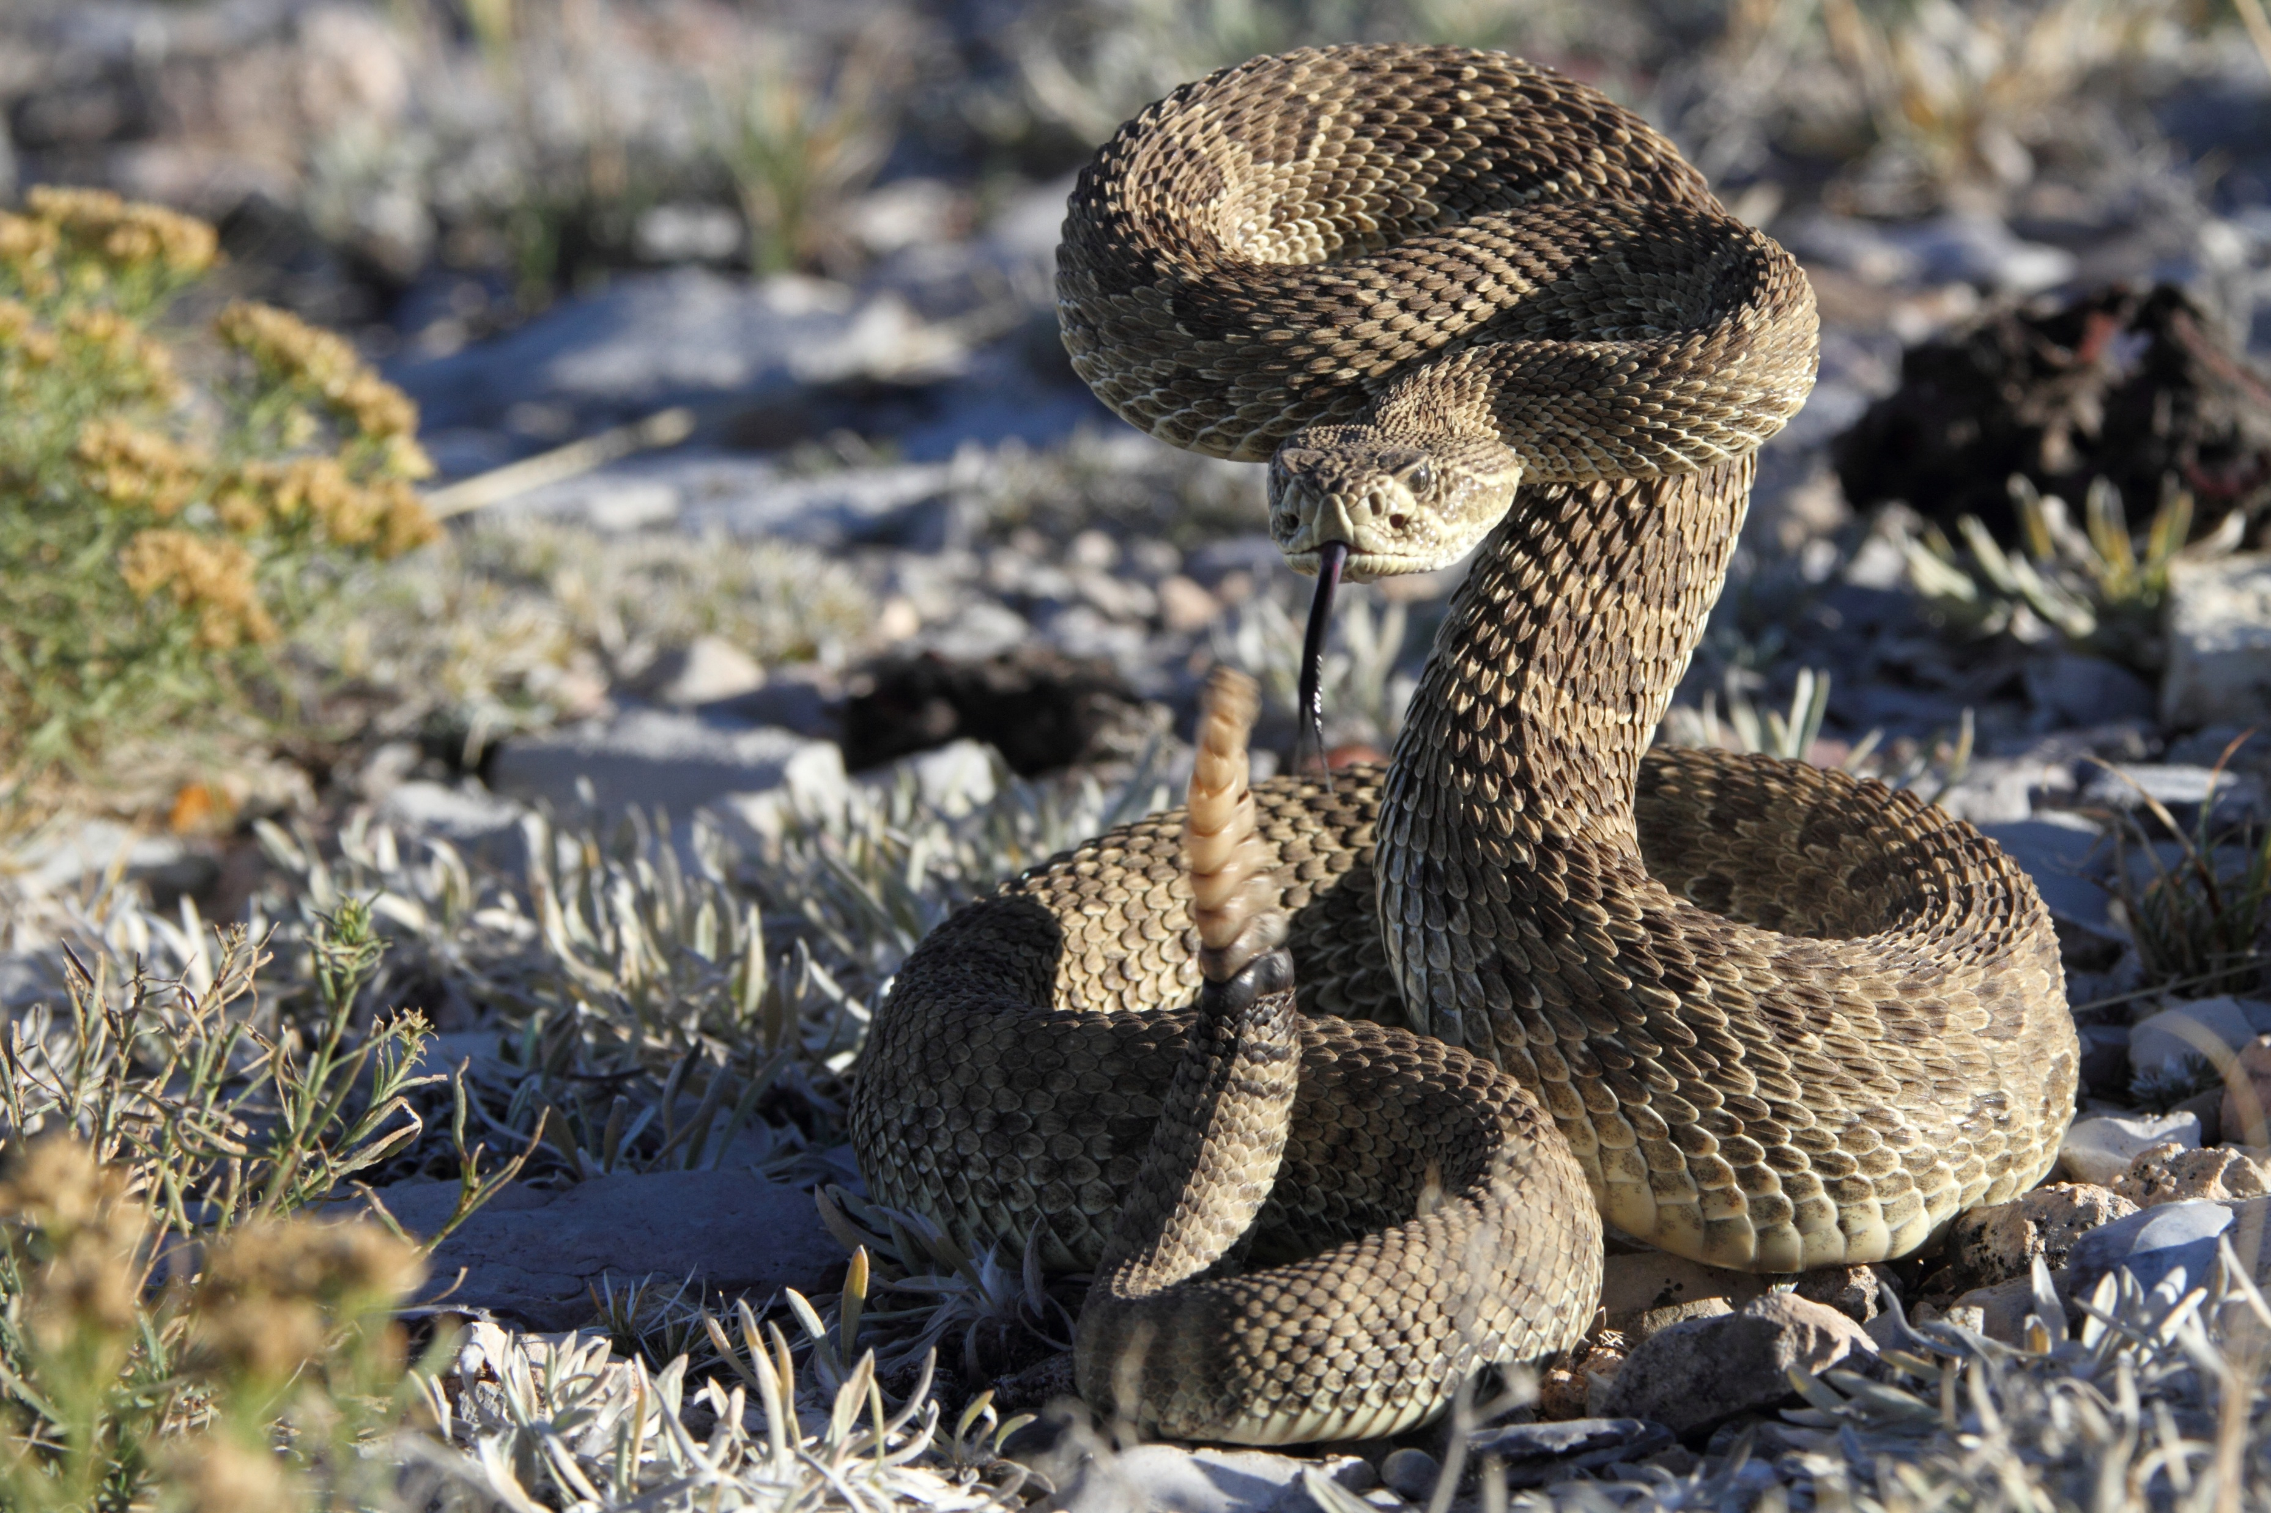
Science Week 2025
Remarkable Reptiles: Their Changes Over Time
KS1 – Teacher Pack and Answers
Session 2
Activity 4: Discuss the facts you remember about these snakes. ✓
Where does each snakes live? What is its habitat?
What does each snake eat?
Is the snake venomous or a constrictor?
king snake
Forests, grasslands and deserts (North America)
Rodents, other snakes, eggs, small reptiles
Constrictor
boa constrictor
Rainforests (South America)
Small mammals and other reptiles
Constrictor
garter snake
Forests, grasslands, marshes (North America)
Fish, frogs and newts
Constrictor
rattlesnake
Deserts (North America)
Warm-blooded animals – birds, mice etc.
Venomous
3
Developing Experts Copyright 2025 All Rights Reserved

