Slide 1

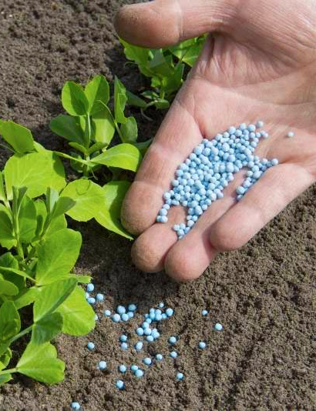
0001.01
Mission Assignment
Task
Developing skills
Think about…
Compare how fertilisers are produced in industry and in the laboratory.
State the elements in NPK fertilisers
What was used as fertilizer before the industrial preparation of fertilisers was invented. .
KS4-17-13:
Using Resources - Explore making fertilisers in the lab and in industry

