Slide 1
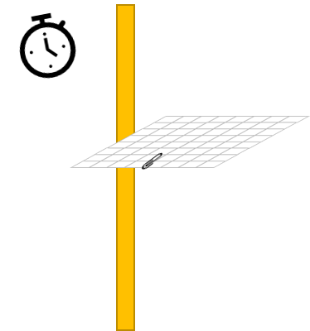
You are going to investigate how the area of a piece
of paper affects how long it takes to fall 1m.
Method
Cut out a piece of paper that is 16cm x 16cm, clip
a paperclip to the paper. Stand a metre stick
upright or affix it to a wall.
Hold the piece of paper at the top of the metre stick
and release it. Use the stopwatch to time how long
it takes the piece of paper to reach the floor.
Record the time in the table.
Fold the piece of paper in half to make an
8cm x 16cm rectangle clip the flap together with
the paperclip. Drop this from top of the metre
stick as before.
Repeat this folding the paper in half each time
and use the paperclip to keep the paper together.
Equipment
Metre stick
Stopwatch
Paper
Scissors
Paperclip
Area (cm x cm) | Time (s)
16 x 16
16 x 8
8 x 8
8 x 4
4 x 4
Stretch
Explain the roles of weight and air resistance in this investigation.
Challenge
Why is it important for the paper to always have the paperclip and not be cut.
Describe the pattern in your results. Explain why you think this occurred.
___________________________________________________________________________________________________________________________________________________________________________________________________________________________________________________________________________________

Slide 2
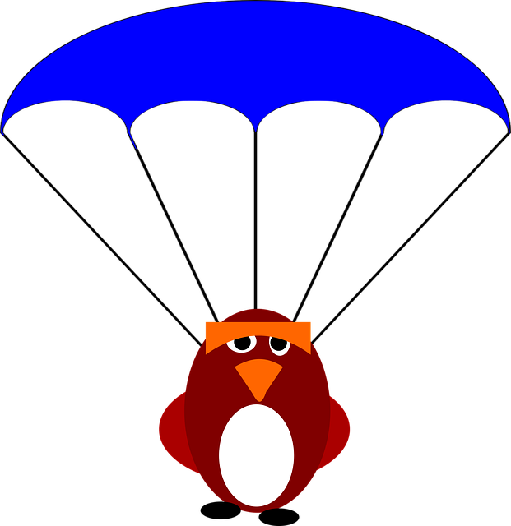
Make and launch your parachute and record your findings.
I made my parachute using the following materials: __________________________________________________________________________________________________________________________________________________________
Stretch:
Make observations about their parachute design and suggest how it could be further improved.
Challenge:
Make observations about their parachute design.
I launched my parachute: Discuss height, location and wind factor.
______________________________________________________________________________________________________________________________________________________________________________________________________________________________________________________
Discuss the effectiveness of your parachute design and how it could be improved. ___________________________________________________________________________________________________________________________________________________________________________________________________________________________________________________________________________________________________________________________________________________________________________________________________________________________________________

Slide 3
Draw your parachute design to scale in the space below.
What will your parachute look like when it is laid out flat?

