Slide 1

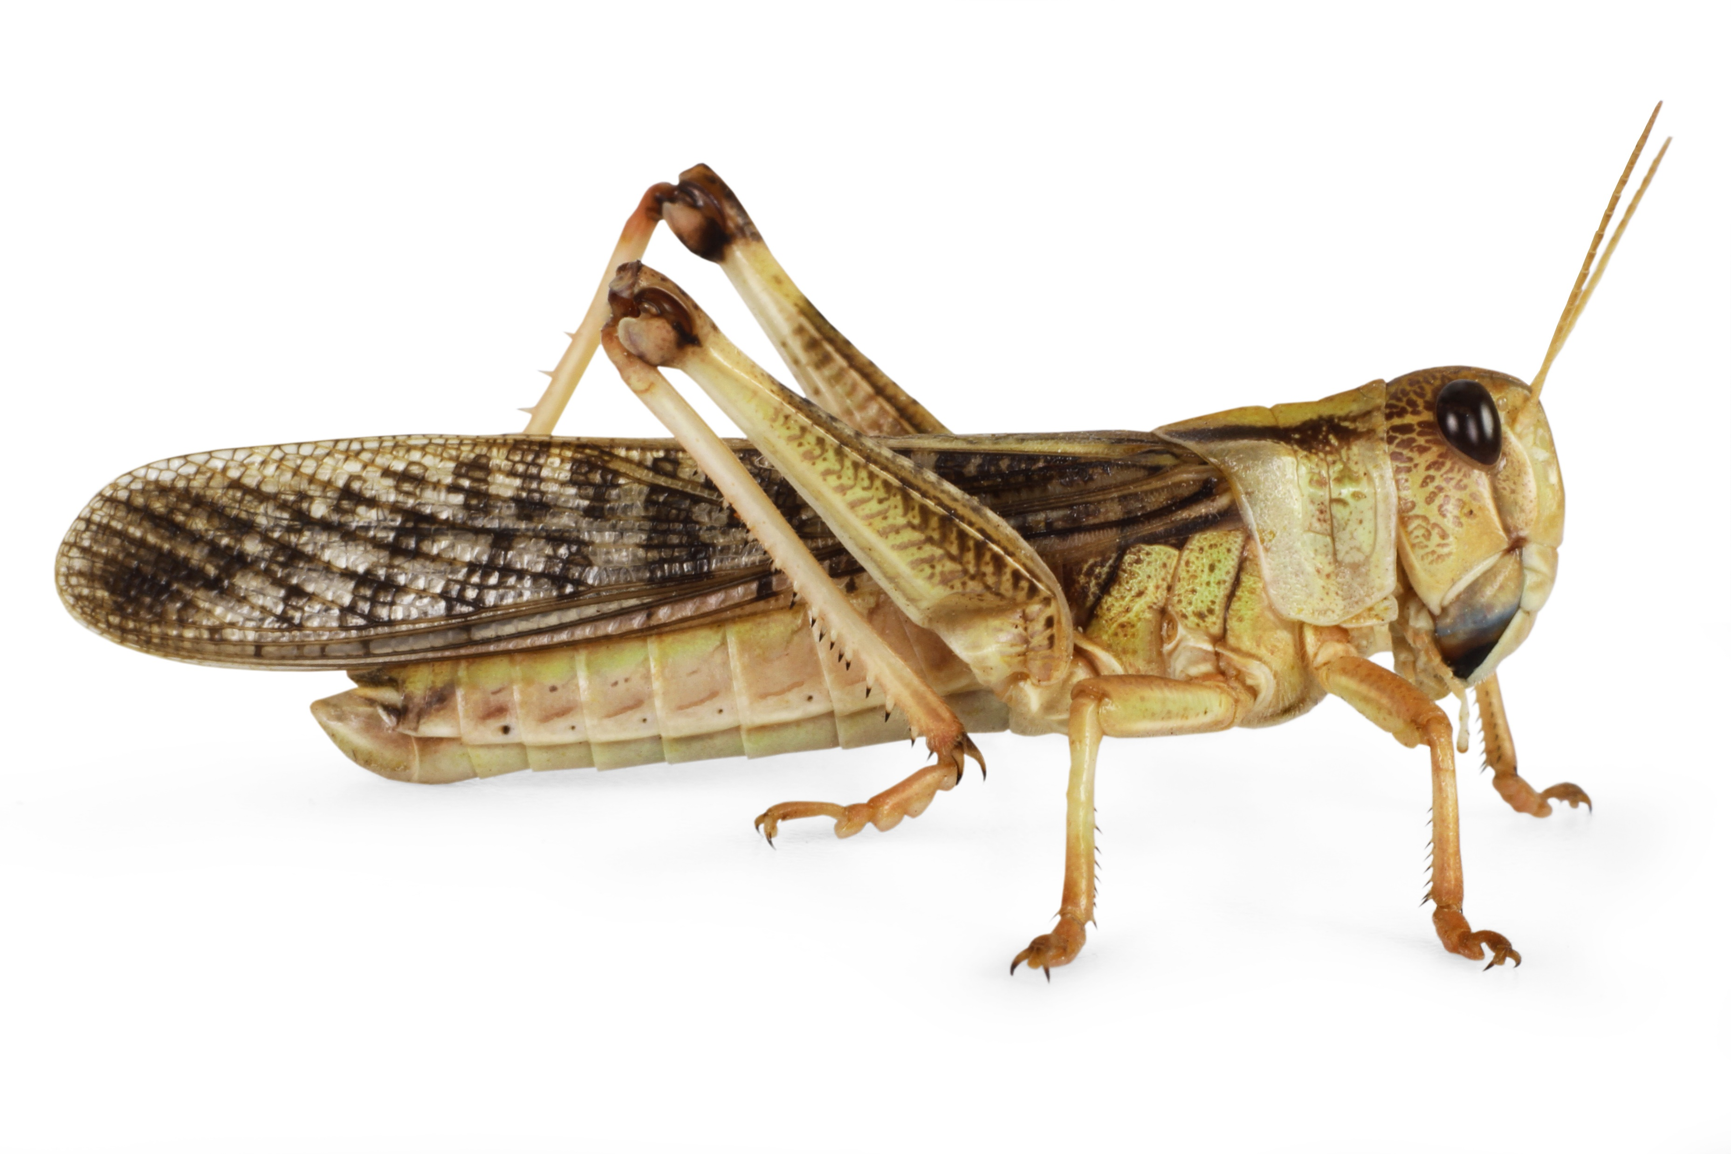
Mission Assignment: DE LIVE Lesson – The Mysteries of Insect Timekeeping
You’ll be told when to complete each activity.
Science Week 2024
Activity 1: Mind map as many insects as you know
Activity 2: Label the locust
Word bank:
head abdomen thorax wings eye leg antenna
Developing Experts Copyright 2024 All Rights Reserved

Slide 2
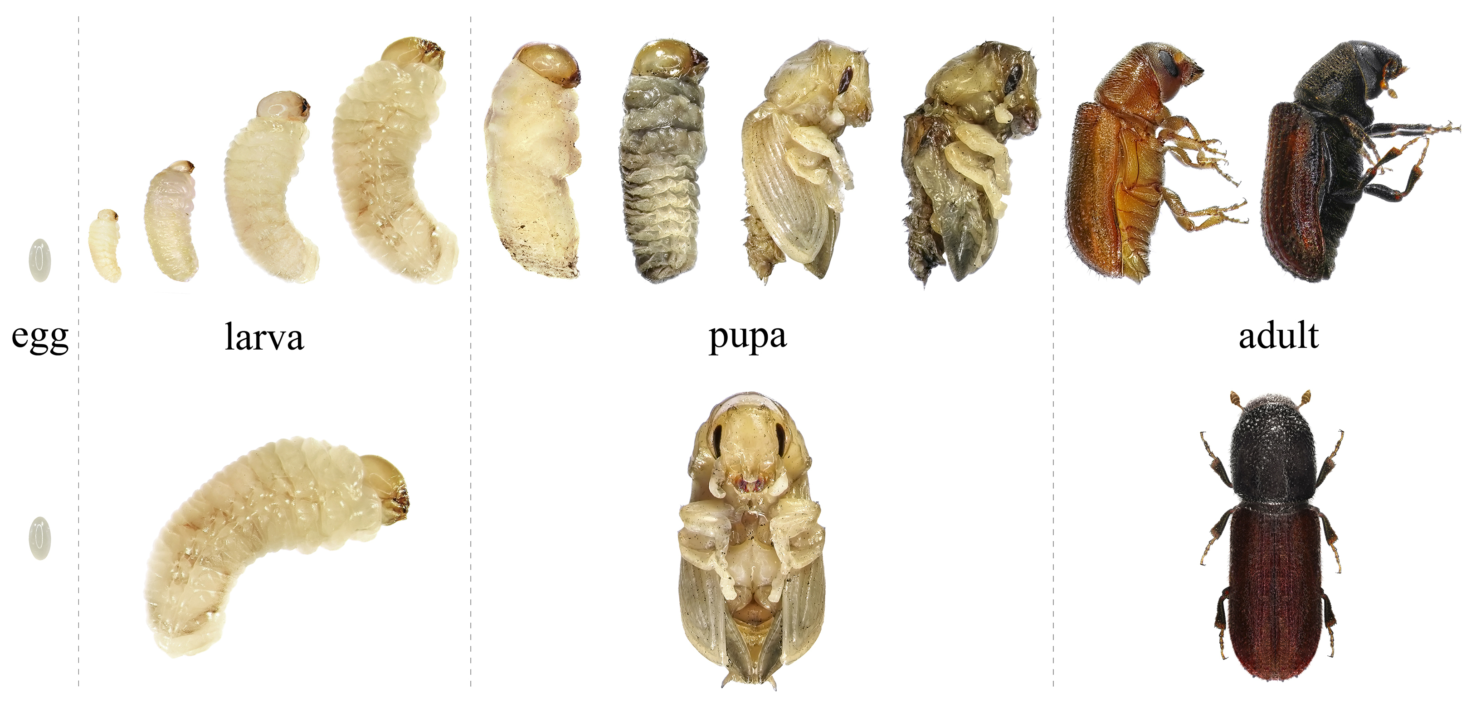
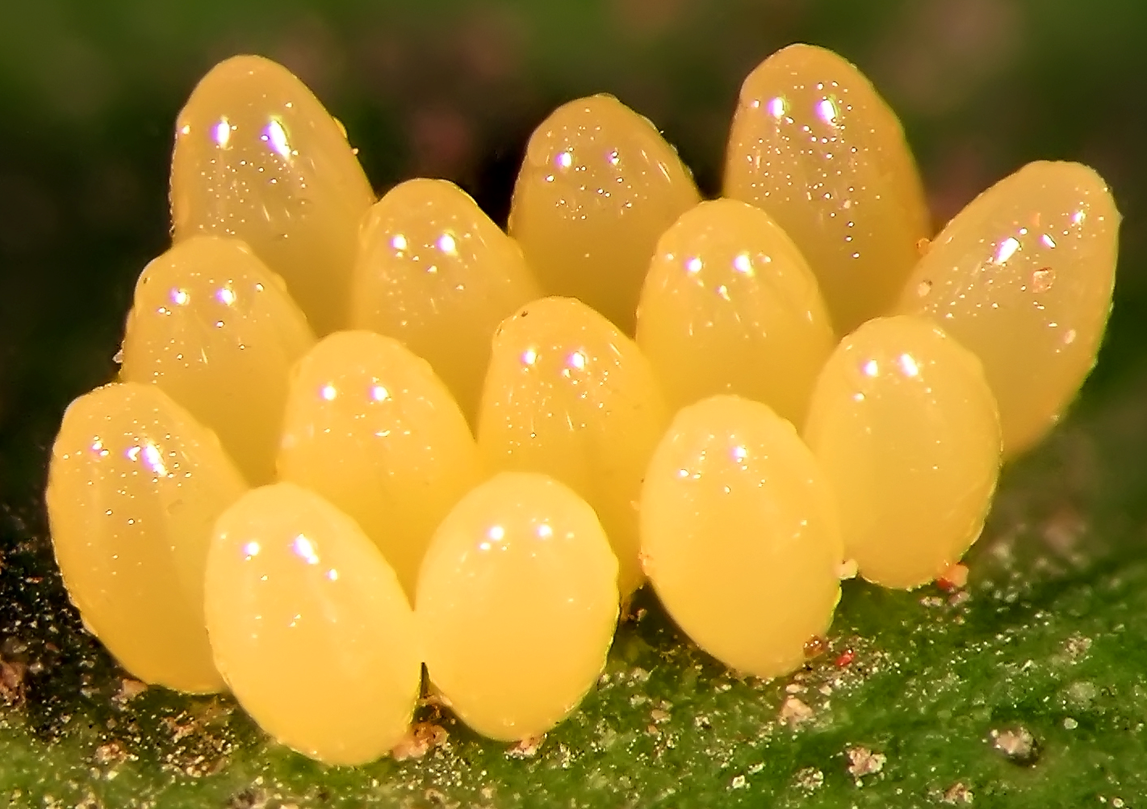
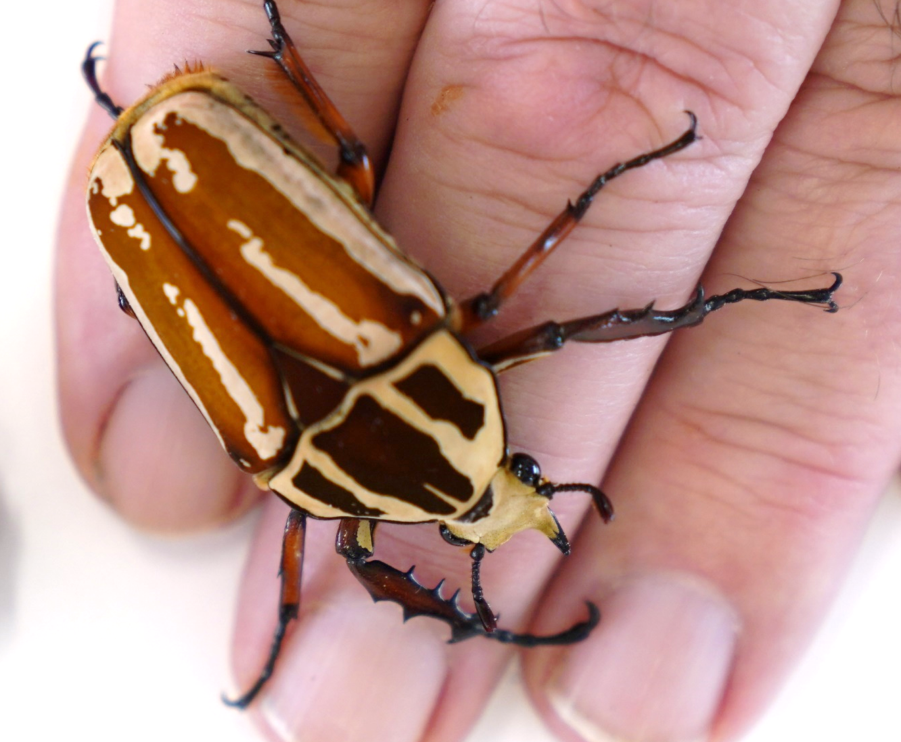
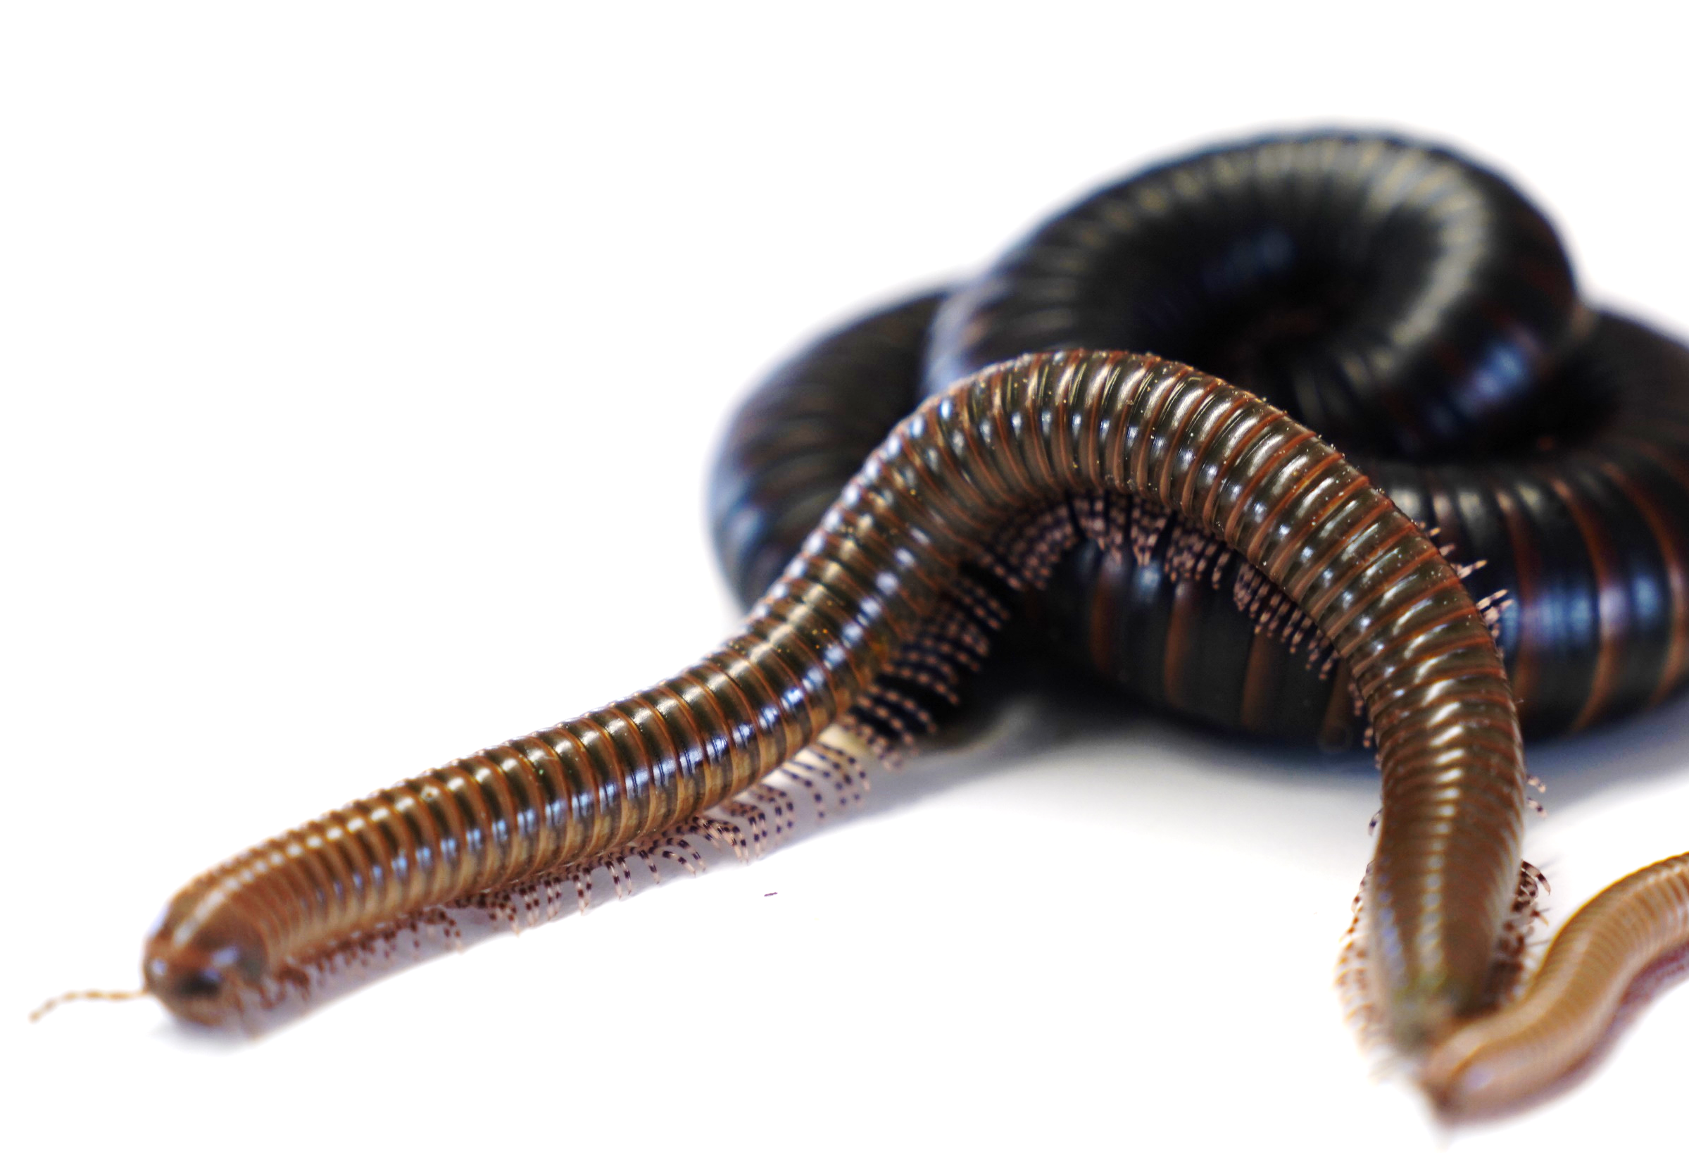
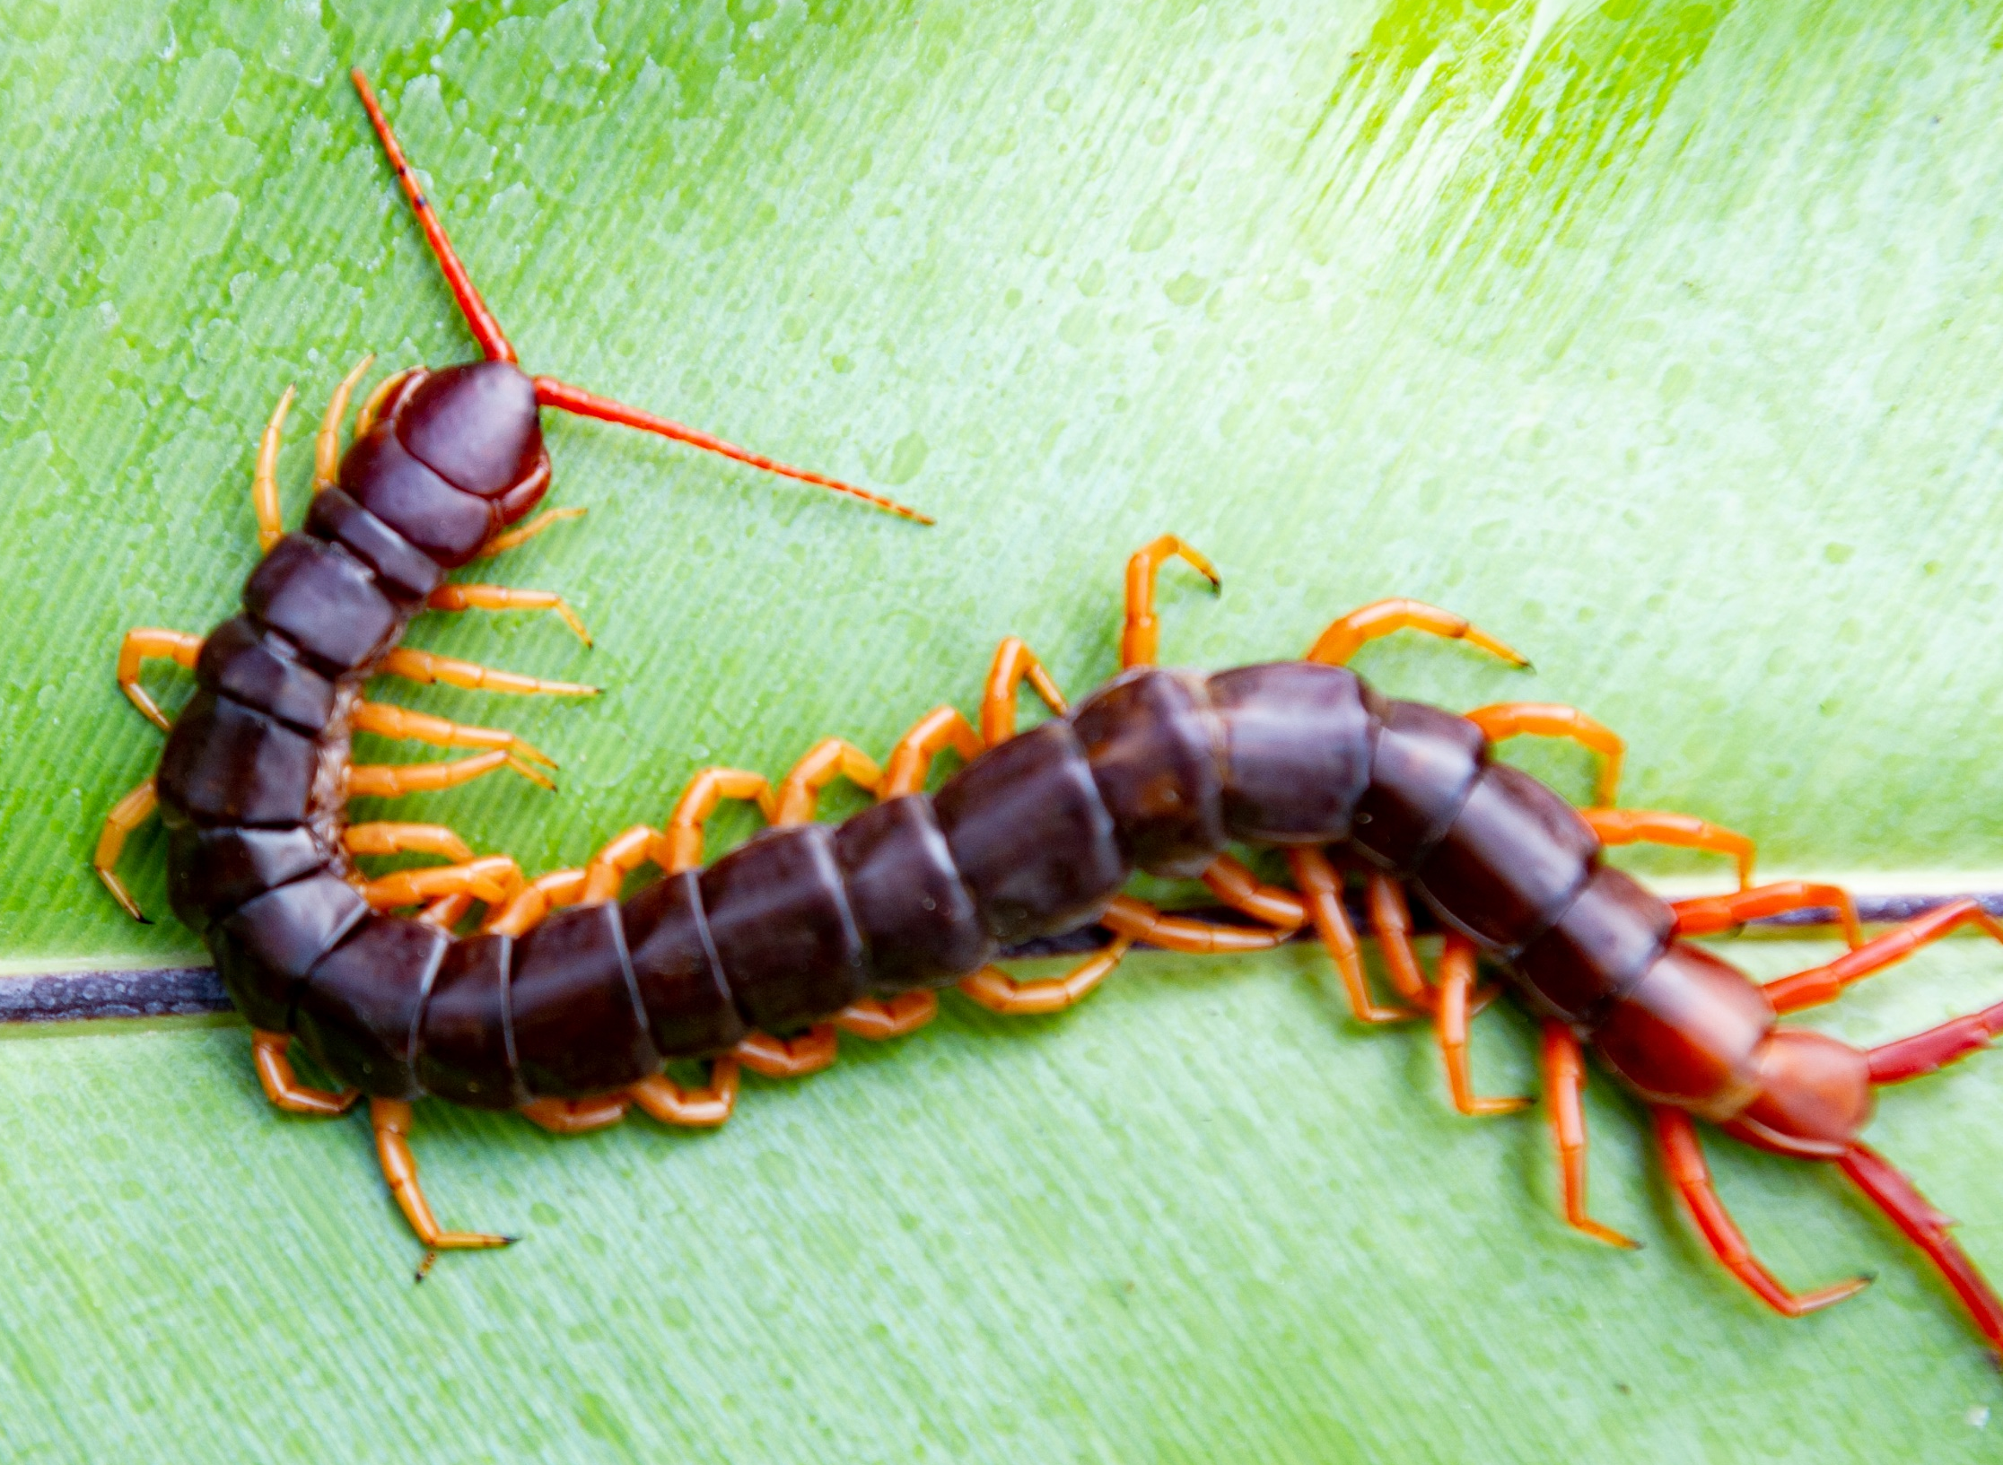
Mission Assignment: DE LIVE Lesson – The Mysteries of Insect Timekeeping
You’ll be told when to complete each activity.
Science Week 2024
Activity 3: Order the stages of a beetle’s life cycle and write a sentence to describe what is happening
_______________________________________________________________________________________________________________
_______________________________________________________________________________________________________________
_______________________________________________________________________________________________________________
_______________________________________________________________________________________________________________
Word bank: egg pupa adult larva
Describe or draw the stages of incomplete metamorphosis.
Activity 4: Spot the difference
What are some similarities and differences between an insect, a millipede and a centipede?
Developing Experts Copyright 2024 All Rights Reserved

