Slide 1
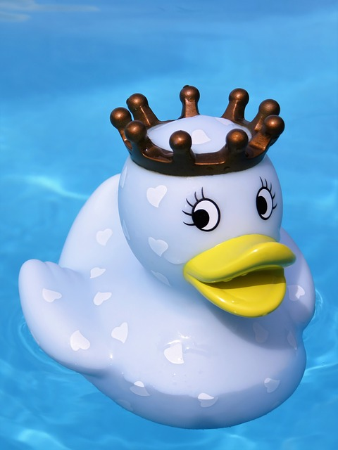
Predict whether each object will sink or float before conducting
your tests. Record your results in the table below.
Remember to calculate the density of each
object you divide the mass by the volume.
density = mass ÷ volume
object | prediction sink or float | mass (g) | volume (cm³) | density (g/cm³) | result sink or float
tennis ball |  |  | 150
golf ball |  |  | 50
ping-pong ball |  |  | 35
marble |  |  | 2
base-10 cube |  |  | 1
What do you notice about the relationship between the density of an object and whether it floats or sinks?
__________________________________________________________________________________________________________________________________________________________________________________
______________________________
______________________________
______________________________
Stretch:
What will happen if you use the same material with a different mass?
Challenge: Explain which material you would use to create a buoyancy aid and why.

Slide 2
In the space below, choose one object you tested and draw the experiment. Using arrows, draw and label the forces acting on it.

