Slide 1

Mission Assignment: Describe the structure of animal cells
KS3-01-02
The cheek of it!
Method
1. Gently scrape the inside of your cheek with a sterile cotton bud.
2. Now, smear the scrapings onto the middle of a clean microscope slide.
3. Place your used cotton bud in a beaker of disinfectant.
4. Place a drop of dilute methylene blue on top to stain the cells.
5. Place a coverslip over the cells, lowering it carefully to avoid air bubbles.
6. Place the slide under the low-power lens of a microscope, focusing carefully. Then, switch to high power and focus using fine adjustment.
7. On your worksheet, draw (in pencil) two or three cells in detail. Try to label them using your knowledge oF animal cells.
8. Remember to note the total magnification you are using.
View your cheek cell on all 3 magnifications. For each magnification, complete the table below:
Observation 1 | Magnification:
Observation 2 | Magnification:
Observation 3 | Magnification:
Developing Experts Copyright 2023 All Rights Reserved

Slide 2
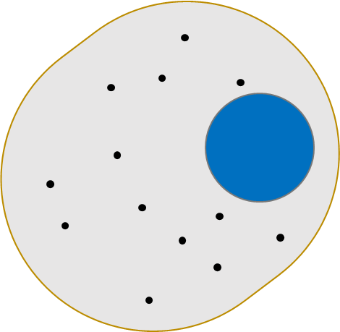
Mission Assignment: Describe the structure of animal cells
KS3-01-02
Animal cell diagram
Using the key words, label the organelles in animal cell.
Key Words
mitochondria nucleus cytoplasm membrane
For each organelle, give its function.
Cell membrane:
______________________________________________________________________________
Nucleus:
______________________________________________________________________________
Cytoplasm:
______________________________________________________________________________
Mitochondria:
______________________________________________________________________________
The function of ribosomes is to make proteins. Ribosomes are not shown on the above diagram. Can you suggest a reason why?
__________________________________________________________________________________________________________________________________________________________________
Developing Experts Copyright 2023 All Rights Reserved

Slide 3
Mission Assignment: Describe the structure of animal cells ANSWERS
KS3-01-02
Animal cell diagram
Using the key words, label the organelles in animal cell.
Mitochondrion/
Mitochondria
Membrane
Cytoplasm
Nucleus
Key Words
mitochondria nucleus cytoplasm membrane
For each organelle, give its function.
Cell membrane:
______________________________________________________________________________
Nucleus:
______________________________________________________________________________
Cytoplasm:
______________________________________________________________________________
Mitochondria:
______________________________________________________________________________
The function of ribosomes is to make proteins. Ribosomes are not shown on the above diagram. Can you suggest a reason why?
__________________________________________________________________________________________________________________________________________________________________
Controls which substances enter and leave the cell.
The control centre of the cell which contains the genetic information.
A jelly like substance that holds the organelle in place. It is also where chemical reactions take place.
Where respiration takes place. During respiration, energy is transferred to the organism so that it can carry out basic functions.
The ribosomes are not on the diagram as it is so small. If the diagram showed the organelles magnified further, then they would be seen.
Developing Experts Copyright 2023 All Rights Reserved

