Slide 1
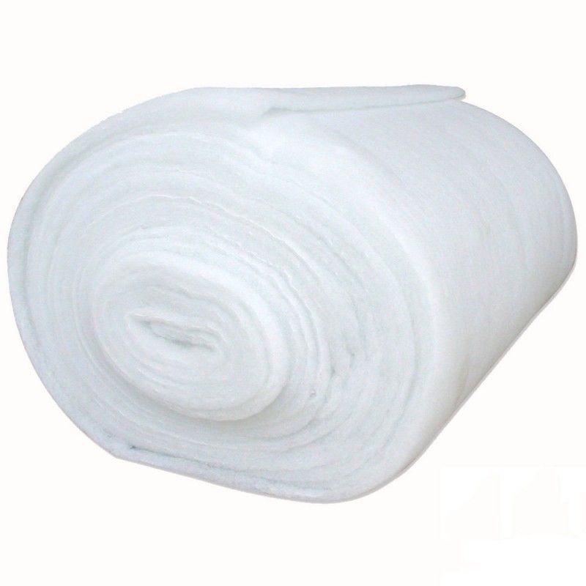

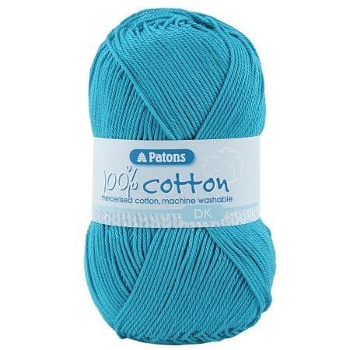
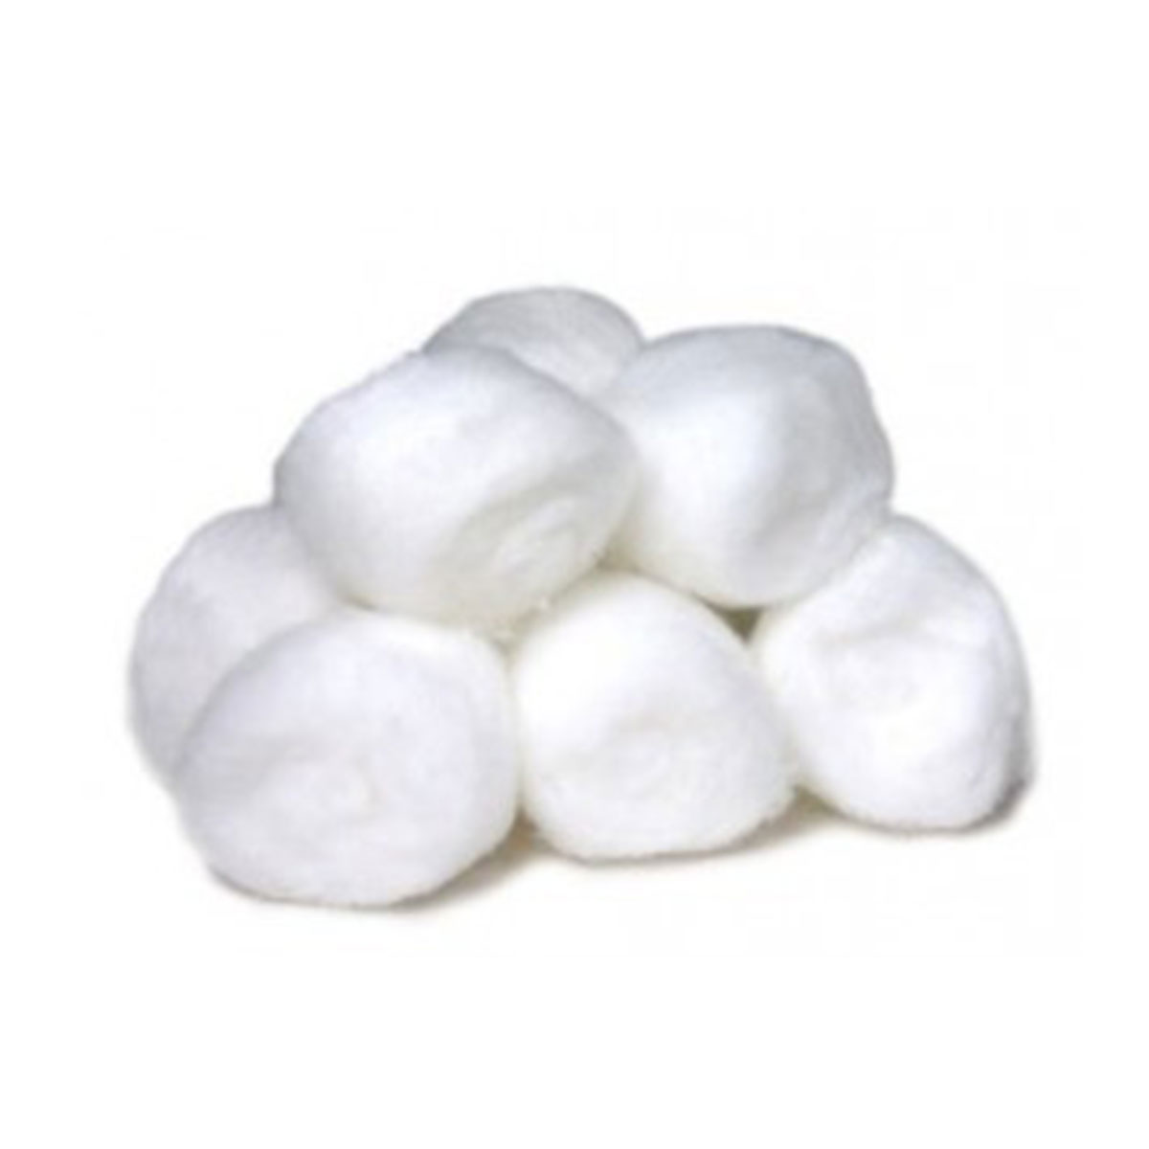
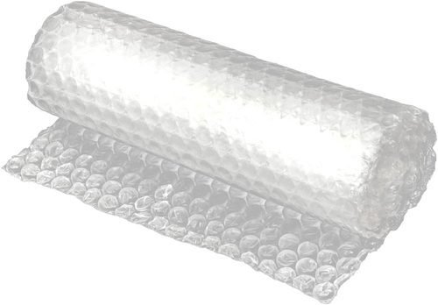
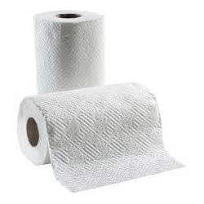
Developing Experts All rights reserved © 2021

Slide 2
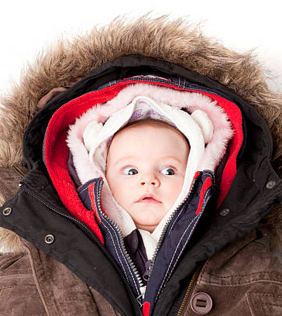
Required Practical
Identify independent, dependent and control variables in an investigation.
Describe the method used to investigate thermal insulation properties of a material.
Plot a graph to analyse the data collected in the investigation.
Evaluate potential sources of error in the investigation and suggest improvements.
Developing Experts All rights reserved © 2021

Slide 3
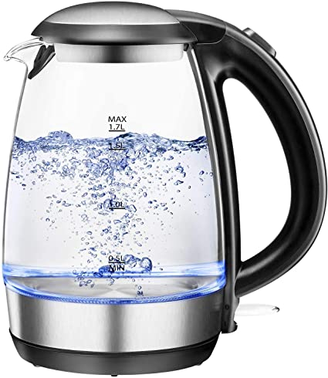
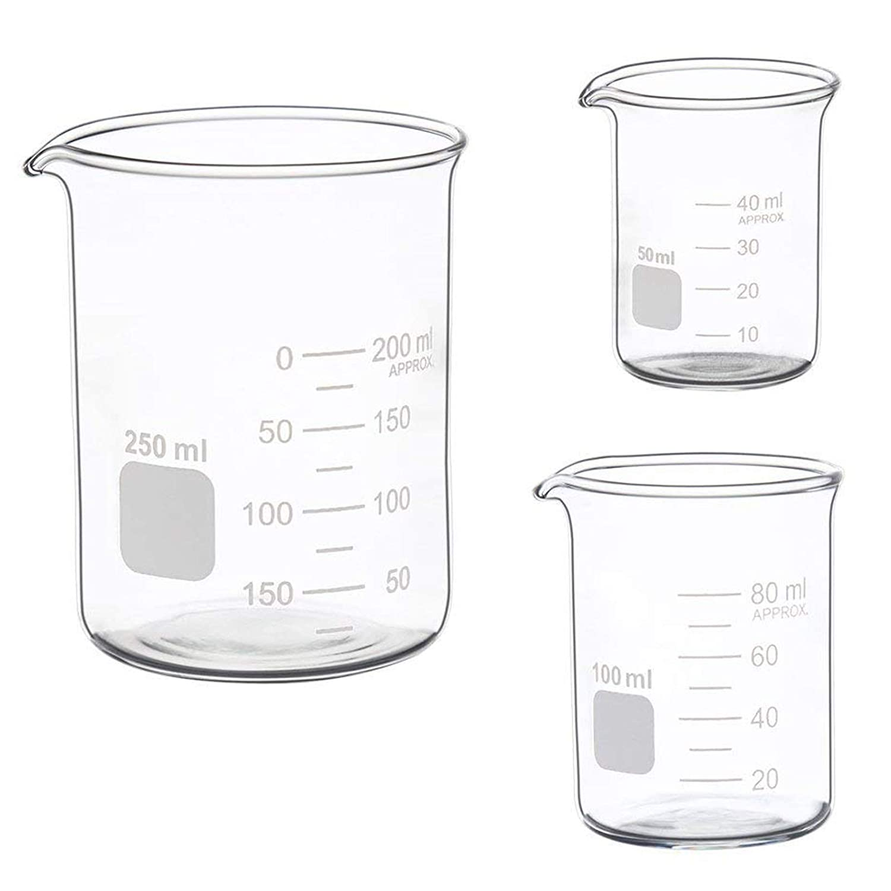
Developing Experts All rights reserved © 2021

Slide 4
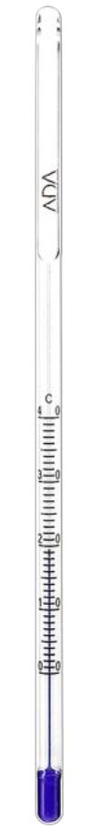
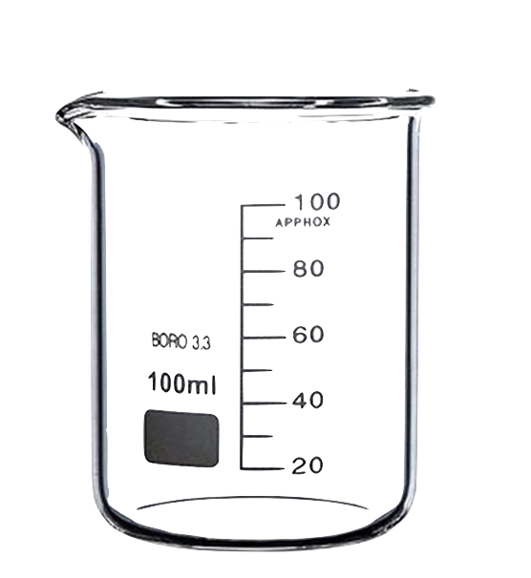
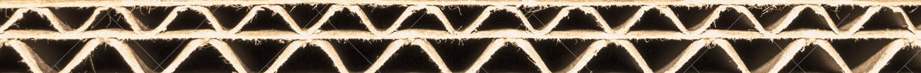
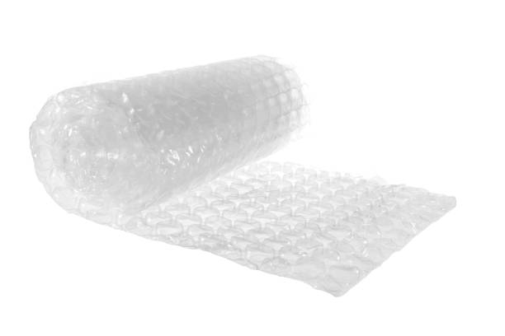
Developing Experts All rights reserved © 2021

Slide 5
Developing Experts All rights reserved © 2021

Slide 6
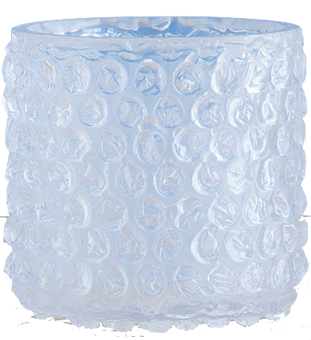
Developing Experts All rights reserved © 2021

Slide 7
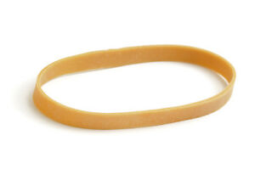
Developing Experts All rights reserved © 2021

Slide 8
cardboard lid
thermometer
dependent
variable (temperature of the water)
independent
variable
beaker
Developing Experts All rights reserved © 2021

Slide 9
Control variables don't change
Volume of water
Mass of insulating material
Keep the starting temperature of the water the same
cardboard lid
thermometer
dependent
variable (temperature of the water)
independent
variable
beaker
Developing Experts All rights reserved © 2021

Slide 10
Time (minutes) | Temperature (°C)
 | No insulating material | Bubble wrap | Cotton wool | Polystyrene
0
3
6
9
12
15
Record all the results in a table this like.
Developing Experts All rights reserved © 2021

Slide 11
Cooling Curve
From these experiments we can plot the cooling curve.
temperature ( °C)
time (minutes)
Developing Experts All rights reserved © 2021

Slide 12
Repeat
Control variables don't change
Volume of water
Type of insulating material
Keep the starting temperature of the water the same
cardboard lid
thermometer
dependent
variable (temperature of water)
independent
variable (number of layers)
beaker
Developing Experts All rights reserved © 2021

Slide 13
 | Temperature (°C) | Extension /cm
Time (minutes) | 0 layers | 2 layers | 4 layers | 6 layers | 8 layers | 10 layers
0
3
6
9
12
15

Slide 14
Summary
Describe how to investigate the effectiveness of thermal insulators.
Developing Experts All rights reserved © 2021

