Slide 1



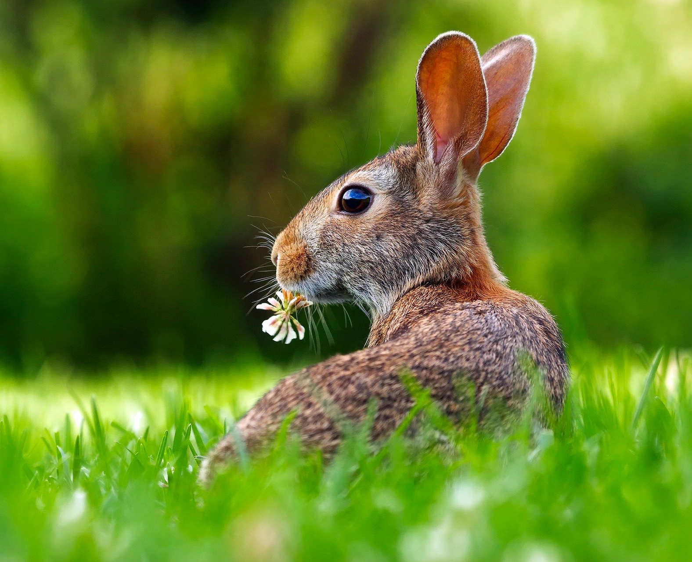
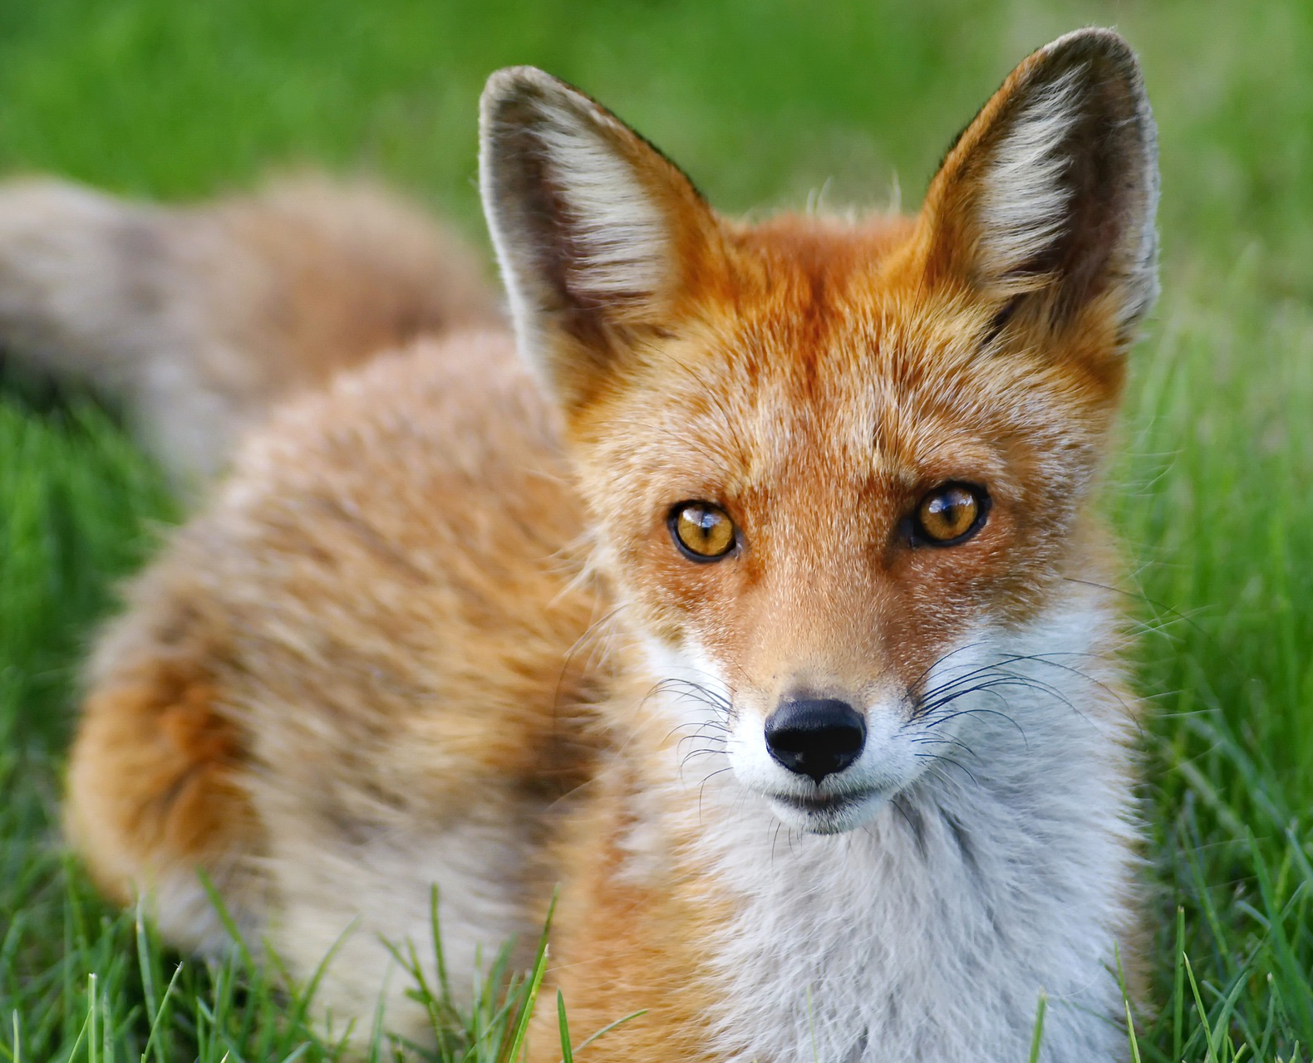
Mission Assignment: Explore trophic levels
Code: KS4_07_19
Identify the trophic levels on food chains
Task 1. The diagram below shows a food chain in a field.
Grass
Rabbit
Fox
Name one consumer shown in the diagram above: ________________
Name one carnivore shown in the diagram above: ________________
What is another name for a carnivore in a food chain? ________________
What is the name for a predator that has no predators? ________________
A disease kills most of the foxes in the field. Suggest why the number of rabbits in the field may then increase: _____________________________________________________________________________________________________________________________________________________________________________________________________________________________________________
What is the name given to all the rabbits in the field shown in the diagram above? Tick the correct one.
  Community
  Ecosystem
  Population
  Territory
Abiotic factors can affect the food chain. Wind direction is one abiotic factor. Name one other abiotic factor.
______________________
Developing Experts Copyright 2022 All Rights Reserved

Slide 2
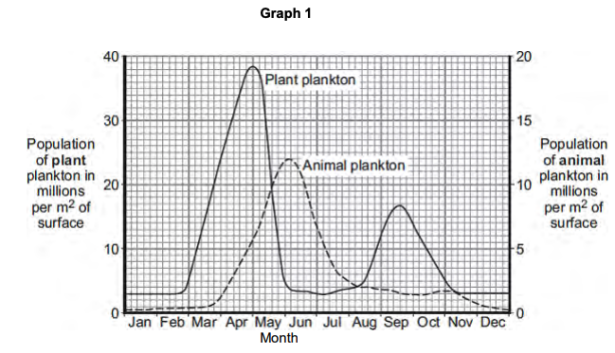
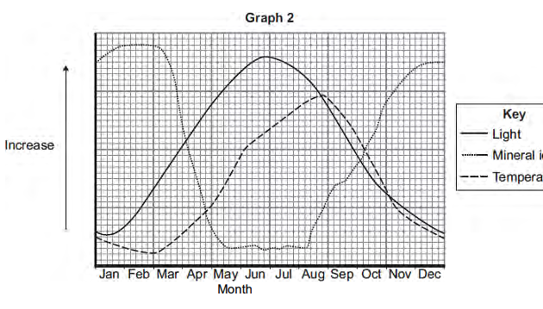
Mission Assignment: Explore trophic levels
Code: KS4_07_19
Task 2. Plankton live in the sea. Animal plankton eat plant plankton. Graph 1 shows how the populations of the plankton change through the year in the seas around the UK. Graph 2 shows changes in some of the conditions in the upper layers of the sea around the UK.
(A) The population of plant plankton increases between February and April. Suggest one reason for the increase. Explain your answer.
____________________________________________________________________________________________________________________________________________________________________________________________________________________________________________________________________________________________________________________________________________________________________________________________________________________________________________________________________________________________________________
(B) The population of animal plankton changes between April and July. Suggest explanations for the changes.
__________________________________________________________________________________________________________________________________________________________________________________________________________________________________________________________________________________________________________________________________________________________________________________________________________________________
(C) The concentration of mineral ions changes between February and December. Suggest explanations for the changes.
__________________________________________________________________________________________________________________________________________________________________________________________________________________________________________________________________________________________________________________________________________________________________________________________________________________________ ______________________________________________________________________________________________________________________________________________________________________________________________________________________________________________________
Developing Experts Copyright 2022 All Rights Reserved

