Slide 1
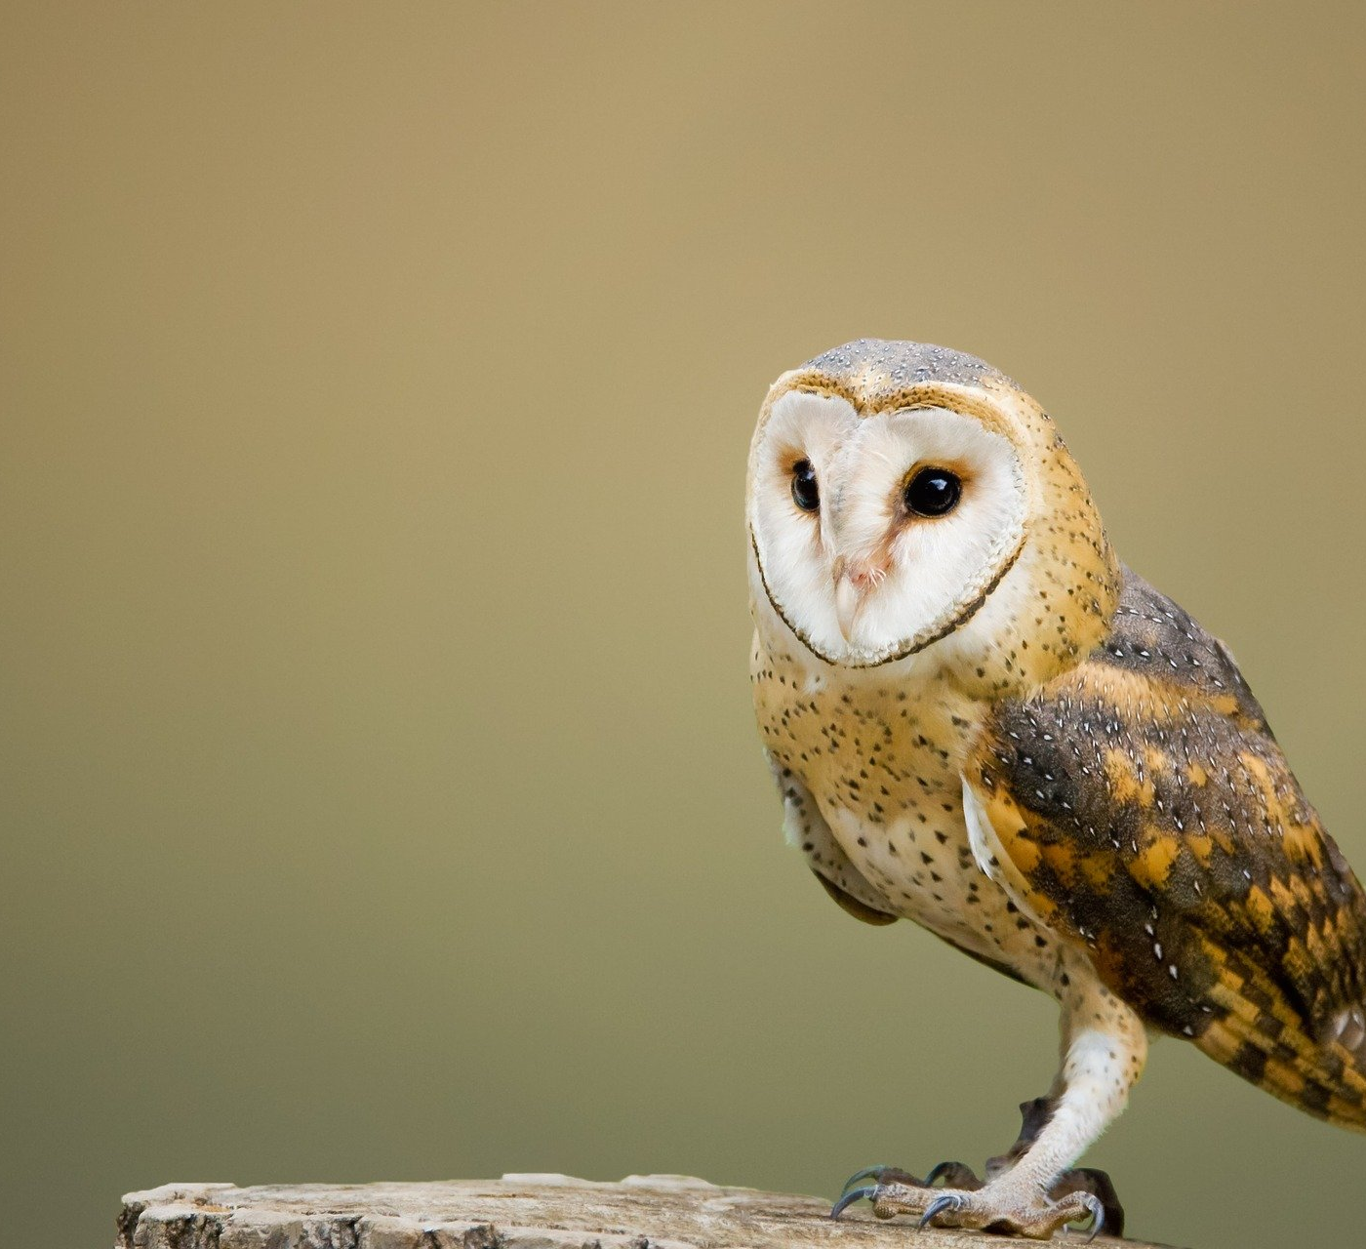
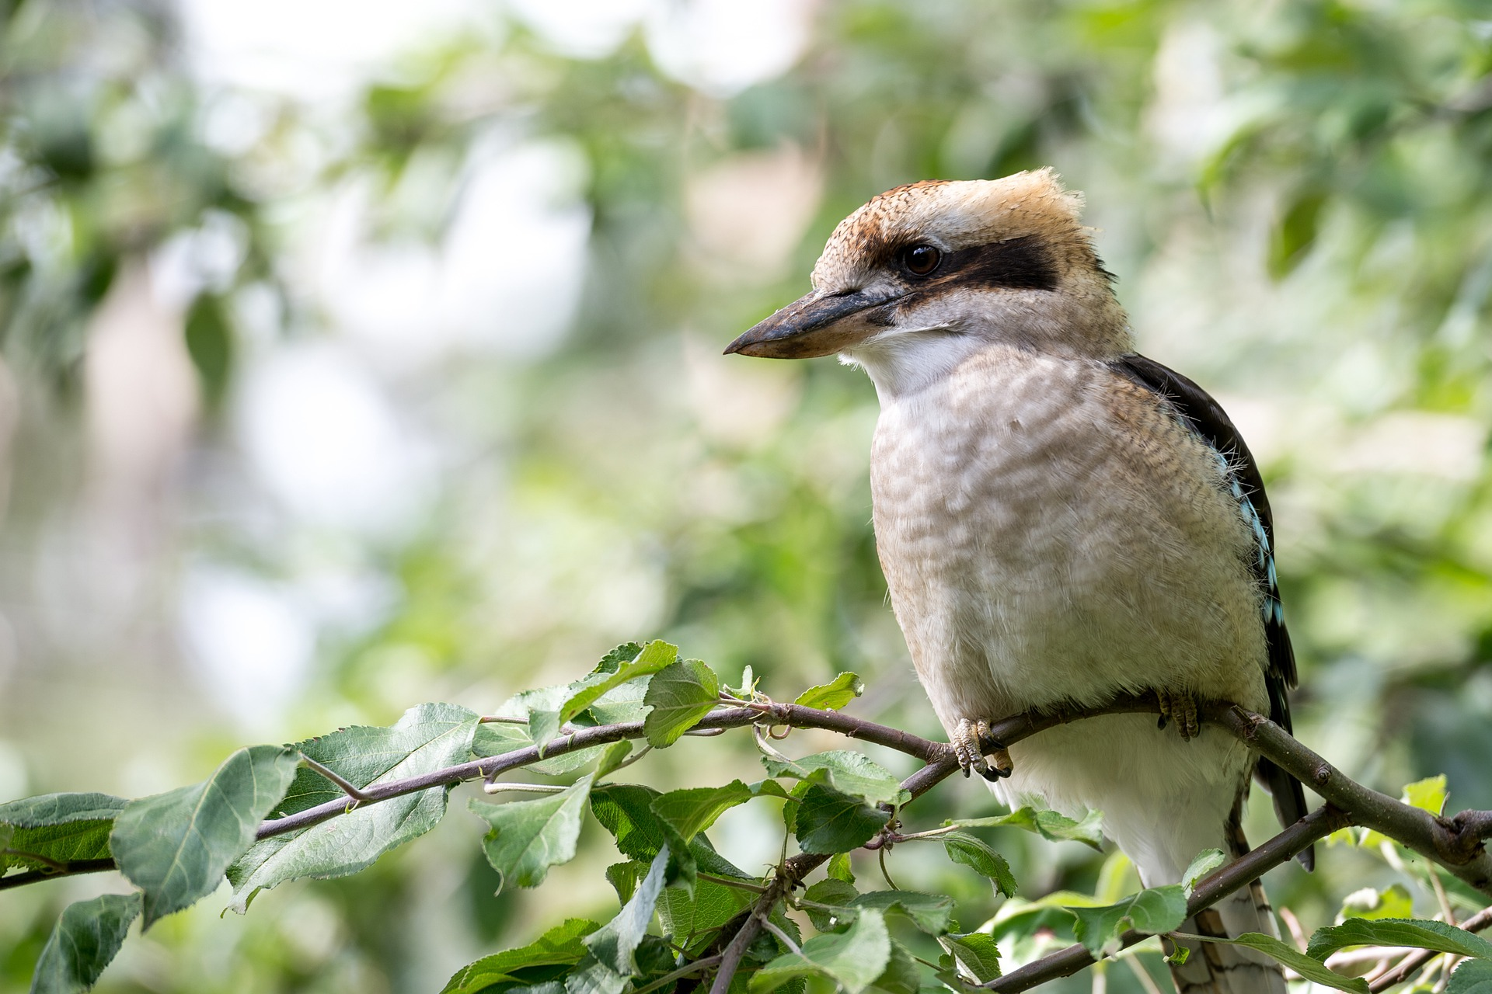
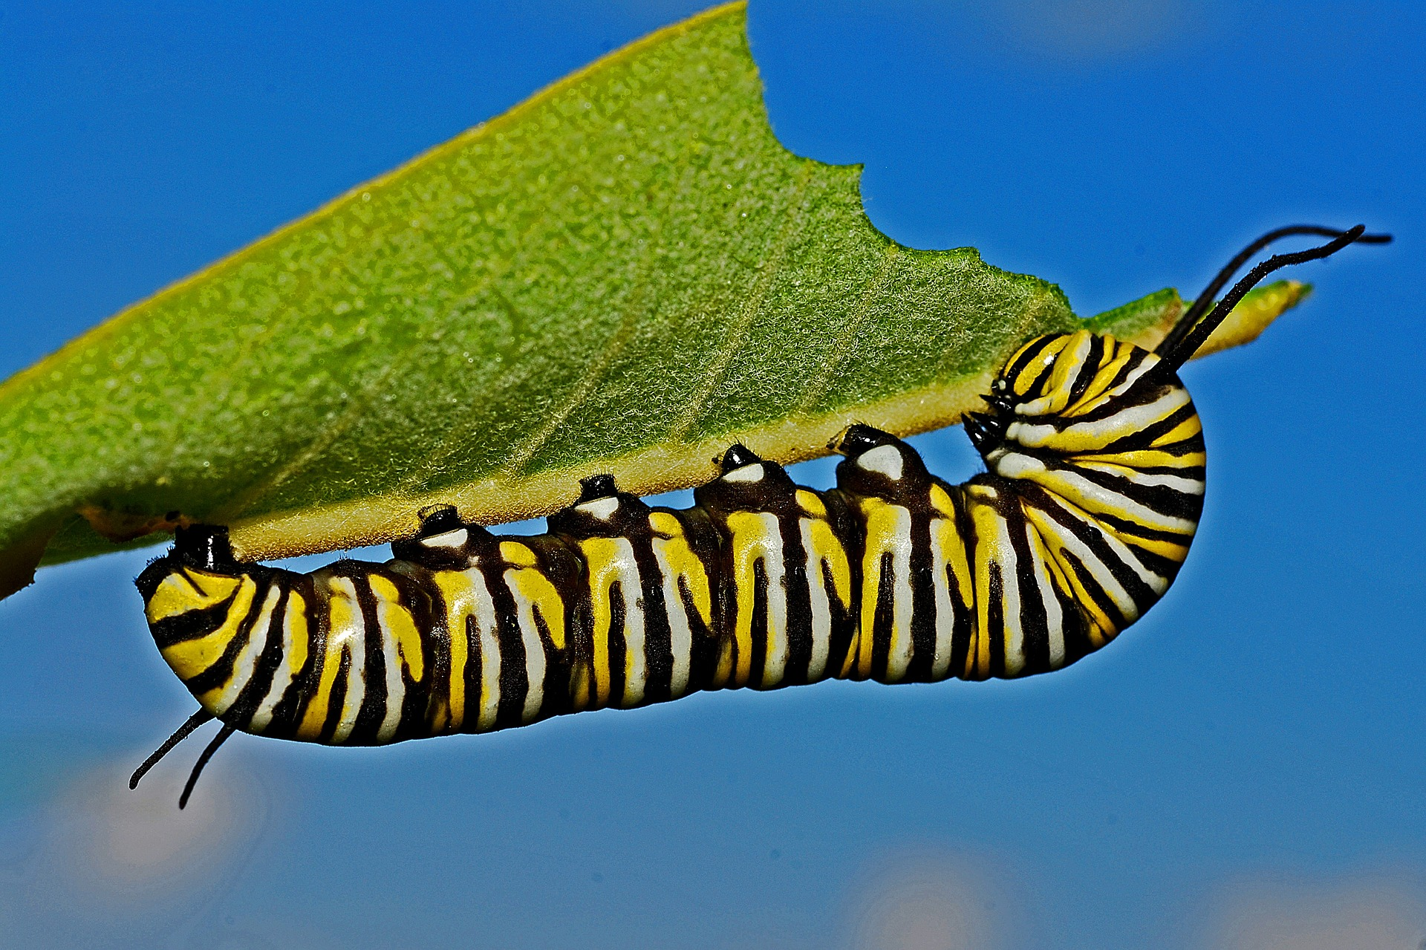
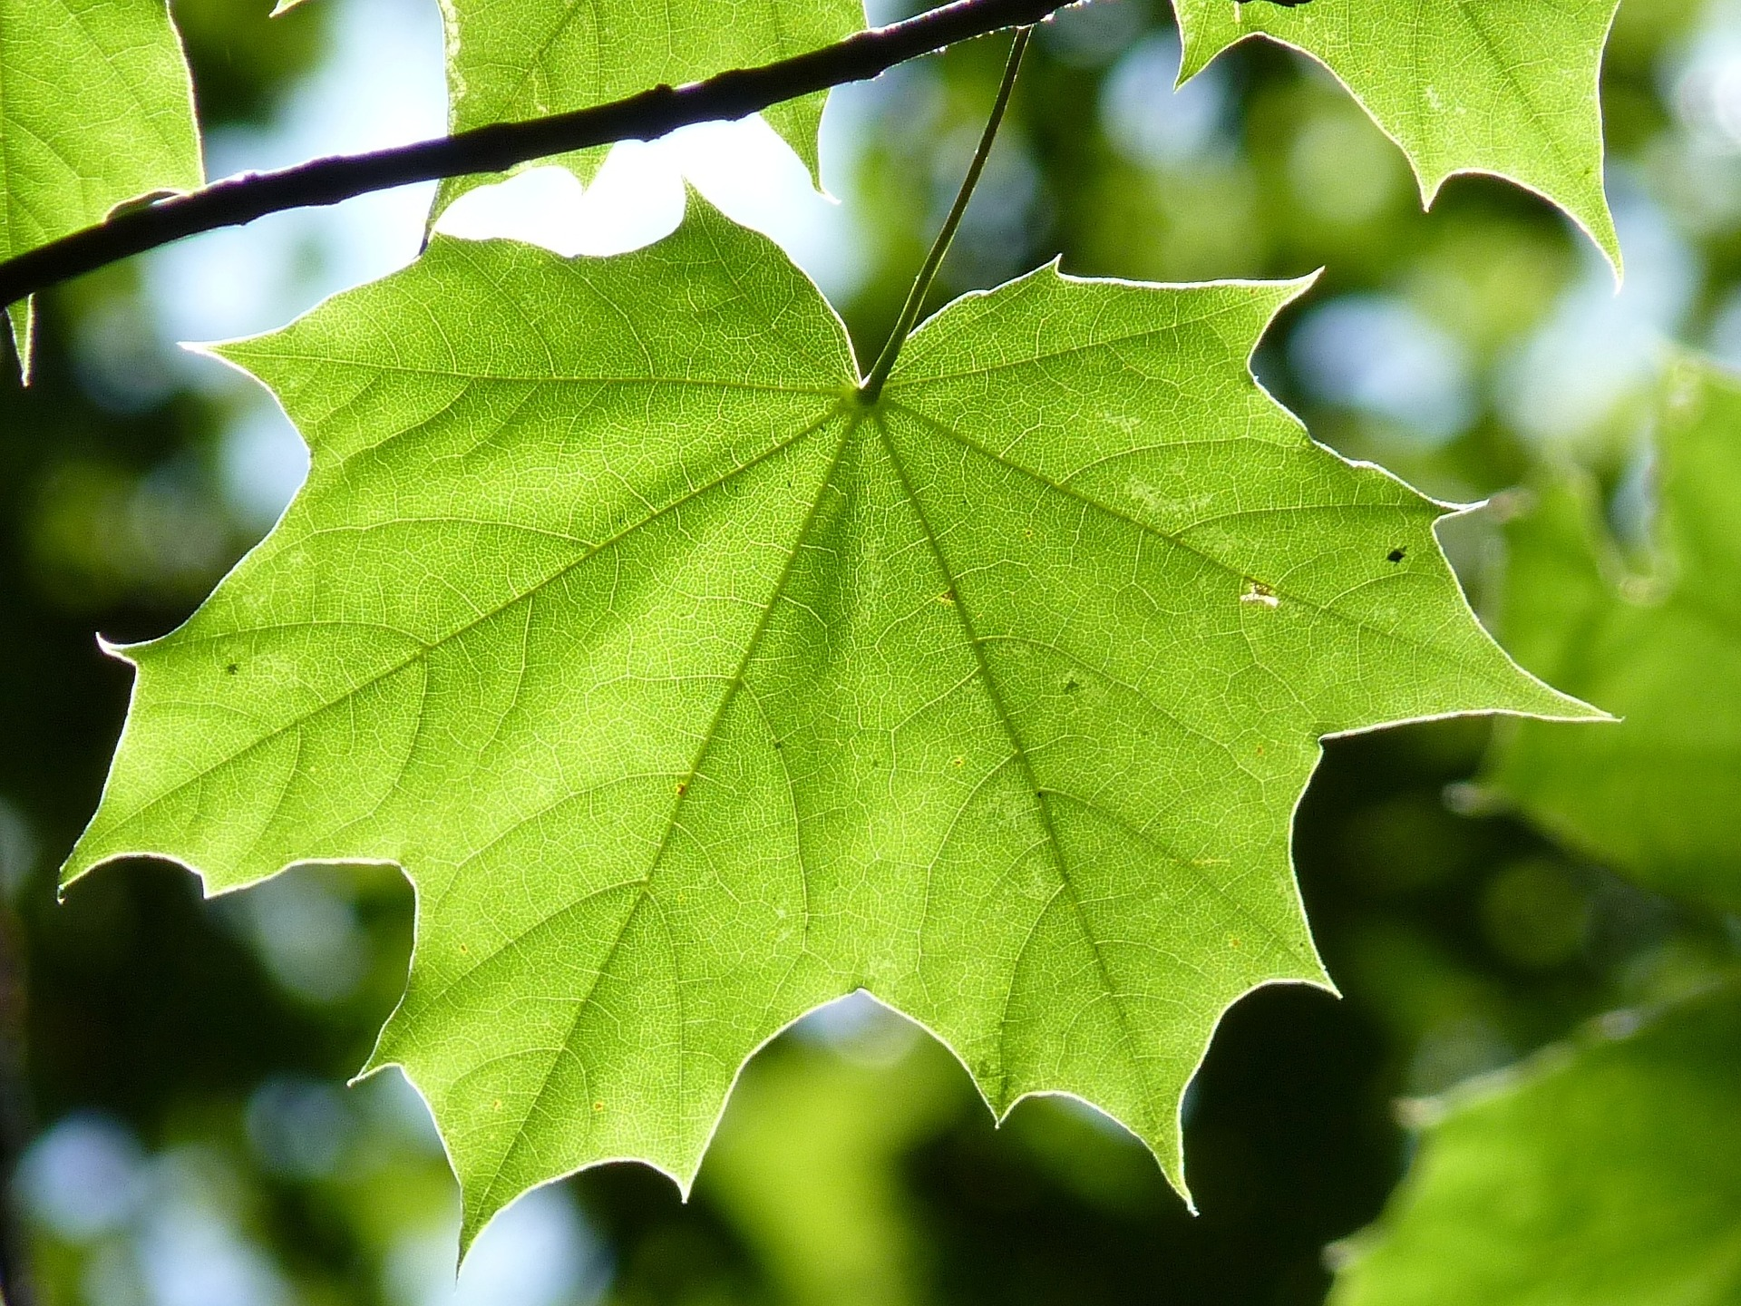
BIRD of PREY
BIRD
CATERPILLAR
TREE LEAF
BIOMASS (glucose/energy)

Slide 2
TERTIARY CONSUMER
SECONDARY CONSUMER
PRIMARY CONSUMER
PRODUCER
BIRD of PREY
BIRD
CATERPILLAR
TREE LEAF
Trophic level 4
Trophic level 3
Trophic level 2
Trophic level 1

Slide 3
TERTIARY CONSUMER
SECONDARY CONSUMER
PRIMARY CONSUMER
PRODUCER
BIRD of PREY
BIRD
CATERPILLAR
TREE LEAF
Trophic level 4
Trophic level 3
Trophic level 2
Trophic level 1
collect, dry, weigh

Slide 4


Slide 5
Level 4
Level 3
Level 2
Level 1
producers

Slide 6
Level 4
Level 3
1%
Level 2
Level 1
producers

Slide 7
BIRD of PREY
BIRD
CATERPILLAR
TREE LEAF
10g BIOMASS eaten

Slide 8
BIRD of PREY
BIRD
CATERPILLAR
TREE LEAF
10g BIOMASS eaten
1g BIOMASS transferred

Slide 9
BIRD of PREY
BIRD
CATERPILLAR
TREE LEAF
10g BIOMASS eaten
1g BIOMASS transferred
biomass lost as waste

Slide 10
biomass lost as respiration
BIRD of PREY
BIRD
CATERPILLAR
TREE LEAF
10g BIOMASS eaten
1g BIOMASS transferred
biomass lost as waste

Slide 11
Level 4
Level 3
Level 2
Level 1

Slide 12
Level 4
Level 3
number of organisms decreases
Level 2
Level 1

