Slide 1

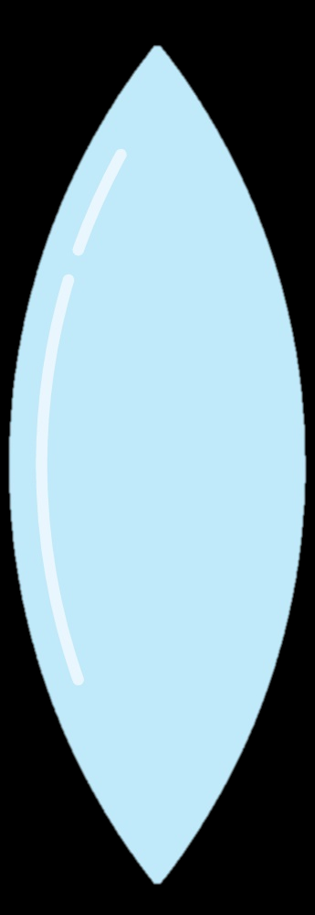
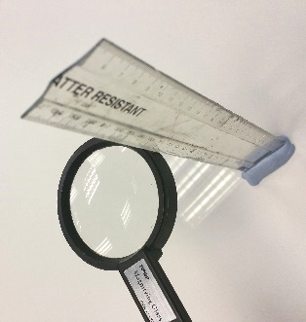
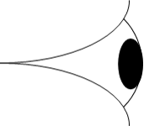
Mission Assignment: Describe how lenses focus light
KS3-19-05
Finding the Focal Length
Find the focal length of two differently sized lenses. The focal length is the distance between the centre of the lens and the focal point (the point where all rays converge).
Focal point
Focal length
Method
This experiment works best under fluorescent strip lights.
Hold the lens directly under the florescent lighting above a clear plain desk. Make sure it is flat.
Move the lens up and down until the image of the lights is clear and focused on the surface.
Use a set square to keep your ruler perpendicular to the desk and measure the distance from the desk.
Focal length of lens 1 (the smaller lens) _____________ cm
Focal length of lens 2 (the bigger lens) _____________ cm
Building a Refracting Telescope
Method
Using modelling clay, stick lens 1 its focal distance away from the end of the ruler.
Add together the focal lengths of lens 1 and 2.
Stick lens 2 this distance apart from lens 1 on the ruler.
Bring the ruler with the lenses to the end of a table and look through your telescope.
Experiment looking at objects which are close, and which are further away.
Note! When you look through your telescope, images will appear upside down.
Focal length of lens 1
Focal length of lens 1 + lens 2
Developing Experts Copyright 2023 All Rights Reserved

