Slide 1

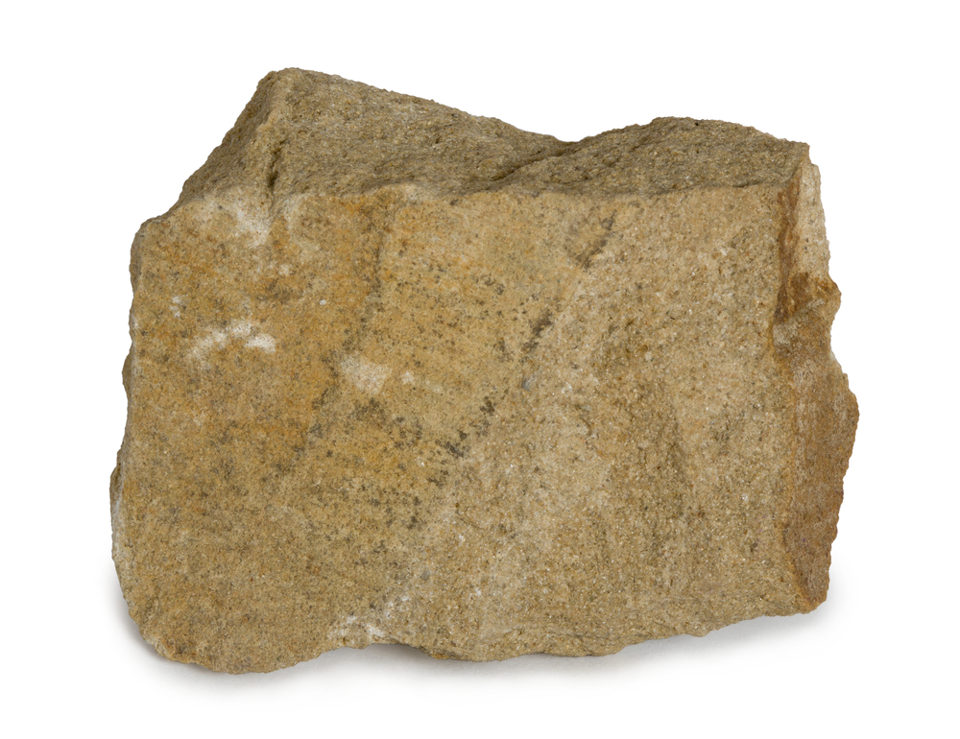



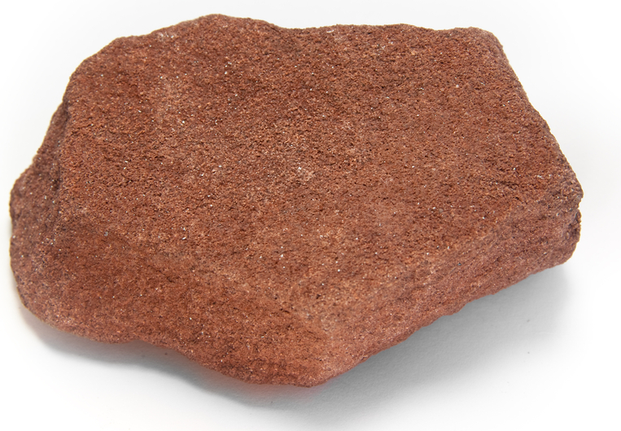
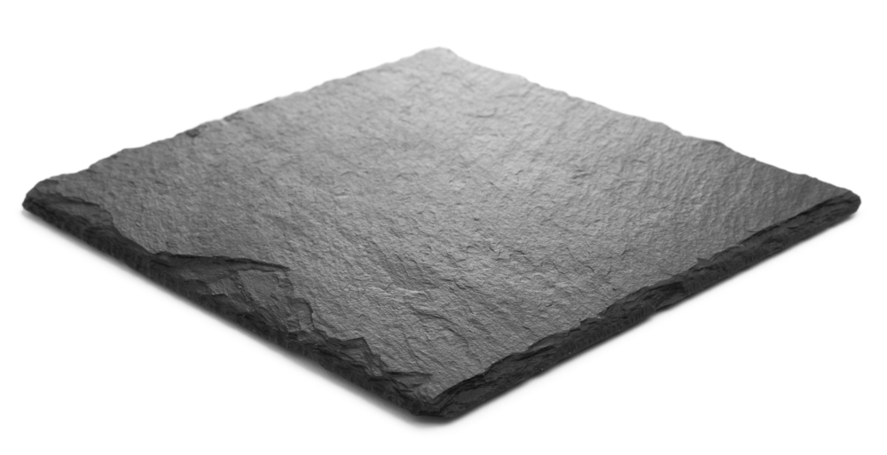
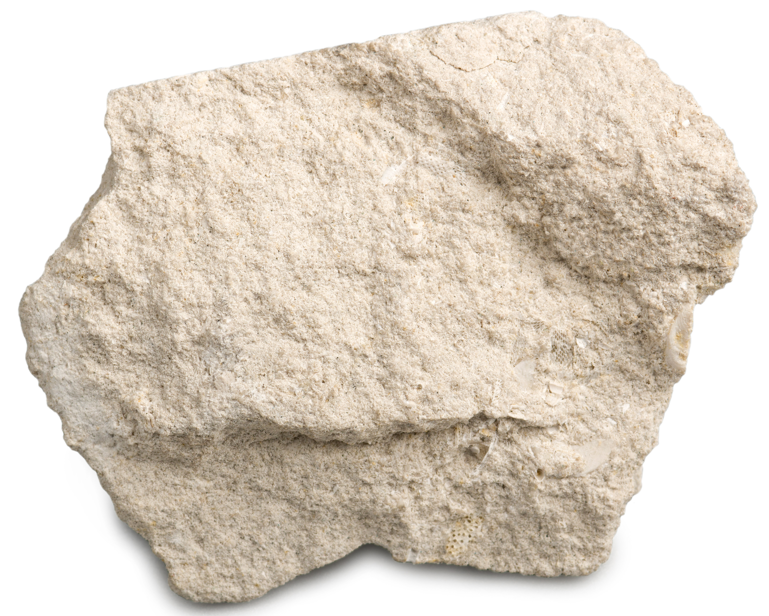
Mission Assignment: Explore the formation and properties of sedimentary and metamorphic rocks
Code: N22_34_02
Cut out the rocks below and
sort them into the right place on the table.
Sedimentary | Metamorphic
1
Developing Experts Copyright 2022 All Rights Reserved

Slide 2



Mission Assignment: Explore the formation and properties of sedimentary and metamorphic rocks
Code: N22_34_02
Write down a use for each type of rock.
Slate:
_________________________________________________
Chalk:
_________________________________________________
Limestone:
_________________________________________________
Marble:
_________________________________________________
Clay:
_________________________________________________
Sandstone:
_________________________________________________
2
Developing Experts Copyright 2022 All Rights Reserved

Slide 3
Mission Assignment: Explore the formation and properties of sedimentary and metamorphic rocks
Code: N22_34_02
Explain the properties of igneous, sedimentary and
metamorphic rocks.
Igneous:
_____________________________________________________________________________________________________________________________________________________________________________________________________________________________________________________
Sedimentary:
_____________________________________________________________________________________________________________________________________________________________________________________________________________________________________________________
Metamorphic:
_____________________________________________________________________________________________________________________________________________________________________________________________________________________________________________________
3
Developing Experts Copyright 2022 All Rights Reserved

