Slide 1

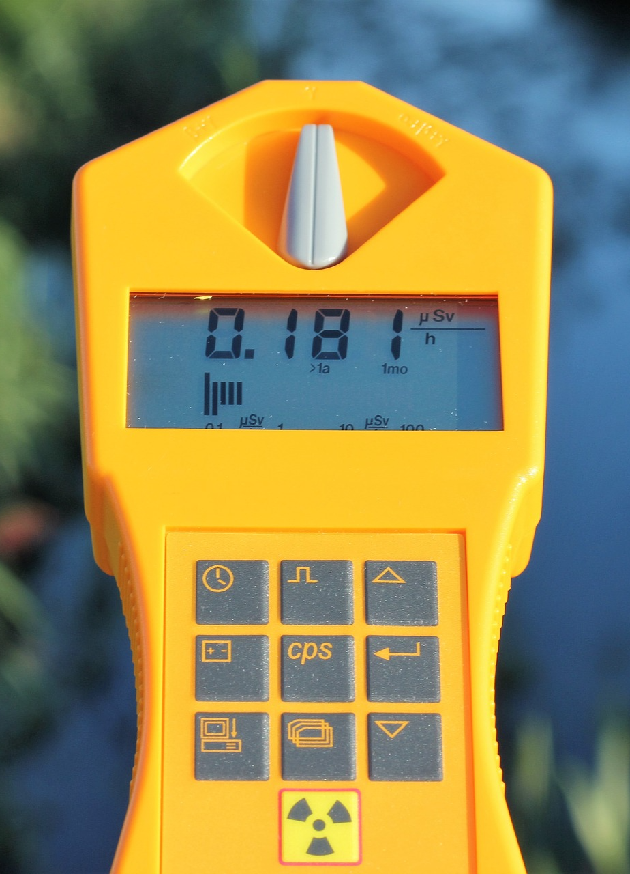
0001.01
Mission Assignment
Task | Draw an infographic of the three different types of radiation to use as a revision guide. For each one, include the symbol and essential facts.
Developing skills | Write clear definitions of the difference between ionising radiation that leads to irradiation and radioactive contamination from unwanted materials.
Think about… | When radiation is used for medical purposes, what precautions are taken to protect people?
KS4-21-04:
Explore radioactivity

