Slide 1
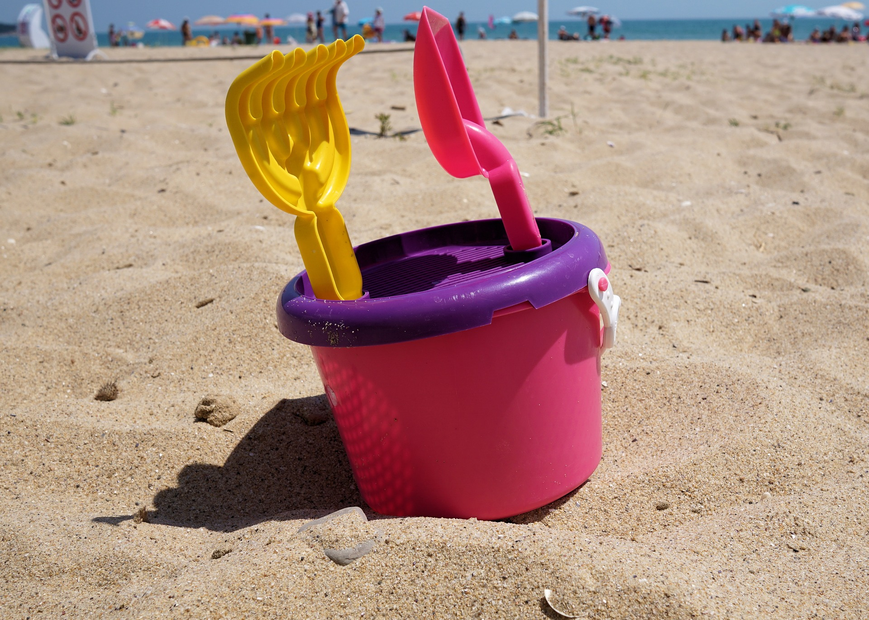
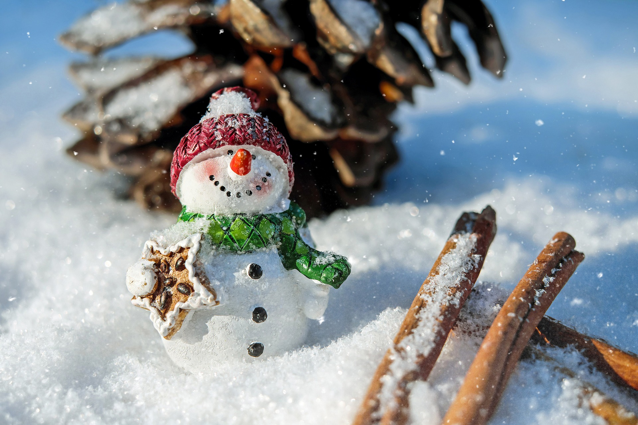
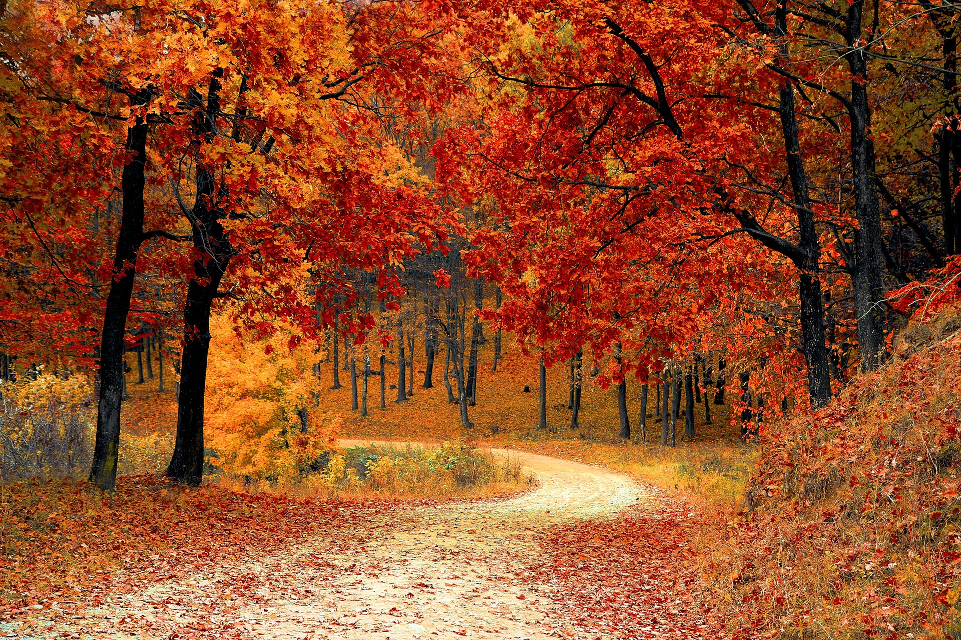
Write the name or draw the symbol of the correct season under the picture.
Spring
Summer
Autumn
Winter
Stretch:
In small groups, describe what it would be like if where you lived was always stuck in winter. Think about how it would feel and what would happen to the plants and animals.
Challenge:
Write a word that describes what each of the four seasons feels or looks like

Slide 2
Cut out the trees to help make your four season tree model

Slide 3
Cut out the trees to help make your four season tree model

