Slide 1
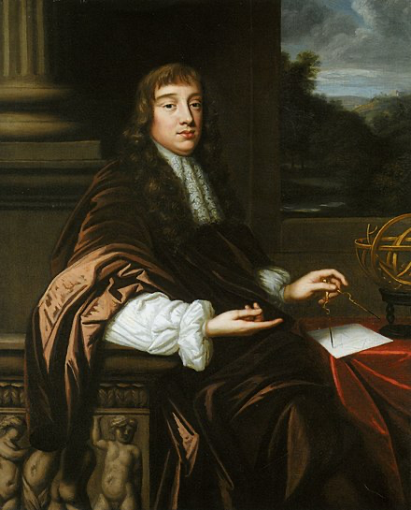
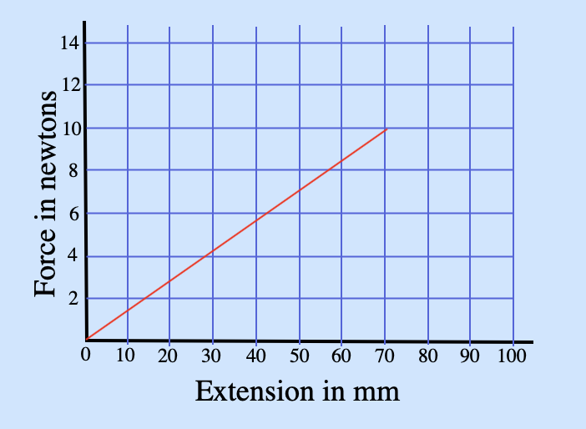
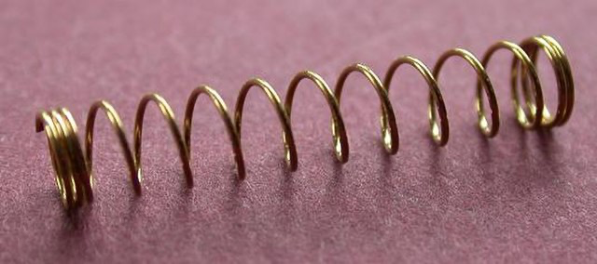
Hooke’s law of elasticity
Robert Hooke was a brilliant scientist and architect. He proposed, or assisted in, many scientific discoveries of his time. As an assistant to Robert Boyle, he developed gas pumps that helped in the foundation of the gas laws.
He was fascinated by the solar system and made observations of Mars and Jupiter. He proposed an inverse square law based on his findings that inspired Sir Isaac Newton.
In 1660, when he was only 25, he discovered the law of elasticity, now known as Hooke’s law; that the extension of a spring is directly proportional to the load that is applied, 𝐹=𝑘e. 𝑘 is the spring constant.
Elastic potential energy is the energy stored as a result of deforming an elastic object.
elastic spring
potential = ½ X constant X extension²
energy 𝑘 (e²)
(Ee)
Ee = ½ 𝑘e ²
This graph illustrates the relationship of the force (in newtons) applied to extend (in mm) the spring.
Question:
Rearrange the equation to make 𝑘 the subject, then, b. rearrange to make e the subject.
a____________________________________________________________
b____________________________________________________________
Gravitational
field strength
10N/kg
Question:
Calculate the elastic potential energy stored by a spring with a constant of 72.0N/m that is extended by 0.300 m
Example:
Calculate the elastic potential energy stored by a spring with a constant of 72.0N/m that is extended by 0.300 m
spring
EPE = ½ X constant X extension²
= 0.5 X 72.0 X 0.300²
= 3.24 J

Slide 2
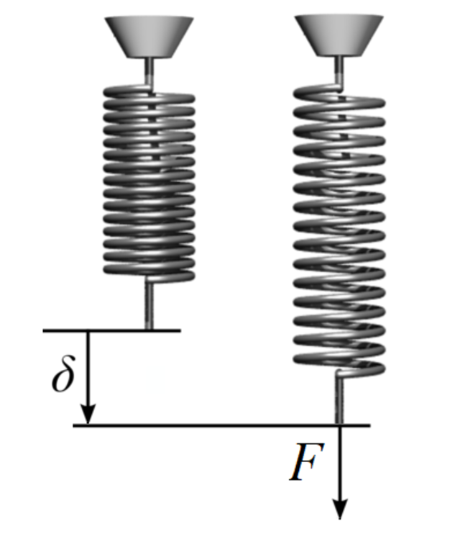
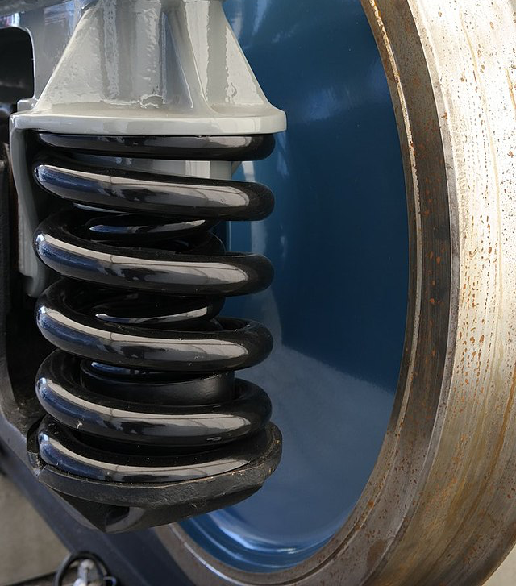
EPE practice
A spring which has a spring constant k = 7.50 N/m,has been stretched 0.40 m from its equilibrium position. What is the potential energy now stored in the spring? _____________________________________________________________________________________________
Complete the triangle opposite for elastic potential energy
Write the units for elastic potential energy
____________________________________________________________________________________
A spring with a spring constant k = 800 N/m has been compressed and 196 J of potential energy is stored. What was the extension of the spring? ______________________________________________________________________________________________________________________________________________________
Calculate the elastic potential energy stored in the spring with a spring constant of 14 N/m, when its extension is 70mm (convert units). ________________________________________________________________________________________________________________________________________________________________

Slide 3


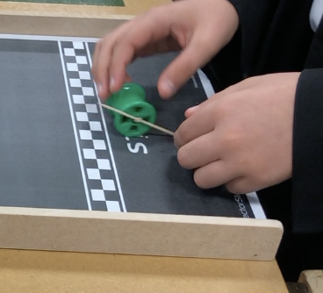
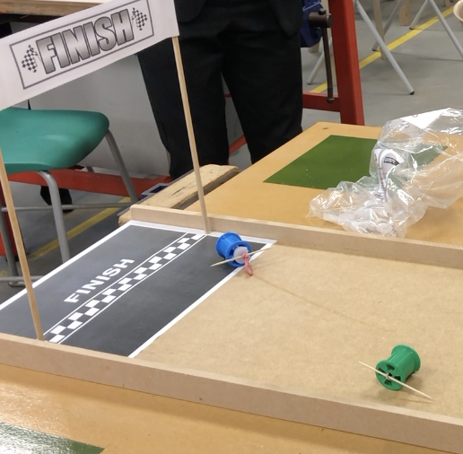
You need:–
  1 cotton spool
  1 toothpick
  1 elastic band
  4 rubber washers
  Tape or paperclip
Thread the elastic band through the spool and secure at one end with paperclip and tape.
Insert a toothpick in the other end of the elastic band and wind up.
Set up the first run of your racer, observe and record findings in the table below.
Make 4 more runs, adding another washer between the toothpick and spool on each run. Record your findings.
In the last section, in your own words, explain the relationship between potential, kinetic, and elastic potential energy based on your recorded findings.
How does friction affect the spool racer?
Spool racer challenger
Observations and findings of the spool racer runs | Run no.
 | 1
 | 2
 | 3
 | 4
 | 5
____________________________________________________________________________________________________ __________________________________________________ __________________________________________________ __________________________________________________ __________________________________________________

