Slide 1


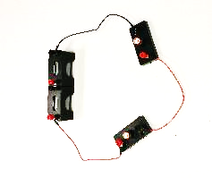
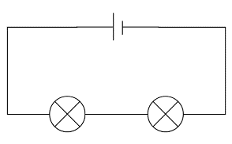
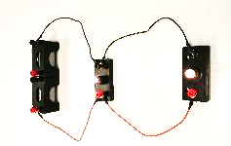
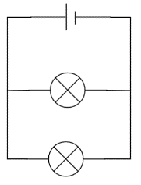
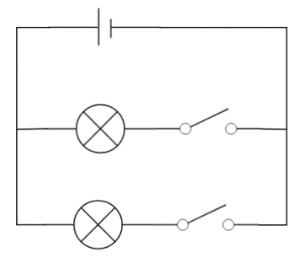
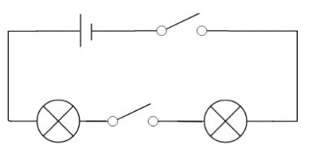
Mission Assignment: Compare series and parallel circuits
KS3-22-02
In this investigation, you will be comparing a series and parallel circuit. You will need to setup your experiment correctly and make appropriate observations.
Series Circuits
Parallel Circuits
If you have a voltmeter, ammeter or multi-meter, you could use this to make some quantitative observations.
Write two conclusions you can make from this experiment.
____________________________________________________________________________________________________________________________________________________________________________________________________________________________________________________________________________________________________________________________________________
Method:
You do not need to setup the two circuits at the same time, but if you can, this will make your comparison easier.
Setup the circuits as shown in the diagram.
Use an appropriate adjective to describe the brightness of the bulbs.
Unscrew one bulb and describe what happens to the other bulb.
Look at the circuits opposite. Describe how they work differently. What happens if you only close one switch?
____________________________________________________________________________________________________________________________________________________________________________________________________________________________________________________________________________________________________________________________________________________________________________________________________________________________________________________________________________________________________________________________________________________________________________________________________________________________________________________________________________________
Developing Experts Copyright 2023 All Rights Reserved

Slide 2
Mission Assignment: Compare series and parallel circuits
ANSWERS
KS3-22-02
In this investigation, you will be comparing a series and parallel circuit. You will need to setup your experiment correctly and make appropriate observations.
Series Circuits
Parallel Circuits
If you have a voltmeter, ammeter or multi-meter, you could also use this to make some quantitative observations.
Write two conclusions you can make from this experiment.
____________________________________________________________________________________________________________________________________________________________________________________________________________________________________________________________________________________________________________________________________________
Method:
You do not need to setup the two circuits at the same time, but if you can, this will make your comparison easier.
Setup the circuits as shown in the diagram.
Use an appropriate adjective to describe the brightness of the bulbs
Unscrew one bulb and describe what happens to the other bulb.
Look at the circuits opposite. Describe how they work differently. What happens if you only close one switch?
____________________________________________________________________________________________________________________________________________________________________________________________________________________________________________________________________________________________________________________________________________________________________________________________________________________________________________________________________________________________________________________________________________________________________________________________________________________________________________________________________________________
- In the top circuit ,the current splits and is shared between the paths.
- In the bottom circuit, the current is shared between the components.
- In the top circuit, if you only closed one switch, the bulb in that path would light. The other bulb would not.
- In the bottom circuit, neither of the bulbs will light if only one switch is closed.
Developing Experts Copyright 2023 All Rights Reserved

